Slide 1
Protection Through Immunizations
Troi Cunningham, RN
Kentucky Immunization Program
October 2015

Slide 2
Why do we immunize?
Diseases are becoming rare due to vaccination
  Smallpox eradicated worldwide – 1980
  Polio eradicated in the Americas – 1994
  Rubella eradicated in the Americas – 2015
  We vaccinate to protect our future

Slide 3
Diseases for which vaccination is routinely recommended
Diphtheria | Herpes zoster (shingles) | Pneumococcal
Haemophilus influenzae (Hib) | Influenza | Polio
Hepatitis A | Measles | Rotavirus
Hepatitis B | Meningococcal | Rubella
Human Papillomavirus (HPV) | Mumps | Tetanus
 | Pertussis | Varicella

Slide 7
Immunization Schedules
All immunizations schedules can be found at:
http://www.cdc.gov/vaccines/schedules/index.html

Slide 8
Vaccines in First 6 years of Life
3 doses of Hepatitis B | 4 doses of IPV
2 or 3 doses of Rotavirus | 2 doses of MMR
5 doses of DTaP | 2 doses of Varicella
3 or 4 doses of Hib | 2 doses of Hepatitis A
4 doses of PCV13 | Annual flu vaccine (aged 6 months and older)

Slide 9
What vaccines do pre-teens and teens need?
All preteens and teenagers need:
  Annual flu vaccine
  1 dose of Tdap Vaccine at age 11-12
  2 doses of Meningococcal Vaccine: one at
  11-12 years of age and booster at 16 years of age
  3 doses of HPV Vaccine starting at age 11-12
  If not already received: 2 doses MMR,
  2 doses of Varicella, and 3 doses of Hep B

Slide 10
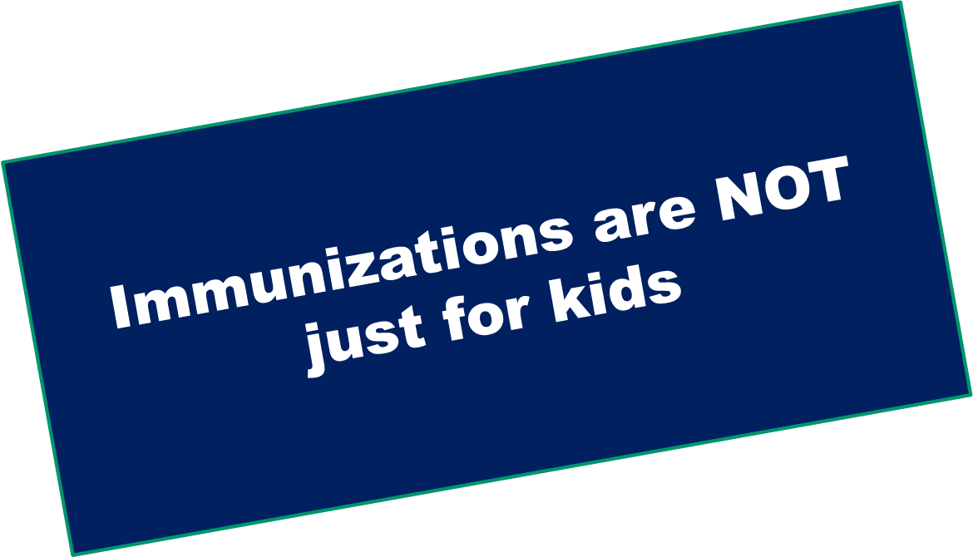

Slide 11
Adult Vaccines…
Seasonal Influenza
Pneumococcal
Zoster (Shingles)
Hepatitis B
Tdap/Td
HPV (human papillomavirus)
Meningococcal
Hep A
Varicella
MMR (measles, mumps, rubella)

Slide 12
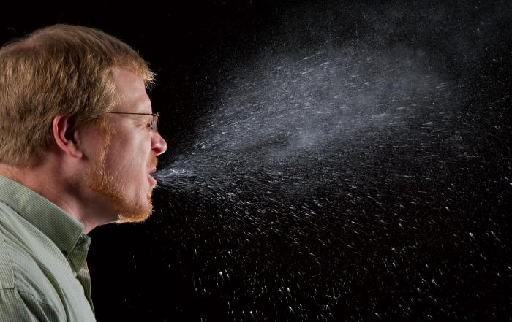
Influenza
This photo shows how the respiratory secretions can spread when someone coughs or sneezes. What if this person had influenza?
Notes:
The timing of flu is very unpredictable and can vary in different parts of the country and from season to season. Most seasonal flu activity typically occurs between October and May. Flu activity most commonly peaks in the United States between December and February.

Slide 13
Influenza in Kentucky 2014-2015
Age Groups | Lab Confirmed Cases | Influenza related Deaths
0-12 years | 118 | 2
13-18 years | 32 | 1
19-35 years | 473 | 15
>65 | 411 | 81
Unknown | 11 | 0
Total | 1045 | 99
92 Long Term Care Facilities with Outbreaks!
DPH NEDDS and MDMS data
Notes:
It’s not possible to predict what this flu season will be like. Flu seasons are unpredictable in a number of ways. While flu spreads every year, the timing, severity, and length of the season varies from one year to another.

Slide 14
Influenza vaccine annually!
  Immunity from Influenza vaccination declines in the year after vaccination
  Strongly recommended to get vaccination when first available
  Everyone aged 6 months and older should get
  the flu vaccine
  It takes about 2 weeks after vaccination for a person to develop peak protective antibody levels.
Notes:
CDC recommends a yearly flu vaccine for everyone 6 months of age and older as the first and most important step in protecting against this serious disease. People should begin getting vaccinated soon after flu vaccine becomes available, ideally by October, to ensure that as many people as possible are protected before flu season begins. However, as long as flu viruses are circulating in the community, it’s not too late to get vaccinated

Slide 15
2015- 2016 Influenza Vaccine
Inactivated influenza vaccine - IIV
  Intramuscular or intradermal routes
  6 months of age and older
    First time vaccinated in 2015 – children aged
    6 months through 8 years will need two doses
    at least 4 weeks apart
  Pregnant women- any trimester
Notes:
The timing of vaccine availability depends on when production is completed. If everything goes as indicated by manufacturers, shipments may begin as early as July or August and continue throughout September and October until all of the vaccine is distributed.
Two types of influenza vaccine are available in the United States, Inactivated influenza vaccine and live attenuated influenza vaccines
All of the 2015-2016 influenza vaccine is made to protect against the following three viruses:
•an A/California/7/2009 (H1N1)pdm09-like virus
•an A/Switzerland/9715293/2013 (H3N2)-like virus
•a B/Phuket/3073/2013-like virus. (This is a B/Yamagata lineage virus)
Fluzone Intradermal® is approved for use in adults aged 18 through 64 years of age

Slide 16
2015-2016 Influenza Vaccine
Live attenuated influenza vaccine - LAIV
  Intranasal route
  Healthy non-pregnant persons, aged 2 years through 49 years
  First time vaccinated in 2015, children aged
  2 years through 8 years will need two doses at least 4 weeks apart

Slide 17
2015-2016 Influenza Vaccine
Quadrivalent vaccines: protects against four flu viruses
  Two Influenza A
  Two Influenza B
Trivalent vaccines: protects against three flu viruses
  Two Influenza A
  One Influenza B
http://www.cdc.gov/flu/about/season/flu-season-2015-2016.htm
Notes:
All of the 2015-2016 influenza vaccine is made to protect against the following three viruses:
•an A/California/7/2009 (H1N1)pdm09-like virus
•an A/Switzerland/9715293/2013 (H3N2)-like virus
•a B/Phuket/3073/2013-like virus. (This is a B/Yamagata lineage virus)
Some of the 2015-2016 flu vaccine is quadrivalent vaccine and also protects against an additional B virus (B/Brisbane/60/2008-like virus). This is a B/Victoria lineage virus.

Slide 18
Human Papillomavirus (HPV)
Most common sexually transmitted infection
Affects both males and females
More than 40 HPV types
HPV can cause genital warts and some can lead to cancer especially anal and cervical cancers
Notes:
HPV is short for human papillomavirus and is a group of more than 150 related viruses. Some other HPV types can lead to cancer, especially cervical cancer. There are more than 40 HPV types that can infect the genital areas of males and females. But there are vaccines that can prevent infection with the most common types of HPV.

Slide 19
HPV Types and Disease Associations
Low Risk Infection – nononcogenic types
  Types 6 and 11
  Benign or low grade cervical cell abnormalities, genital warts and laryngeal papillomas
High Risk Infection – oncogenic types
  Include types 16, 18, 31, 45 and others
  Can cause low grade cervical cell abnormalities, high grade cervical cell and anogenital cancers

Slide 20
Routine HPV Vaccination Recommendations
Advisory Committee on Immunization Practices (ACIP) recommends routine vaccination of females and males 11 to 12 years of age
Catch-up vaccination ACIP recommendations:
  Females through 26 years of age
  MSM and immunocompromised males through 26 years of age
  Other males age 21 years of age
Notes:
HPV vaccines offer the best protection to girls and boys who receive all three vaccine doses and have time to develop an immune response before being sexually active with an
another person. That's why HPV vaccination is recommended for preteen girls and boys at age 11 or 12 years.

Slide 21
Routine HPV Vaccination Recommendations (Cont)
The vaccination series can be started as young as 9 years of age at the clinician’s discretion
Routine schedule is 0, 2, 6 months
Third dose should follow the first dose by at least 24 weeks
Series does not need to be restarted if the schedule is interrupted
Notes:
HPV vaccines are given as a series of three shots over 6 months to protect against HPV infection and the health problems that HPV infection can cause.

Slide 22
HPV Vaccine
9vHPV and 4vHPV (GARDASIL, Merck)
  Both contains 6,11,16,and 18
  9vHPV contains additional 5 types: 31,33,45,52,58
  Can be given to both females and males
  Early success with genital wart prevention
  Later benefit for cancer prevention
Notes:
In the male population, HPV vaccine can be given up to the age of 26 years for those persons with certain risk factors the include for gay and bisexual young men (or any young man who has sex with men) and also for young men with compromised immune systems (including HIV).

Slide 23
HPV Vaccine (cont)
2vHPV (CERVARIX, GSK)
  Contains types 16 and 18 (high risk)
  Not approved for males

Slide 24
Pertussis-What is it?
Highly contagious respiratory disease
  Caused by bacterium Bordetella pertussis
  Bacteria releases toxins in the lungs that damages the cilia and causes inflammation
Uncontrollable, violent coughing
Deep breath after coughing “fits” results in a “whooping” sound (may not occur in infants)

Slide 25
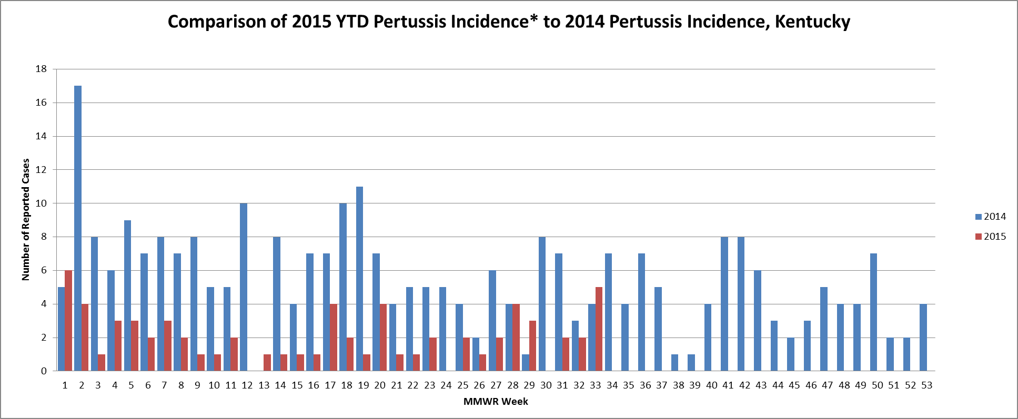

Slide 26
DTaP and Tdap Vaccine
DTaP childhood series completed at age 5 years
Tdap at age 11-12; one time dose
Adult dose: One Tdap, if not already received,
can be given at anytime; then, follow-up in
10 years with Td
ACIP recommends Tdap with each pregnancy
Provides protection by ‘cocooning’ the newborn who is too young to vaccinate

Slide 27
Resources
  Vaccines and Immunizations CDC: http://www.cdc.gov/vaccines/default.htm
  Immunization Schedules CDC: http://www.cdc.gov/vaccines/schedules/index.html
  Kentucky Immunization Program: chfs.ky.gov/kip

Slide 28
Resources Cont.
Preventing Seasonal Flu
http://www.cdc.gov/flu/protect/vaccine/index.htm
HPV Vaccines
http://www.cdc.gov/hpv/vaccine.html
Pertussis (Whooping Cough)
http://www.cdc.gov/vaccines/vpd-vac/pertussis/default.htm

Slide 29

???? QUESTIONS ???

Slide 30
Troi Cunningham, RN
Nurse Consultant
Kentucky Immunization Program
502.564.4478
troi.cunningham@ky.gov

