Slide 1

Needs of Mental Health Patients During Emergencies

Slide 2

During Any Disaster
Impact Intensified By Pre-existing Conditions:
People with fewer economic resources
Living in lower cost, structurally vulnerable residences in higher risk areas
Cultural, racial and ethnic groups
Elderly on fixed income
Lack of home ownership or insurance
Single-parent
People with disabilities
Behavioral health issues

Slide 3
Types of Major Mental Illness
Schizophrenia
Schizoaffective disorder
Bipolar Disorder
Major Depression
Panic and other Severe Anxiety Disorders
Post Traumatic Stress Disorder
Personality Disorder

Slide 4
Prevelance
U.S. Adults with a Mental Disorder in Any One Year
Type of Mental Disorder % Adults
● Anxiety disorder 18.1
● Major depressive disorder 6.7
● Substance use disorder 3.8
● Bipolar disorder 2.6
● Eating disorders 2.1
● Schizophrenia 1.1
Any mental disorder 26.2

Slide 5
Facts about Mental Illness
Mental illnesses are biologically based brain disorders. They cannot be overcome through "will power" and are not related to a person's "character" or intelligence.
Mental disorders fall along a continuum of severity. The most serious and disabling conditions affect five to ten million adults (2.6 – 5.4%) and three to five million children ages five to seventeen (5 – 9%) in the United States.
Mental disorders are the leading cause of disability (lost years of productive life) in the North America, Europe and, increasingly, in the world. By 2020, Major Depressive illness will be the leading cause of disability in the world for women and children.

Slide 6

Dealing With Stress
Watch for signs of stress
Warning Signs of Stress
  Short tempers, frequent arguments
  Greater consumption of drugs or alcohol
  Smoking more than usual
  Getting upset over minor irritations
  Difficulty sleeping, bad dreams
  Aches, pains, stomach problems
  Loss of concentration
  Depression

Slide 7

Stress Reactions
“Normal Reactions To Abnormal Events”

Slide 8

Normal Signs of Stress
Behavioral
  Hyperactive
  Isolation / withdrawal
  Don’t want to leave home
  Aggressiveness
  Hyper-vigilance
  Increased drug/alcohol use

Slide 9



Normal Signs of Stress Emotional
    Anger
    Hopeless
    Worry
    Depression
    Guilt
    Overwhelmed
    Numb

Slide 10

Normal Signs of Stress
Physical
  Headaches
  Stomach problems
  Sleep problems
  Eating changes
  Health problems worsening
  Fatigue / Exhaustion
  Aggravation
  New health problems

Slide 11



Normal Signs of Stress
Cognitive
  Can’t cope
  Nightmares
  Difficulty concentrating
  Difficulty remembering
  Difficulty making decisions
  Bad thoughts

Slide 12


Older Adults
Common Reactions
-Withdrawal / Isolation
-Fear of loss of independence (fear of institutionalization)
-Worsening of chronic health problems
-Suspicion
-Depression/Anxiety
-Reluctant to leave home
-Confusion
-Inability to Concentrate
-Difficulty Remembering
-Nightmares
Interventions
-Provide assistance with recovery of possessions if possible
-Provide strong and persistent verbal reassurance
-Provide orienting information
-Encourage discussion of disaster losses and expressions of emotions
-Spend time with them- “show you care”
-Recognize limitations
-Sleep and Diet Control

Slide 13

Psychological Crisis
An acute response to a trauma, disaster, or other critical incident in which:
  Psychological balance is disrupted
  One’s usual coping mechanisms have failed
  Evidence of significant distress, impairment, dysfunction

Slide 14
Mediating Factors
The victim’s prior experience with the same or a similar event. The emotional effect of multiple events can be cumulative, leading to greater stress reactions.
The intensity of the disruption in the survivors’ lives. The more the survivors’ lives are disrupted, the greater their psychological and physiological reactions may become.
The meaning of the event to the individual. The more catastrophic the victim perceives the event to be to him or her personally, the more intense will be his or her stress reaction.
The emotional well-being of the individual and the resources (especially social) that he or she has to cope. People who have had other recent traumas may not cope well with additional stressors.
The length of time that has elapsed between the event’s occurrence and the present. The reality of the event takes time to “sink in.”
Notes:
You should not take the disaster victim’s surface attitudes personally. MRC members may expect to see a range of responses that will vary from person to person, but the responses they see will be part of the psychological impact of the event—and probably will not relate to anything that the volunteer have or have not done.

Slide 15
Stabilizing Individual
The goal of psychological first aid is to stabilize the incident scene by stabilizing individuals.
  Assess the disaster victims for injury and shock.
  Provide support by:
    Listening.
    Empathizing.
  Help disaster survivors connect with natural support systems.
Notes:
Disaster Victims that show evidence of being suicidal, psychotic, or unable to care for themselves should be referred to mental health professionals for support. (This occurs infrequently.)

Slide 16
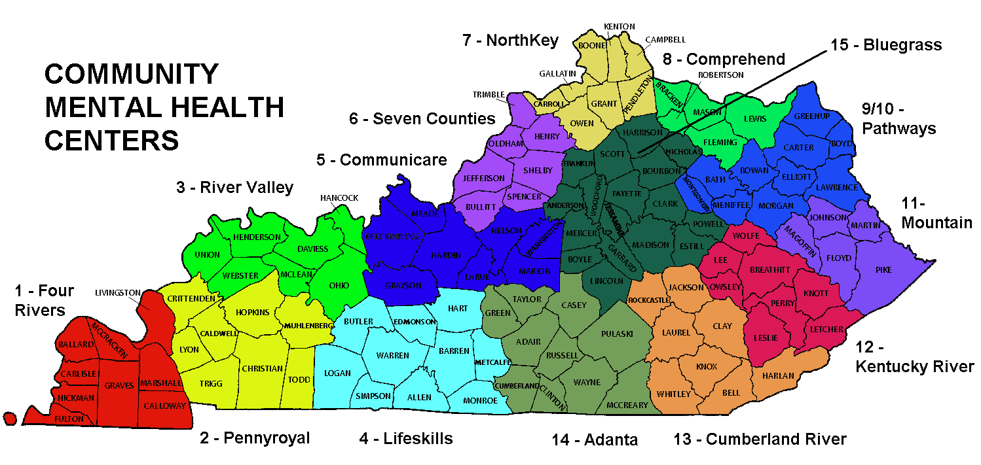
DBHDID Behavioral Health Centers

Slide 17
6 Core Emergency Service Elements within the regional CMHC
1-800 Crisis and Information Lines
Mobile Crisis Services provide flexible crisis supports in a variety of settings (such as homes, emergency rooms, police stations, outpatient mental health settings, schools) and at flexible hours of the day. The purpose is to decrease the potential for more intensive services by providing more immediate community crisis services.
Notes:
Each Regional MHMR Board operates a 24 hour crisis and information line to respond to emergencies in their region.
These 1-800 lines are also TTY accessible for the person who is in crisis and also may be deaf or hard of hearing.
Staff typically receive specialized training on how to respond to persons who are in crisis

Slide 18
6 Emergency Service Elements
Crisis Stabilization Units (CSUs) are utilized when individuals in a behavioral health emergency cannot be safely accommodated within the community, but are not in need of hospitalization. The purpose is to stabilize the individual and re-integrate them back into the community in a timely fashion
Other Residential Overnight Crisis Services are offered as an alternative to a crisis stabilization unit. Beds are available in alternative settings, such as personal care homes, therapeutic foster care, or emergency apartments. These settings provide overnight, flexible, out-of-home care that is designed to meet the individual’s need.
Notes:
As of July 1, 2004, each Regional MH/MR Board within Kentucky had developed a crisis stabilization program for adults and a crisis stabilization program for children
A major change from the initial years of adult program development was that several Regions developed crisis stabilization “programs” as opposed to residential “units” with 7-8 beds each. This development seems to have been spawned by the success of crisis stabilization programs for children that were non-residential and provided an array of services designed to prevent out of home placement

Slide 19
6 Emergency Service Elements
23-hour Holding Beds - short, intensive treatment in a safe environment, in a less restrictive setting than hospitalization. This service element is appropriate when it is expected that the immediate crisis can be managed in less than 24 hours. Services may include medication management, collaborative team meetings, and referral services.
Transportation Services offer safe, timely and cost effective support to individuals in need of transportation to mental health services. This service is critical to an integrated emergency service array. The purpose is to decrease the need for more restrictive settings by providing the ability for individuals to maintain on-going necessary mental health services.

Slide 20
Regional Availability of Emergency Services by Type
Crisis and Information Lines ~ 14 Regions
Walk In Crisis (8a-5p) ~ 14 Regions
Walk In Crisis (after hours) ~ 8 Regions
Mobile Crisis Services ~ 8 Regions
1-800-Suicide Lines ~ 8 Regions
Residential Crisis Units (A) ~ 11 Regions
Residential Crisis Units (C ) ~ 9 Regions
Overnight Crisis Beds (A) ~ 3 Regions
Overnight Crisis Beds (C) 5 Regions

Slide 21


Watch out for “Burn-out”
This state of exhaustion, irritability and fatigue creeps up unrecognized and can markedly decrease the individual’s effectiveness and capability.
Peers are often a great support.

Slide 22
Substance Abuse during disasters
Due to the overwhelming experience of disasters survivors may be vulnerable to unhealthy coping strategies.
Survivors may:
resume abusing substances

Slide 23
Coping with Substance Abuse after a disaster
Regular attendance to Alcoholic Anonymous Meetings
Regular attendance to Narcotics Anonymous Meetings
Talk to a Professional
Seek Professional Mental Health Counseling
Talk to your sponsor

Slide 24
Contact Information
Janine Dewey MA, CADC
100 Fair Oaks Lane 4E-D
Frankfort, KY 40621
502-564-4456 Ext. 4520

