Slide 1
Assisting Non-English Speaking Individuals During Emergencies and Disasters

Slide 2
Agenda

Slide 3
Who is a refugee?

Slide 4
Refugee Resettlement

Slide 6
Refugee Resettlement Agencies

Slide 7
During the First 30 days

Slide 8
After 30 Days

Slide 9
Many Things to Learn

Slide 10
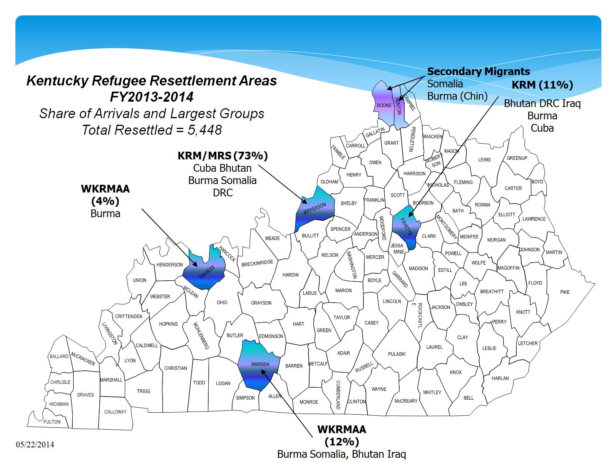

Slide 13
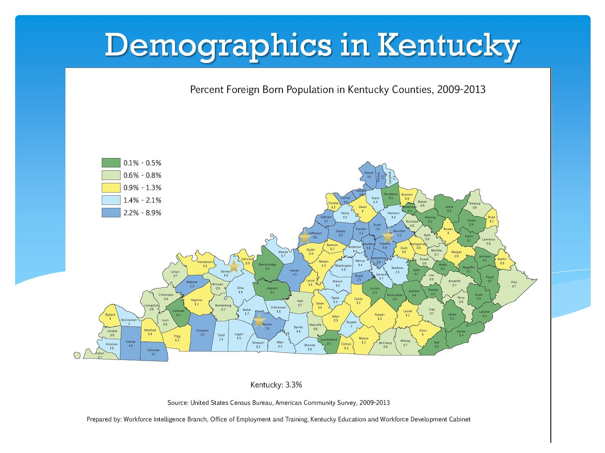
Demographics in Kentucky

Slide 14
Language Access

Slide 15
Title VI of Civil Rights Act of 1964

Slide 16
Executive Order 13166

Slide 17
What is the Number or Proportion of LEP Individuals in Your Service Area?

Slide 19
Experience of Violence and Trauma

Slide 20
Trauma and Emergencies

Slide 21
Steps for Engaging Newcomers in Preparedness

Slide 22
Providing language access

Slide 23
Providing Language Access

Slide 24
Refugee Resettlement Agencies

Slide 25
Other Resources

