Slide 1


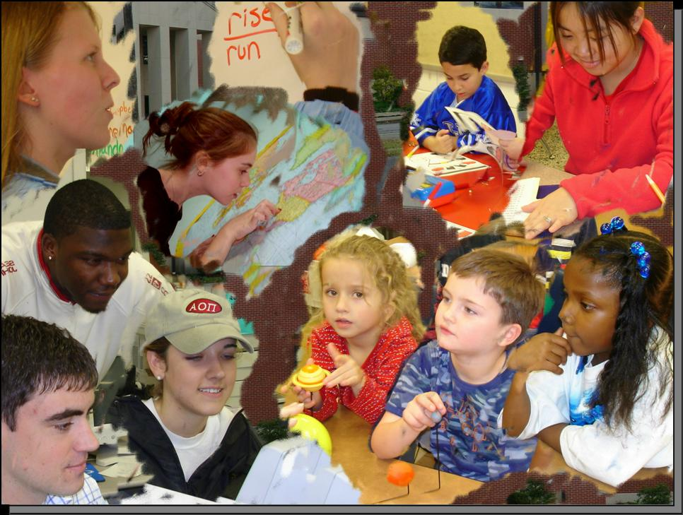

Slide 2
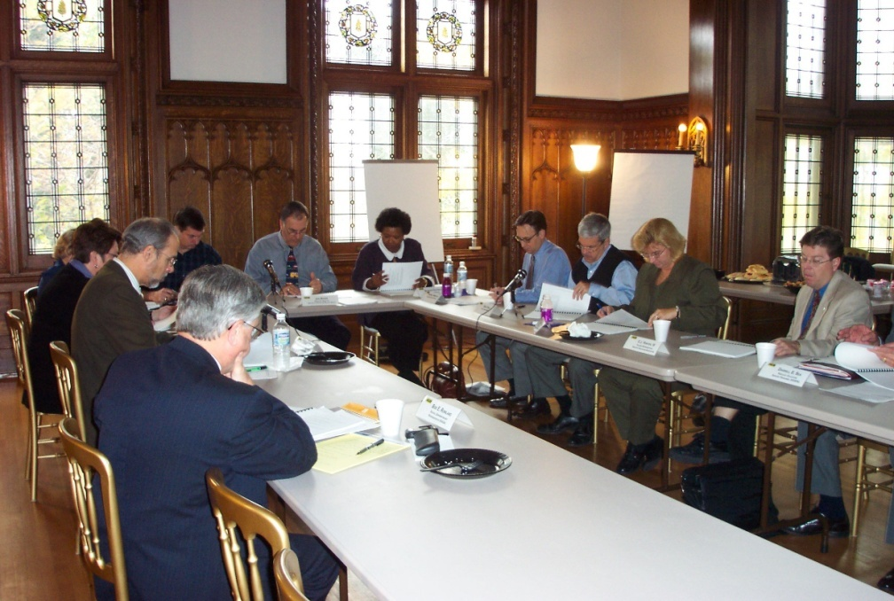
Overview
Past, Present and Future
  will be providing detailed information about the Kentucky Center for School Safety’s activities from its inception until present…

Slide 3





Past
A Brief History
House Bill 330
  Kentucky’s school children and educators say, “Thank you.”
Governed by a Board of Directors
A unique model
  EKU-Contract agency and central operations
  KSBA-Training and conferences
  MuSU-Post-Secondary/pre-service training, resource center (research, best practices) and website
  University of Kentucky- research and grant writing
Notes:
Bill Moduleski

Slide 4
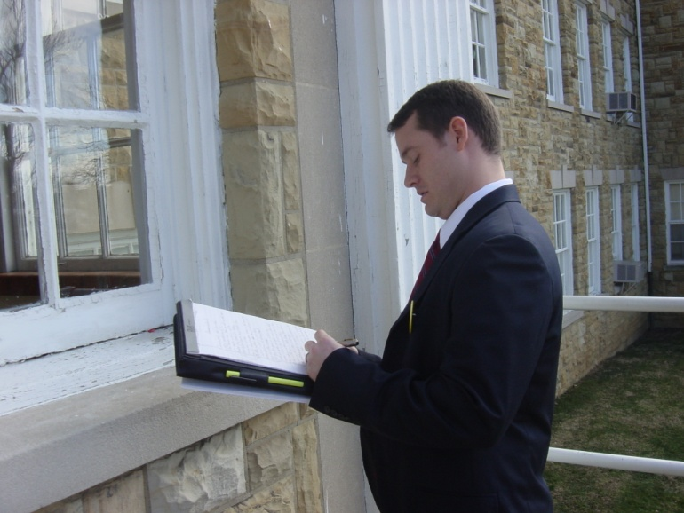
Definition of School Safety
Multi-faceted Issue
To continually address the needs of educators and students as it relates to the provision and enhancement of providing safe and healthy learning environments for both.
These needs generally fall into one of the four following categories:
  Physical Safety
  Relationships (staff and students)
  Personal Safety
  Behavioral Expectations

Slide 5
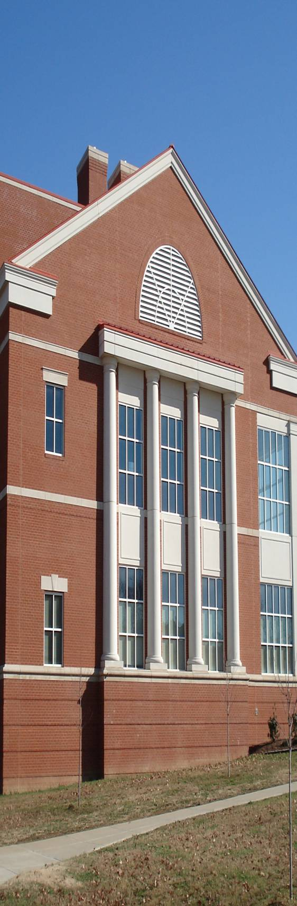

Physical Safety
(campus and building safety)
Crime Prevention Through Environmental Design (CPTED)
Physical Plant Safety
Bus Safety
Parking Lot Safety
Hazardous Materials – deteriorating lab chemicals, mercury, asbestos--etc.

Slide 6
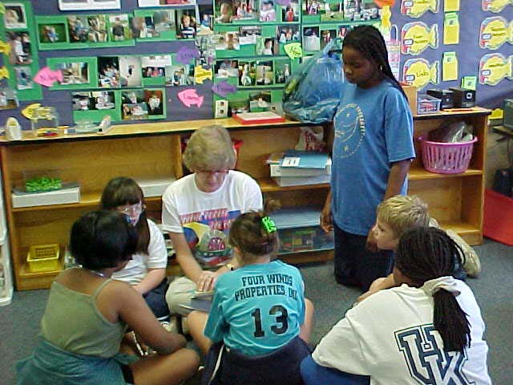
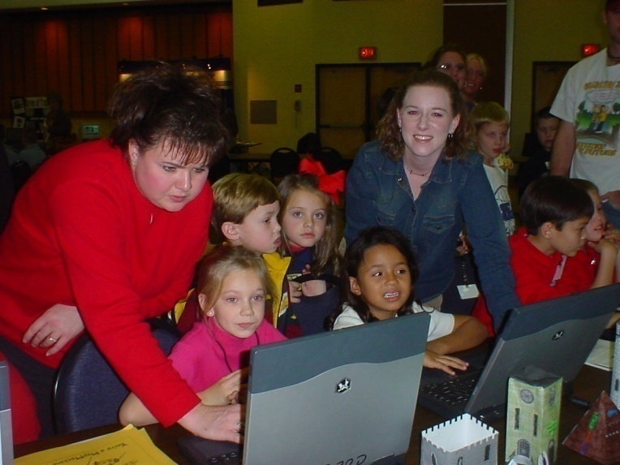
Relationships
Between Staff and Students
Teacher/student relationships
Building trust among school staff, students and parents
Finding ways for students to be “connected” to the school—during and after the school day
Establishing a welcoming school climate and culture

Slide 7
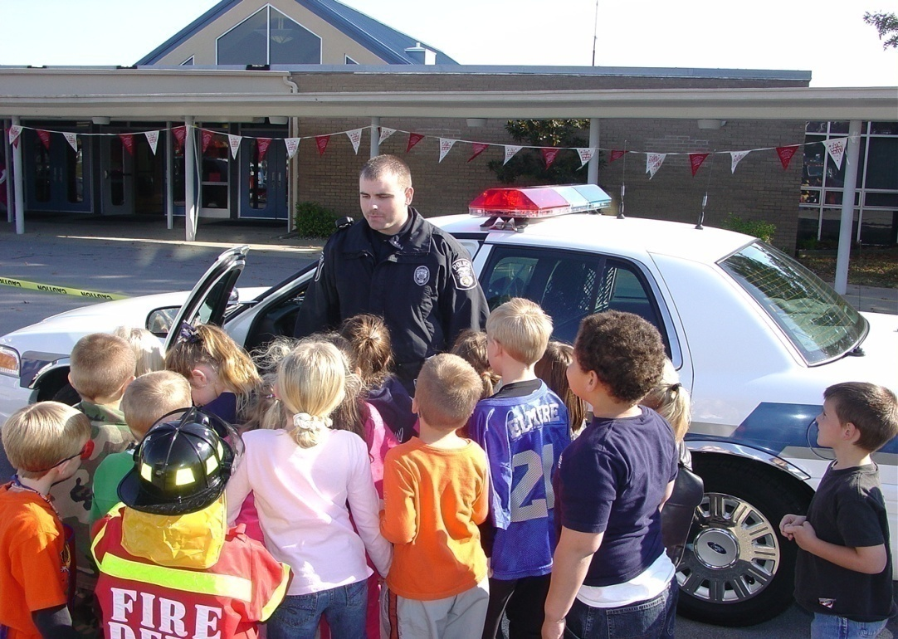
Personal Safety
Emergency preparedness
Bullying
Outside aggression
Internet Safety
Gangs
School Resource Officers (SROs)

Slide 9

Services that the Kentucky Center for School Safety (KCSS) provides to SROs
Training
Technical Assistance
Bi-annual survey of SROs
Funding announcements
Support the Kentucky Association of School Resource Officers
Master database of SROs in the State of Kentucky
Have met with various other states on how to organize a state SRO program.

Slide 10
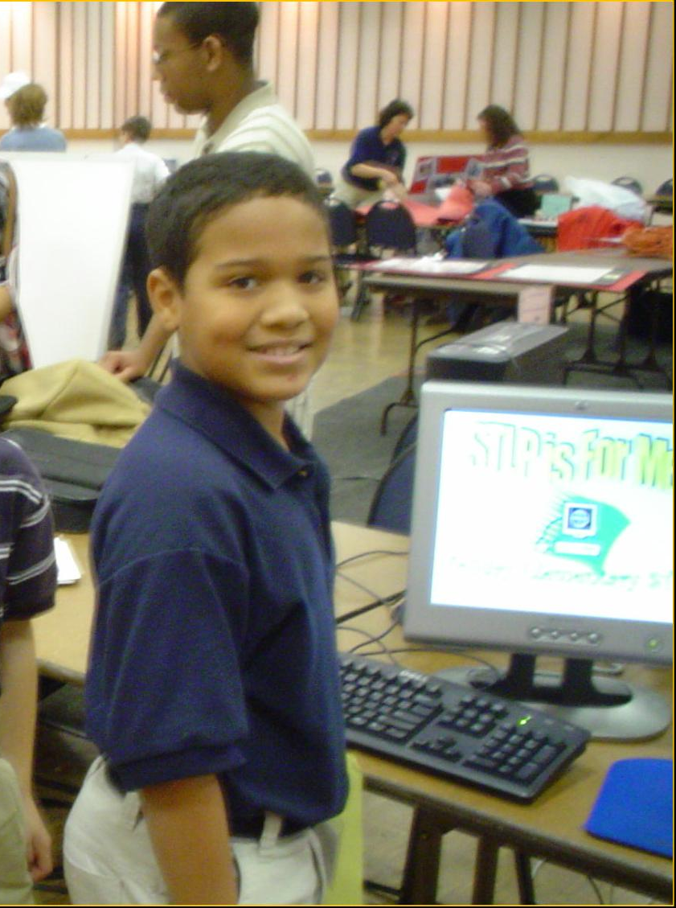
Behavioral Expectations
Appropriate student behavior, Citizenship (Internet)
Classroom management practices
“Heath/Columbine/SandyHook” issues-lessons learned
Board Policies and Laws
Alternative Education
Persistently Dangerous Schools-NCLB

Slide 11
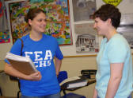
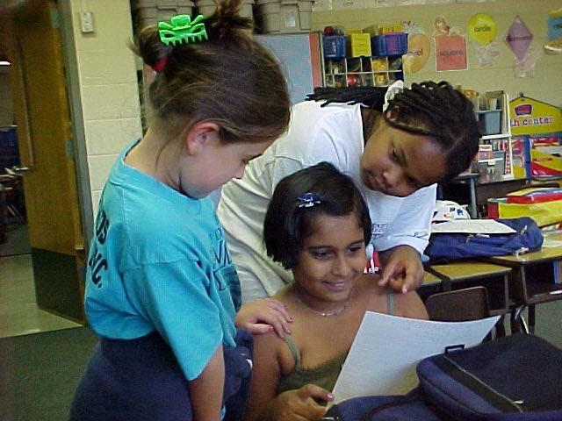
Are Schools Safe?
Most definitely!
Are schools perfectly safe?
No
However, statistically, schools remain the safest places in our society…why??? . . .
Because we have been trained to make them so.

Slide 12
Technical Services
KCSS has provided technical services in 4,366 different settings across the Commonwealth that have involved 228,000people
Who are these receiving services:
  Teachers
  School administrators
  Board Members
  Parents
  University professors
  First responders
  Bus drivers
  School Resource Officers
  Law enforcement and
  Other safety interested people

Slide 13

Trainings
KCSS has conducted 284 statewide trainings involving 28/000+ participants, with topics such as:
  Emergency Preparedness (SB8/HB354)
  Crisis Management
  Threat Assessment
  Anti-Bullying (HB91 implementation)
  Bus Driver Safety
  Pandemic Flu (currently H1N1)
  Conflict Resolution
  Cyber-Bullying
  Dealing with Aggressive Parents in School Settings
  Violence Prevention Curriculum
  Classroom/School-wide Management Systems
  And various others

Slide 14
Issues that we face in Kentucky
Bullying

Slide 15
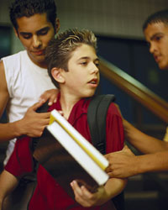
At least 160,000 students skip classes each school day because they fear physical harm.
(National Education Association)

Slide 16
Bullying in Kentucky Schools
There were 20,172* incidents of harassment and/or bullying in Kentucky Schools during the 2013-14 school year… or 4 incidents every minute.
*KDE-Kentucky School Report Card

Slide 17

More than 150,000 school age children bring a gun to school each school day.
U.S. Department of Education and Center for Disease Control and Prevention

Slide 18

Define Bullying
Unwanted acts directed toward another person
Usually repeated
Usually involves an imbalance of power.
KRS 158.156=Chapter 508 Felony acts…
a.) Assault
b.) Menacing
c.) Wanton endangerment
d.) Terroristic threatening
e.) Criminal abuse
f. ) Stalking

Slide 19

Who “owns” this and what about “zero tolerance?”
This is not just a school issue, it’s a life-long issue. Bullying doesn’t stop after graduation... (unfortunately!)
KCSS position is a modified “zero-tolerance”: (one size doesn’t fit all) investigate every incident and make decisions based on the facts of each case.

Slide 20
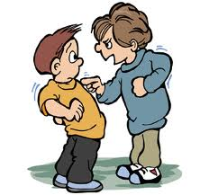
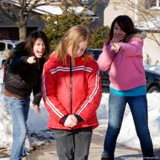
What’s the extent of the bullying problem in our state?
The #1 problem
80% occurs electronically and usually goes undetected by adults (texting and Facebook…)
The # of girls bullying other girls has increased significantly
It seems as though schools are being asked to handle this “community problem.”

Slide 21
Who’s problem is this?
Bullying is everyone’s problem.
We are all in this together and it’s going to take “The Village” to effectively address this problem: parents, school officials, students, private sector, churches, governmental agencies, just to name a few.
Let’s do the math:
24 hrs. in a day X 365 days= 8,760 hours
Schools are in session for 7 hrs. X 180 days= 1,260 hours
This leaves 7,500 hrs. per year (or 86% of the child’s time per year) “someone else” must model acceptable behavior and monitor the behavior of kids other than the schools.

Slide 22

On-line Tip Line

Slide 23
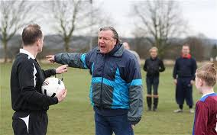
Hot topics
Parental aggression
2004 & 2012 studies
20% of elementary and secondary teachers in the first 5 years of their tenure wanted to quit teaching because of parent aggression.
Most parents are adhering to Board Policies (civility standards) however, some are still harassing staff.
Parent groups and educators need to address this for the benefit of the student.

Slide 24
A great technology that has created many problems!
Cell phones
Are the focal point to most student/student behavioral issues.
Has created the number issue in secondary schools…because of misuse.
Principals and teachers are extremely frustrated…and do not feel supported in enforcing regulations that are intended to control this device.

Slide 25
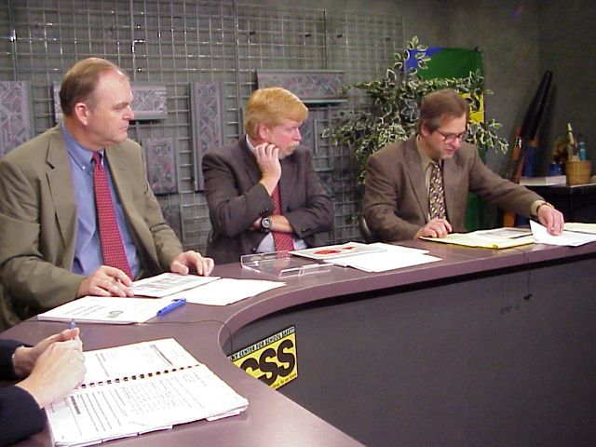
Where Are We Now?
Our primary audience remains our state’s educators.
We continue to provide expertise and support to our fellow state agencies as they, in turn, do for us.
To continue to identify and address school safety concerns as they evolve.

Slide 26


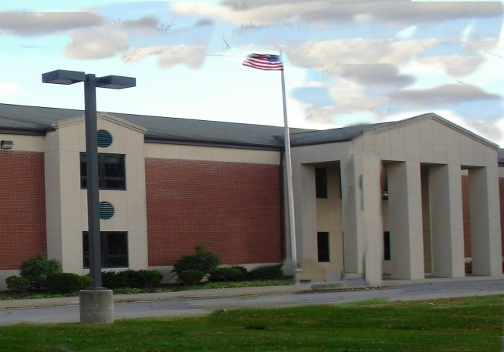
Conclusion
We know that safe and healthy learning environments are best achieved through the promotion of strong partnerships, (i.e., it takes educators, parents, lawmakers, community agencies and the business community to make this happen.)
With your continued support, we, your Kentucky Center for School Safety, are here to support that effort -- one student (perhaps your loved one), one staff member and one school at a time.

Slide 27
  Call or Write
  Jon Akers
  Eastern Kentucky University
  105 Stratton Building
  521 Lancaster Ave.
  Richmond, KY 40475
  Toll Free 1-877-805-4277
  jon.akers@eku.edu
Kentucky Center for School Safety

Slide 28

COME VISIT US AT
WWW.KYSAFESCHOOLS.ORG
Notes:
`

