Slide 1
Chronic Disease Disaster Preparedness Patient Resource Manual
KOIN Meeting October 22, 2014
Kentucky Department for Public Health
Chronic Disease Prevention Branch
Sue Thomas-Cox, RN, Branch Manager

Slide 2
Patient Resource Manual
The Kentucky Department for Public Health through a grant from CDC developed a curriculum in coordination with the University of Louisville in 2008 “ Disaster Preparedness for Persons with Chronic Disease”
Released the first edition December 1, 2008 which included instructors manual and training power point, participant manual, patient resource manual and a DVD
Originally distributed to BT coordinators and also placed on the Kentucky Medical Association Website
Updated only the Patient Resource Manual in 2013 and reprinted limited copies

Slide 3
Patient Resource Manual
Uses
People with chronic diseases
Caregivers of people with chronic diseases
Volunteers at shelters
Trainers in communities

Slide 4
Patient Resource Manual
TABLE OF CONTENTS
PREFACE
WHY PREPARE?
WHAT YOU NEED TO DO
IF DISASTER STRIKES
ADDITIONAL RESOURCES
DISEASE SPECIFIC INFORMATION

Slide 5
Patient Resource Manual
DISEASE SPECIFIC INFORMATION:
Asthma, Chronic Obstructive Pulmonary Disease (COPD) and Other Lung Diseases
Cancer
Dementia and Memory Loss
Diabetes
Heart Disease, High Blood Pressure and Stroke
Kidney Disease/Dialysis
Osteoporosis, Arthritis and Bone Disease
Parkinson’s Disease, Alzheimer’s Disease and Other Neurological Disorders

Slide 6
Patient Resource Manual
Forms
Basic disaster kit preparation
Basic disease specific information
Basic information on equipment and supplies
Basic information on medication
Basic restricted diet information
Links to additional resources

Slide 7
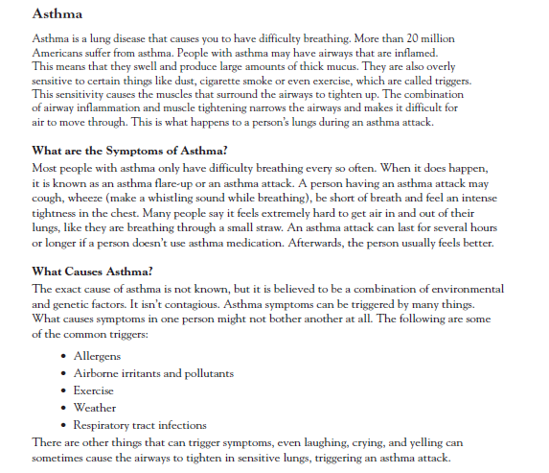
Patient Resource Manual

Slide 8
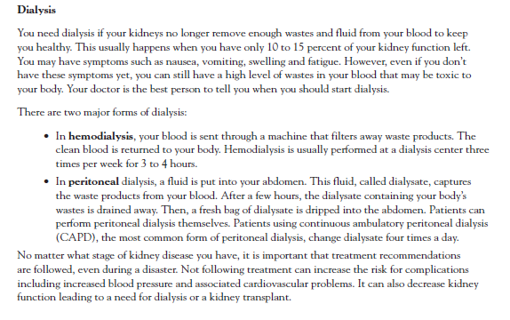
Patient Resource Manual

Slide 9
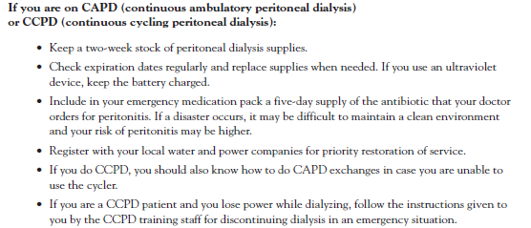
Patient Resource Manual

Slide 10
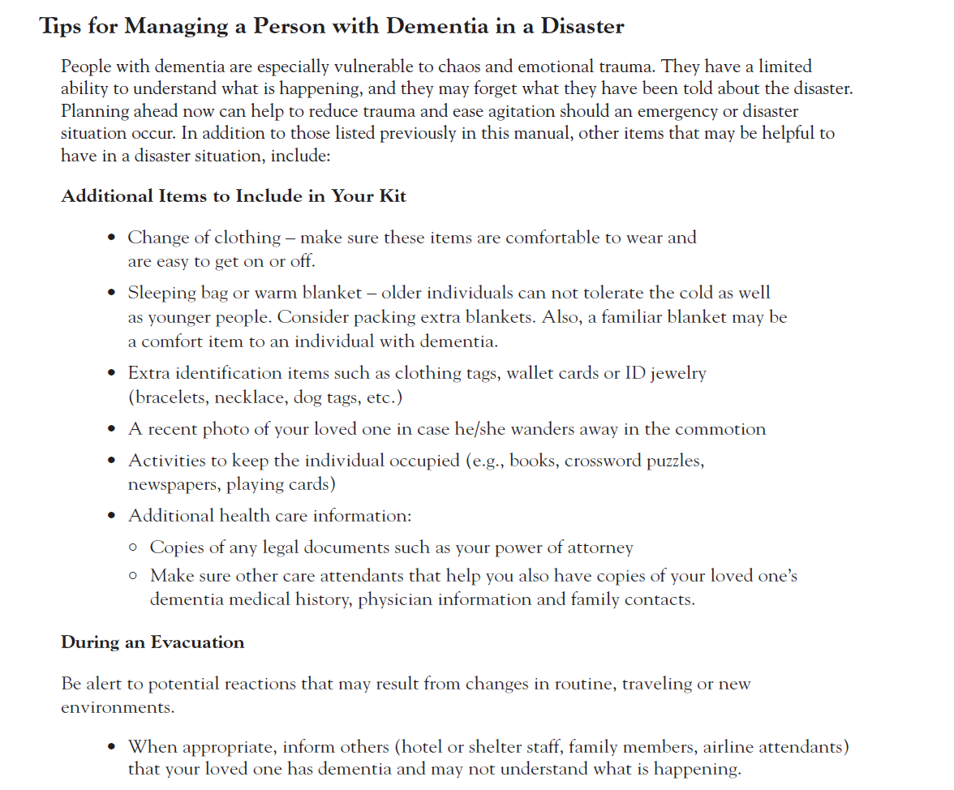
Patient Resource Manual

Slide 11
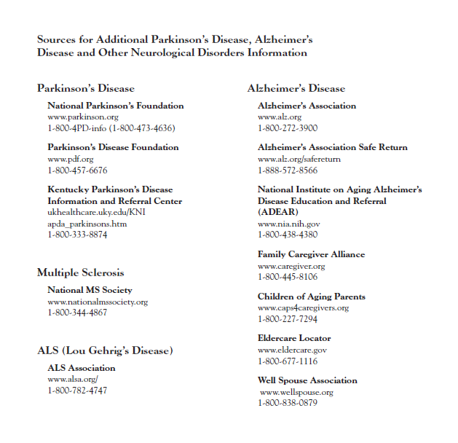
Patient Resource Manual

Slide 12
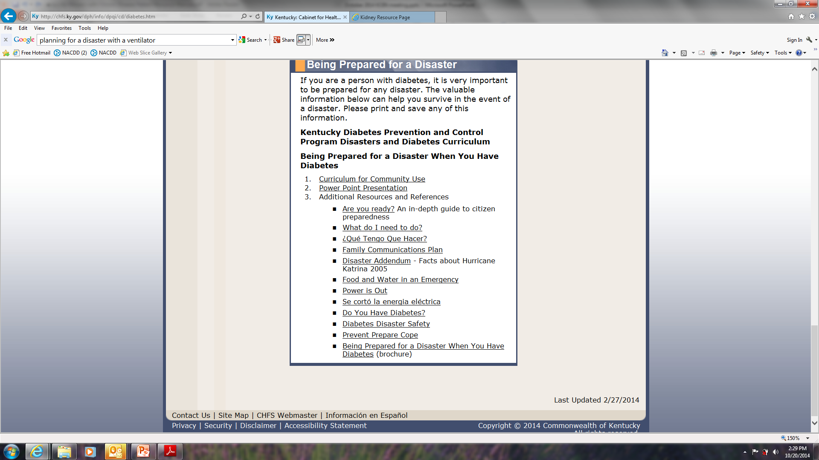
Patient Resource Manual

Slide 13
Patient Resource Manual
Distribution
Limited printed copies are available as a revision is planned for 2015.
Copies are available on the website http://chfs.ky.gov/dph/info/dpqi/cd/
sue.thomas-cox@ky.gov

Slide 14
Additional Resources
Disaster Planning Handbook for Behavioral Health Treatment Programs SAMSHA TAP 34 Get Your Copy of TAP 34
http://www.kidneydisasters.org/
http://www.therenalnetwork.org/home/disasterplan.php
Many more resources
Thank you
Questions?

