Slide 1
The Role of the Healthcare Provider in Zika Virus Disease
2017 Kentucky Zika Summit
May 11, 2017
Brooke Happ
Zika Coordinator

Slide 2
Objectives
Describe the clinical manifestations and clinical management of Zika virus disease
Outline the process for identifying and counseling at-risk patients
Discuss laboratory testing and interpretation as well as reporting requirements for Zika virus
Provide resources for clinicians including where to find the most recent clinical guidance from CDC and the updated areas of Zika virus transmission

Slide 3
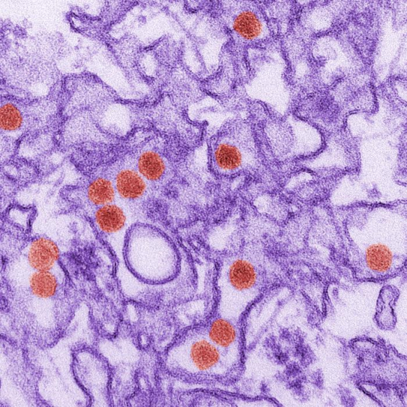
Zika Virus
Single-stranded RNA virus
Genus flavivirus, family Flaviviridae
Closely related to Dengue Virus, Yellow Fever Virus, Japanese Encephalitis Virus (JEV), and West Nile Virus (WNV)
Arthropod-borne virus primarily transmitted by the bite of an infected Aedes species mosquito
Digitally-colorized transmission electron microscope image of Zika virus with virus particles shown in red.

Slide 4
Where has Zika virus been found?
Approximate known distribution of Zika virus, 1947 – 2007.
https://www.ncbi.nlm.nih.gov/pmc/articles/PMC2819875/
Notes:
Approximate known distribution of Zika virus, 1947–2007. Red circle represents Yap Island. Yellow indicates human serologic evidence; red indicates virus isolated from humans; green represents mosquito isolates.

Slide 5
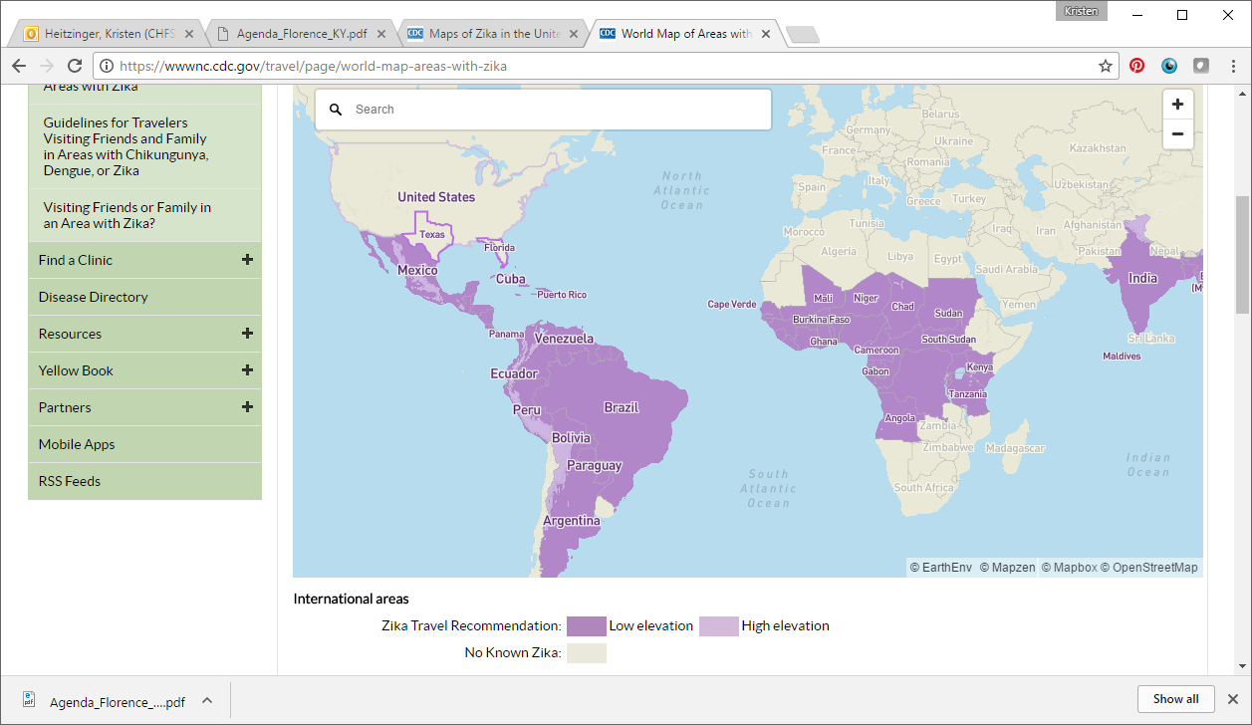
Where is Zika now?
CDC’s Zika website provides information about areas with both endemic and active Zika transmission: https://www.cdc.gov/zika/geo/index.html
Includes US map with updated case counts
Includes world map with a list of countries

Slide 6
Transmission
Bite from an infected mosquito
Sexual transmission from an infected person to his or her partners
Maternal-fetal
Laboratory exposure
Blood transfusion (theoretical)

Slide 7
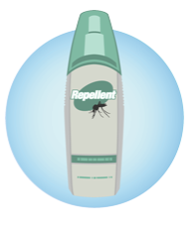
Prevention
The best way to prevent diseases spread by mosquitoes is to protect yourself and your family from mosquito bites.
Use Environmental Protection Agency (EPA)-registered insect repellents on exposed skin.
Use a repellent with one of the following active ingredients: DEET, picaridin, IR3535, oil of lemon eucalyptus or para-menthane-diol, or 2-undecanone.
Wear long-sleeved shirts and long pants.
Stay in places with air conditioning or window and door screens to keep mosquitoes outside.
Remove standing water around your home to reduce mosquito breeding sites.

Slide 8
Travel Recommendations
Pregnant women and their partners should avoid travel to Zika-affected areas.
Returning travelers infected with Zika can spread the virus to mosquitoes if bitten while viremic or through sex.
To avoid spreading Zika virus, returning travelers should:
Prevent mosquito bites by continuing to use insect repellent for 3 weeks.
Use condoms or not have sex for the time periods outlined in CDC guidance for preventing sexual transmission.
Postpone conception for 6 months after return from travel.

Slide 9
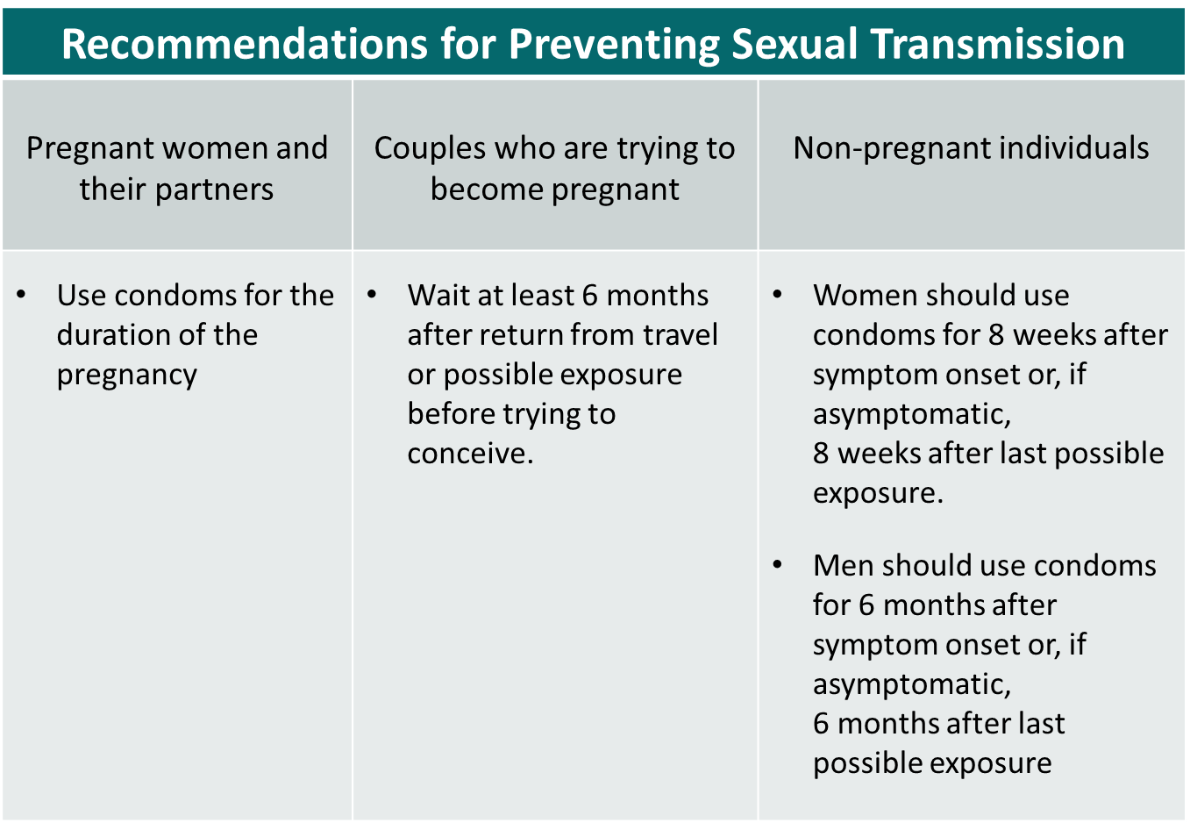

Slide 10
Infection Control
Standard Precautions should be used to protect healthcare personnel from all infectious disease transmission, including Zika virus.
Occupational exposure that requires evaluation includes percutaneous exposure or exposure of non-intact skin or mucous membranes to any of the following: blood, body fluids, secretions, and excretions.
For more information, visit: http://www.cdc.gov/zika/hc-providers/infection-control.html

Slide 11
Infection Control in Labor & Delivery Settings
Healthcare personnel should assess the likelihood of the presence of body fluids or other infectious material based on:
Condition of the patient,
Type of anticipated contact, and
Nature of the procedure or activity.
Apply practices and personal protective equipment as indicated.

Slide 12
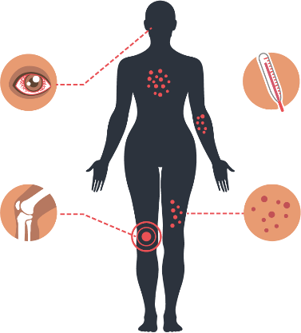
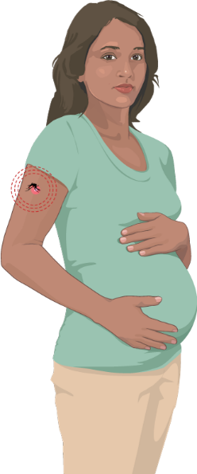
Incubation and Viremia
Incubation period for Zika virus disease is 3–14 days.
Zika viremia ranges from a few days to 1 week or longer.
Some infected pregnant women can have evidence of Zika virus in their blood longer than expected.
Virus remains in semen and urine longer than in blood.
3 – 14 days

Slide 13
Clinical Presentation
An estimated 80% of persons infected with Zika virus are asymptomatic.
Most common symptoms:
Acute onset of fever
Maculopapular rash
Arthralgia
Conjunctivitis
Other symptoms include muscle pain and headache.
Symptoms typically last several days to a week.

Slide 14
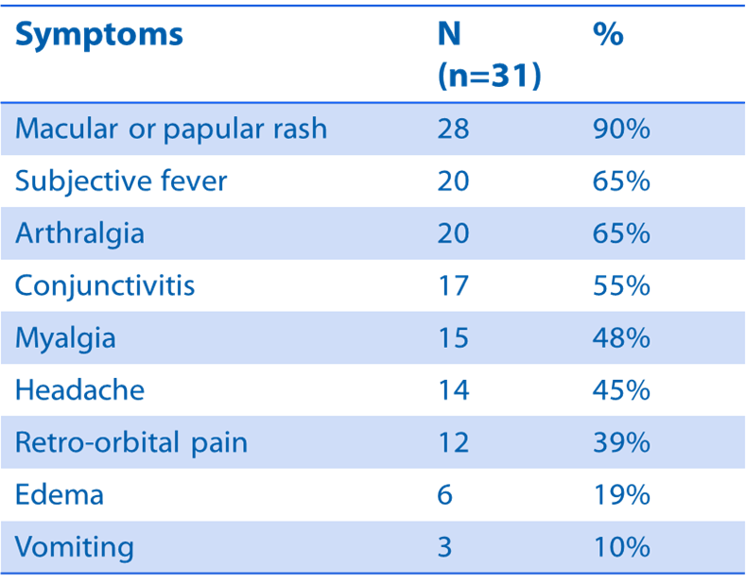
Reported clinical symptoms among confirmed Zika virus disease cases
Yap Island, 2007, Duffy M. N Engl J Med 2009
Notes:
This chart lists the symptoms of Zika virus infection and the number and percentage of cases reported with each symptom in a study conducted in Yap Island during the 2007 outbreak.
Among 31 confirmed cases, the most common symptom was rash.
More than half also reported subjective fever, arthralgia or conjunctivitis.
Other clinical signs and symptoms reported included myalgia, headache, retro-orbital pain, edema and vomiting.

Slide 15
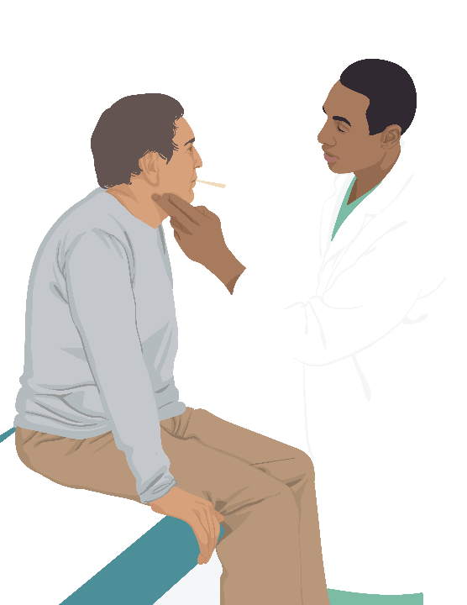
Clinical Disease Course and Outcomes
Clinical illness is usually mild.
Severe disease requiring hospitalization is uncommon.
Fatalities are rare.
Research suggests that Guillain-Barré syndrome (GBS) is strongly associated with Zika.
Only a small proportion of people with recent Zika infection get GBS.
Zika virus infection during pregnancy can cause damage to the brain, microcephaly, and congenital Zika syndrome.

Slide 17
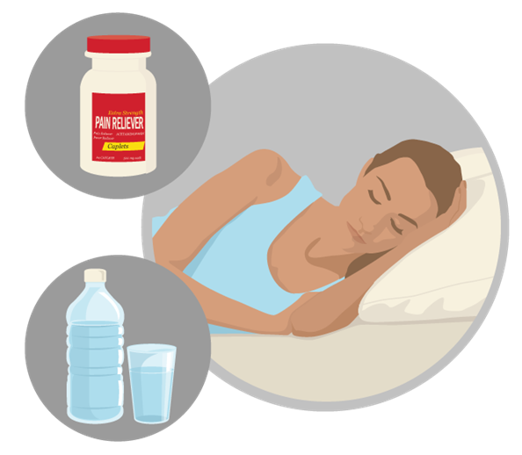
Clinical Management
No vaccine or specific antiviral treatment
Treat the symptoms:
Rest
Drink fluids to prevent dehydration
Take medicine such as acetaminophen to reduce fever and pain
Aspirin and non-steroidal anti-inflammatory drugs should be avoided until dengue can be ruled out to reduce the risk of bleeding.

Slide 18
Diagnosis
Based on the typical clinical features, the differential diagnosis for Zika virus infection is broad.
In addition to dengue, other considerations include:
Preliminary diagnosis is based on the patient’s clinical features, places and dates of travel, and activities.
Leptospirosis
Malaria
Rickettsia
Group A streptococcus
Rubella
Measles
Parvovirus
Enterovirus
Adenovirus
Alphavirus (e.g., chikungunya)

Slide 19
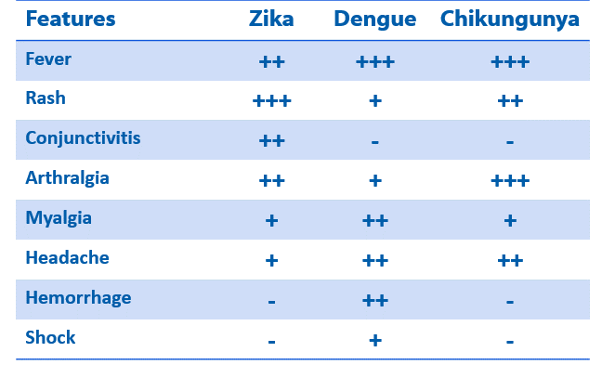
Clinical features: Zika virus compared to dengue and chikungunya
Rabe, Ingrid MBChB, MMed “Zika Virus- What Clinicians Need to Know?” (presentation, Clinician Outreach and Communication Activity (COCA) Call, Atlanta, GA, January 26 2016)
Notes:
It may be challenging to distinguish infections with Zika virus from those with dengue and chikungunya viruses
They're transmitted by the same mosquitoes with similar ecologies and they can circulate in the same areas.
They all have similar clinical features.
This chart compares the symptoms.
The number of plus signs indicates the frequency at which symptoms have been reported. A dash indicates the virus is not characterized by that symptom.
In comparison to dengue and chikungunya:
Zika is more likely to cause a rash.
Fever is common but not invariably present.
Cases are more likely to present with conjunctivitis.
Arthralgia, although common, is not as prominent as in chikungunya.

Slide 20
Identification of At-Risk Patients
Healthcare providers should know the clinical manifestations of Zika virus disease and be able to assess risk factors and exposures to Zika virus.
Key patient populations:
Women and their partners who are planning to conceive
Pregnant women and their partners
All travelers to areas with risk of Zika
Infants born to mothers with compatible maternal exposure

Slide 21
Assessing Pregnant Women
All pregnant women should be asked at each prenatal care visit if they:
Traveled to or lived in an area with Zika during their pregnancy or periconceptional period
Had sex without a condom with a partner who has traveled to or lives in an area with Zika
Pregnant women who have a possible exposure to Zika virus are eligible for testing for Zika virus infection.

Slide 22
www.cdc.gov/zika/pdfs/zikapreg_screeningtool.pdf

Slide 23
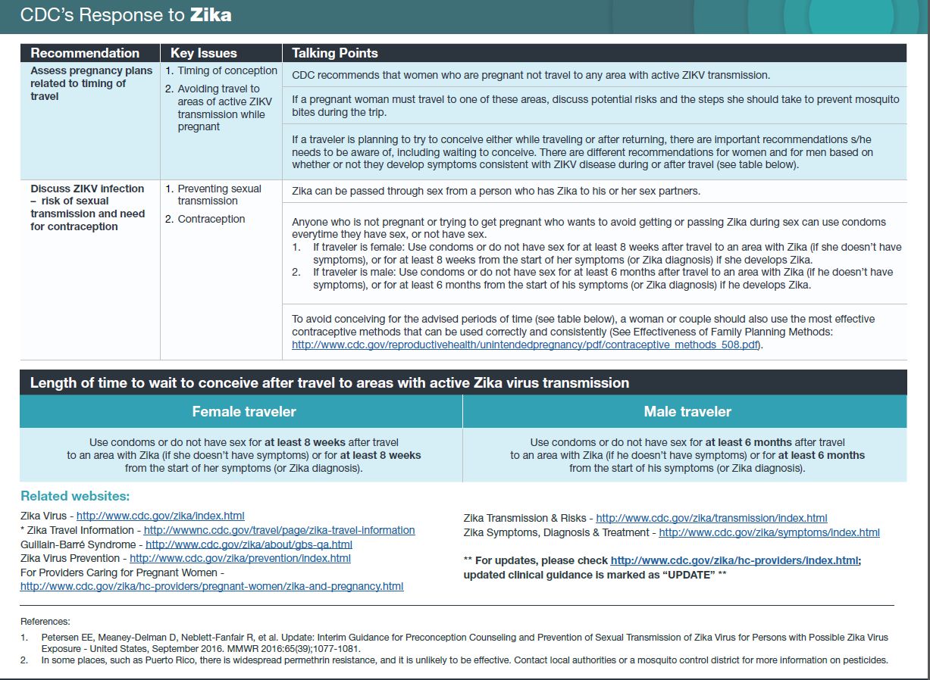

Slide 24
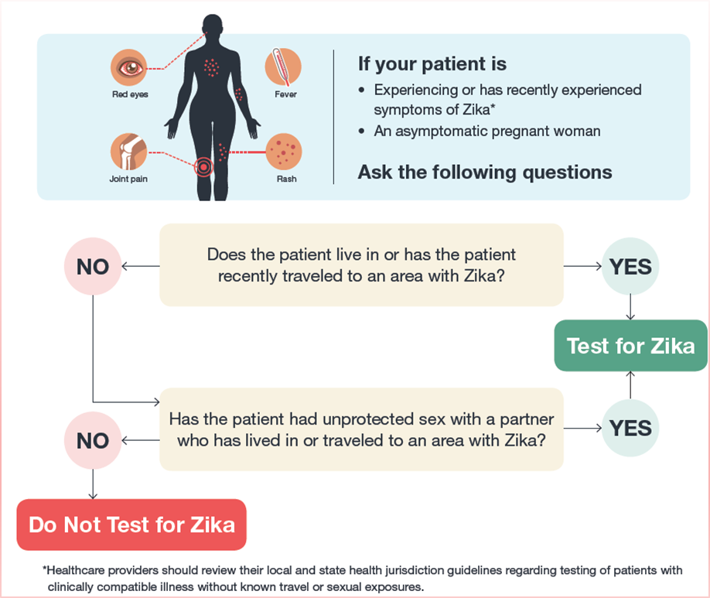
Who should be tested for Zika?
CDC does not recommend routine testing for asymptomatic men, children, and women who are not pregnant.

Slide 25
Testing for Infants
CDC recommends laboratory testing for:
All infants born to mothers with laboratory evidence of possible Zika virus infection during pregnancy.
Infants who have abnormal clinical or neuroimaging finds suggestive of congenital Zika syndrome and a mother with a possible exposure to Zika virus.
Infant samples for Zika virus testing should be collected ideally within the first 2 days of life.

Slide 26
Laboratory Testing
Healthcare providers who have identified a patient with possible exposure to Zika virus should request approval for testing from public health or order testing through a commercial laboratory.
Requests for public health testing approval should be directed to the Regional Epidemiologist based on the patient’s county of residence.
Providers caring for patients identified at the time of delivery should contact KDPH Reportable Diseases section.

Slide 27
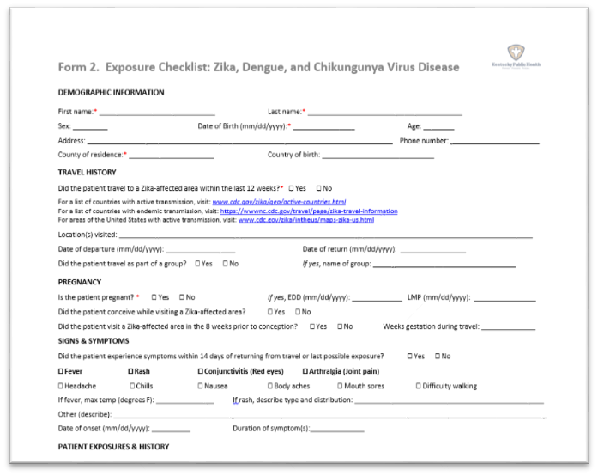
Laboratory Testing
Healthcare providers should complete “Form 2: Exposure Checklist: Zika, Dengue, and Chikungunya Virus Diseases” and submit securely to the Regional Epidemiologist.
This data collection form includes information about exposures, pregnancy, and other patient data.

Slide 28
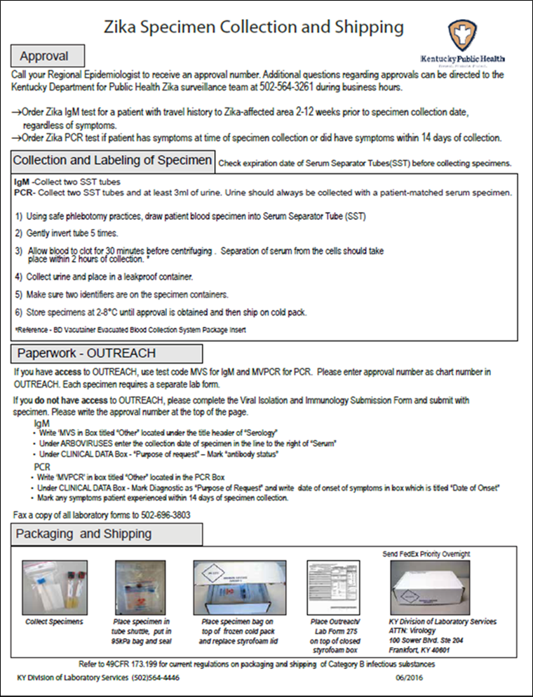
Laboratory Testing
Healthcare providers should follow the “Zika Specimen Collection and Shipping Instructions” found online at http://chfs.ky.gov/dph/info/lab/.
The Kentucky Division of Laboratory Services is certified to perform Trioplex PCR and Zika IgM testing.
Confirmatory testing is performed at CDC on specimens that are positive, equivocal, or uninterpretable by Zika IgM.

Slide 29
Laboratory Testing
Molecular Method
Nucleic Acid Amplification Test (NAT) for viral RNA in body fluids or tissues (Trioplex PCR)*
Serologic Method
Zika virus immunoglobulin M (IgM) enzyme-linked immunosorbent assay (Zika MAC-ELISA)* to detect anti-Zika IgM antibodies in serum.
Plaque reduction neutralization test (PRNT) to detect neutralizing antibodies in serum
*FDA has issued Emergency Use Authorizations
(EUAs) for these two CDC assays.

Slide 30
Laboratory Testing
Zika virus infection can be diagnosed by performing RNA NAT on serum and urine within the first two weeks following start of illness or exposure.
Serology assays can also be used to detect Zika virus-specific IgM and neutralizing antibodies.

Slide 31
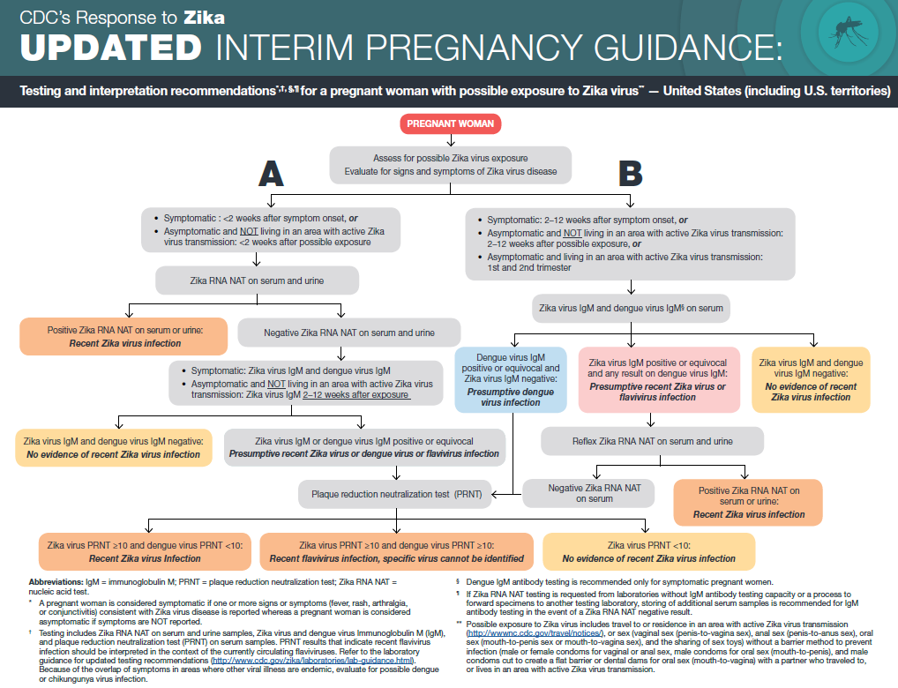

Slide 32
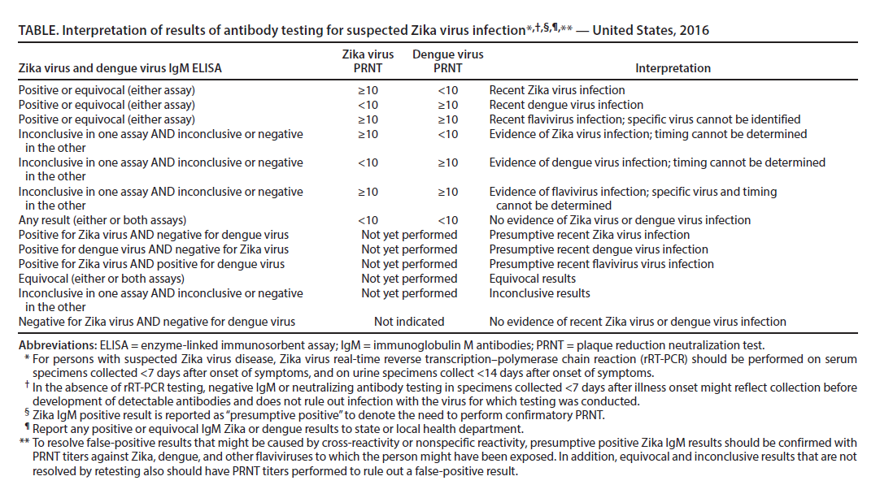
Laboratory Testing
Interim Guidance for Interpretation of Zika Virus Antibody Test Results: https://www.cdc.gov/mmwr/volumes/65/wr/mm6521e1.htm

Slide 33
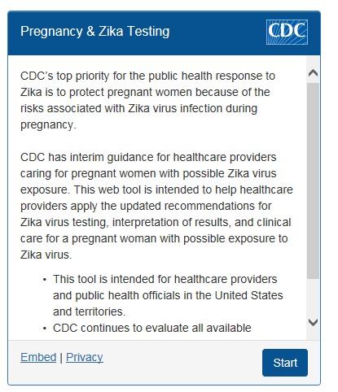
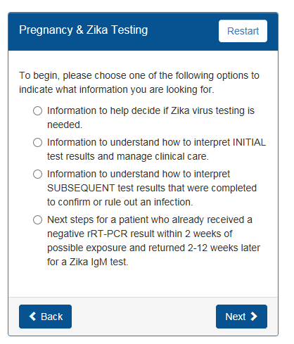
Laboratory Testing
Update: Interim Guidance for Health Care Providers Caring for Pregnant Women with Possible Zika Virus Exposure — United States, July 2016: https://www.cdc.gov/mmwr/volumes/65/wr/mm6529e1.htm?s_cid=mm6529e1_e

Slide 34
What happens next?
When any patient tests positive for Zika virus (any test):
The Regional Epidemiologist or local health department staff ensures the provider receives the result and that the patient is educated on preventing transmission.
When a pregnant patient tests positive for Zika virus (any test):
KDPH works with the obstetric provider and birthing hospital to provide individualized guidance for the mother as well as guidance for laboratory and clinical evaluation of the infant.
When any patient tests positive for Zika virus by RNA NAT during mosquito season:
The local health department and KDPH coordinate an environmental assessment and response.

Slide 35
Reporting Results
Zika virus infection and Zika virus disease are nationally notifiable conditions.
902 KAR 2:020 Reportable Diseases Surveillance: priority notification within one business day
Reporting suspected cases to state or local health departments facilitates diagnosis and mitigates the risk of local transmission.
For tests performed at commercial laboratories, healthcare providers and laboratories should report cases to public health.
For tests performed at DLS, results are made available to the submitting facility.

Slide 36
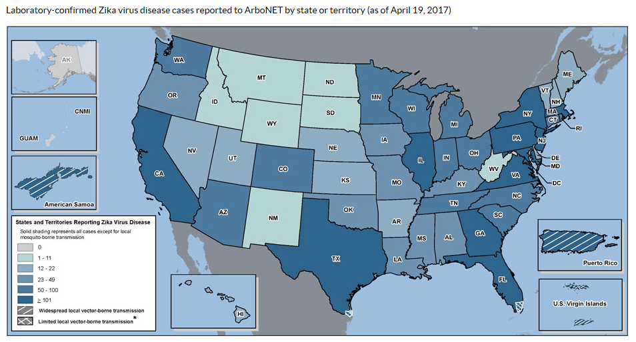
Reporting Results
State or local health departments report laboratory-confirmed cases to CDC through ArboNET, the national surveillance system for arboviral diseases.

Slide 37
FAQ
Should I travel to ______ ?
How long do I have to wait to get pregnant if I traveled somewhere with Zika?
If I get a negative result, do we still have to use condoms?
Is breastfeeding safe?

Slide 38
CDC Online Resources

Slide 39
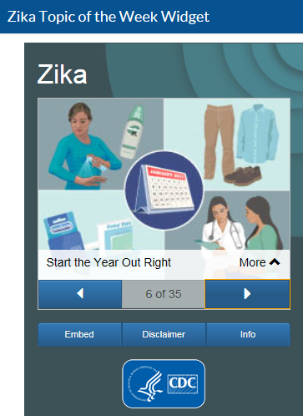
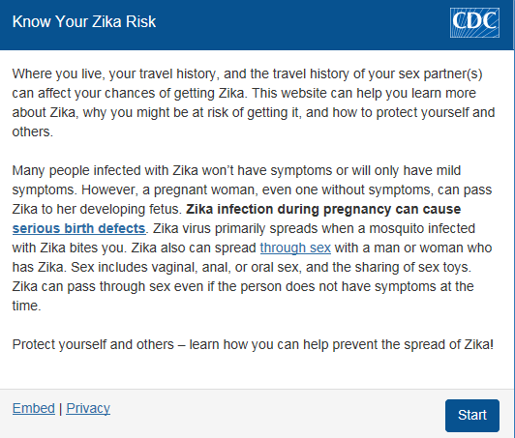
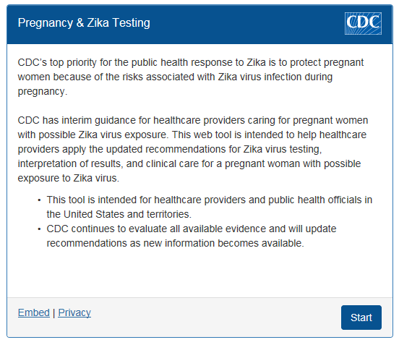
CDC Zika Widgets
https://www.cdc.gov/widgets/zika/index.html

Slide 40
CDC Clinical Guidance
Pregnant Women and Women of Reproductive Age
Interim Guidelines for Health Care Providers Caring for Pregnant Women with Possible Zika Virus Exposure
Interim Guidance for Health Care Providers Caring for Women of Reproductive Age with Possible Zika Virus Exposure
Infants and Children
Interim Guidelines for Healthcare Providers Caring for Infants and Children with Possible Zika Virus Infection
Interim Guidelines for the Evaluation and Testing of Infants with Possible Congenital Zika Virus Infection
Sexual Transmission
Interim Guidelines for Prevention of Sexual Transmission of Zika Virus

Slide 41
Resources
CDC Key Messages – Zika Virus Disease (https://www.cdc.gov/zika/pdfs/zika-key-messages.pdf)
Clinician Outreach and Community Activity (COCA) Calls/Webinars (http://emergency.cdc.gov/coca/index.asp)
Zika Video Resources (http://www.cdc.gov/zika/hc-providers/training-resources.html)
Diagnostic Testing (http://www.cdc.gov/zika/hc-providers/diagnostic.html)
CDC’s Health Alert Network (http://emergency.cdc.gov/han/2016.asp)
MMWR Zika Reports (http://www.cdc.gov/mmwr/zika_reports.html)
CDC Learning Connection (http://www.cdc.gov/learning/index.html)

Slide 42
Thank you!
Brooke Happ, Zika Coordinator
Reportable Diseases Section
502-564-3261 ext. 4231
Brooke.Happ@ky.gov
Betsy Kitchens, Infant Zika Nurse Coordinator
Division of Maternal and Child Health
1-800-843-5877 ext. 3103
Betsy.Kitchens@ky.gov
Zika Surveillance Team & Zika Pregnancy Workgroup:
Anna Yaffee
Brooke Happ
Betsy Kitchens
Katie Myatt
Kim Porter
Monica Clouse
Sandy Kelly
Sara Robeson

