Slide 1

Congenital Zika Infection. Prenatal Diagnosis and Neuropathology
Rita W. Driggers, MD
Associate Professor of Gynecology and Obstetrics
Johns Hopkins University School of Medicine
Medical Director, Maternal Fetal Medicine
2017 Kentucky Zika Summit
May 11, 2017

Slide 2
Disclosures
I have no disclosures.
Member of the American Congress of Obstetricians and Gynecologists (ACOG) Ad Hoc Zika Expert Workgroup

Slide 3
Objectives
Describe the basics of Zika virus to include:
  Modes of transmission
  Symptoms of infection
Explain pregnancy outcomes associated with maternal Zika infection
Review prevention of Zika in pregnant women
Describe standard precautions to prevent the spread of Zika virus during healthcare delivery
Notes:
And what’s even more concerning is how little we really know about Zika virus.

Slide 4
Objectives
Present the earliest prenatal diagnosis of congenital Zika syndrome and lessons learned:
  Prolonged maternal viremia
  Microcephaly occurs late in disease process
  New Zika strains have strong predilection for human neural tissues
Notes:
And what’s even more concerning is how little we really know about Zika virus.

Slide 5
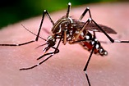
First time in history…
“Never before in history has there been a situation where a bite from a mosquito could result in a devastating malformation.”
–Dr. Tom Frieden, Former CDC Director, Fortune, April 13, 2016
Notes:
And what’s even more concerning is how little we really know about Zika virus.

Slide 6
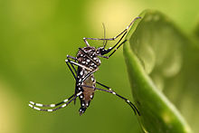
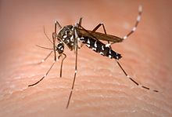
What is Zika Virus?
Single stranded RNA virus
Closely related to dengue, yellow fever, Japanese encephalitis, and West Nile viruses
Primarily transmitted by two Aedes species mosquitoes
Additional modes of transmission
  Intrauterine and perinatal transmission
  Sexual transmission
  Laboratory exposure
  Blood transfusion
Aedes aegypti
  Aedes albopictus
Notes:
So what do we know about Zika virus?
Most reported sexual transmissions have been from persons with symptomatic Zika virus infections, including from men to female sex partners (10-12), from a man to his male sex partner (13), and from a woman to her male sex partner (14). Two new reports describe one presumed and one more definitive case of sexual transmission from a man with asymptomatic Zika virus infection to his female sex partner (15, 16). Sexual transmission of Zika virus has been associated with condomless anal sex and vaginal sex and possibly also with fellatio (17). Among reported cases of sexually transmitted Zika virus infection, the longest reported period between symptom onset and sexual contact that might have transmitted Zika virus was 32–41 days (18).

Slide 7
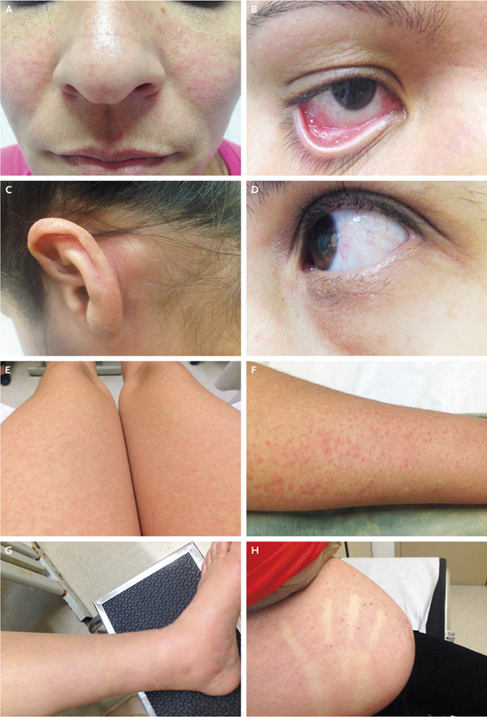
Zika Symptoms
Most common symptoms:
  Fever
  Rash
  Joint/muscle pain
  Conjunctivitis
  Headache
80% of people infected are asymptomatic
Notes:
Fortunately, most cases are asymptomatic and when symptomatic the illness tends to be very mild lasting only a week or two

Slide 8
Zika, Pregnancy, and Congenital Zika Syndrome
8
Notes:
As it stands now, we have many more questions than answers about Zika virus especially as it relates to pregnancy. The CDC issues weekly updates in their MMWR to try to keep us informed. Thank you for your attention. I welcome your questions.

Slide 9

Zika Virus Infection in Pregnant Women
Pregnant women can be infected
  Through a mosquito bite
  Through sex without a condom with an infected partner
If infected around conception
  Zika might present risk to fetus
If infected during pregnancy
  Zika can be passed to the fetus during pregnancy or around the time of birth
www.cdc.gov/zika

Slide 10

Zika Virus in Pregnancy
  Incidence of Zika virus infection in pregnant women is not known
  Infection can occur in any trimester
  No evidence of increased susceptibility
  The clinical course is similar in pregnant women and in non-pregnant people
Centers for Disease Control and Prevention, CDC Health Advisory: Recognizing, Managing, and Reporting Zika Virus Infections in Travelers Returning from Central America, South America, the Caribbean and Mexico, 2016.
Besnard, M., et al., Evidence of Perinatal Transmission of Zika Virus, French Polynesia, December 2013 and February 2014. Euro Surveill, 2014. 19(14): p. 1-5.
Oliveira Melo, A., et al., Zika Virus Intrauterine Infection Causes Fetal Brain Abnormality and Microcephaly: Tip of the Iceberg? Ultrasound in Obstetrics & Gynecology, 2016. 47(1): p. 6-7.

Slide 11
CDC Lab Confirms Zika In Fetal Tissues
Evidence of Zika virus identified in:
  Amniotic fluid
  Placenta
  Brain
  Products of conception
www.cdc.gov/zika

Slide 12
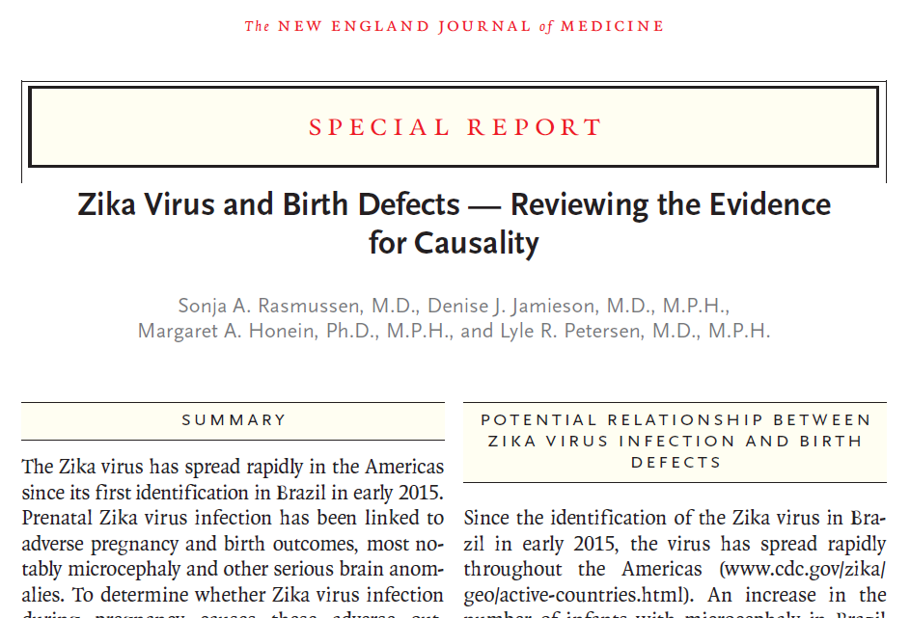
Zika is a Cause of Microcephaly
www.cdc.gov/zika

Slide 13
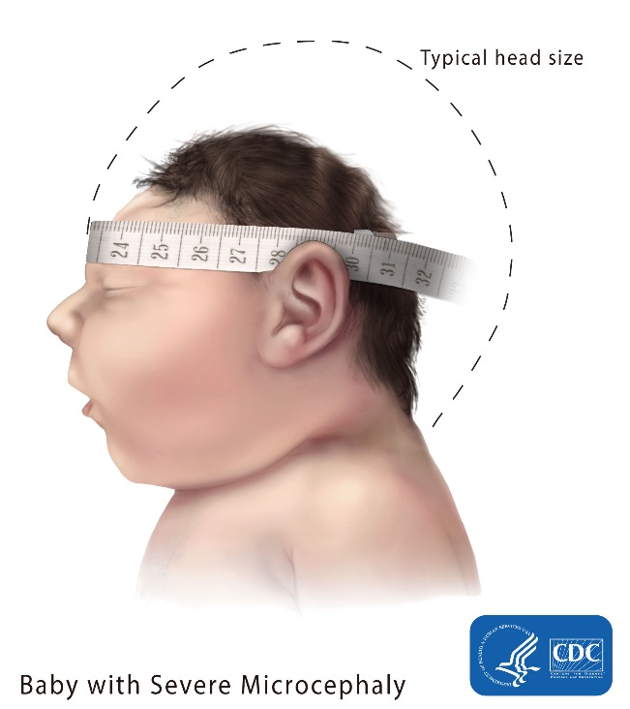
Congenital Zika Syndrome
Recently recognized pattern of congenital anomalies associated with Zika virus infection during pregnancy that includes:
  Microcephaly
  Intracranial calcifications
  Other brain anomalies
Congenital Zika virus infection also linked to
  Eye anomalies
  Hearing loss
  Limb abnormalities
  Impaired growth

Slide 14
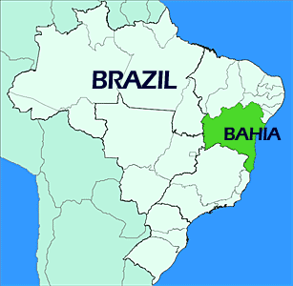
Potential Risk of Microcephaly
1 - 13% estimated risk of microcephaly due to Zika virus infection in first trimester
  Modeling based on current outbreak in Bahia, Brazil
Important to remember:
  Data limited (infection rates unknown; microcephaly cases still being reported)
  Microcephaly difficult to detect prenatally
  Microcephaly only one of a range of possible adverse outcomes
Johansson MA, Mier-Y-Teran-Romero L, Reefhuis J, Gilboa SM, Hills SL. Zika and the Risk of Microcephaly. N Engl J Med. 2016 May 25.
Notes:
More recent data from the US experience found that 10%

Slide 15
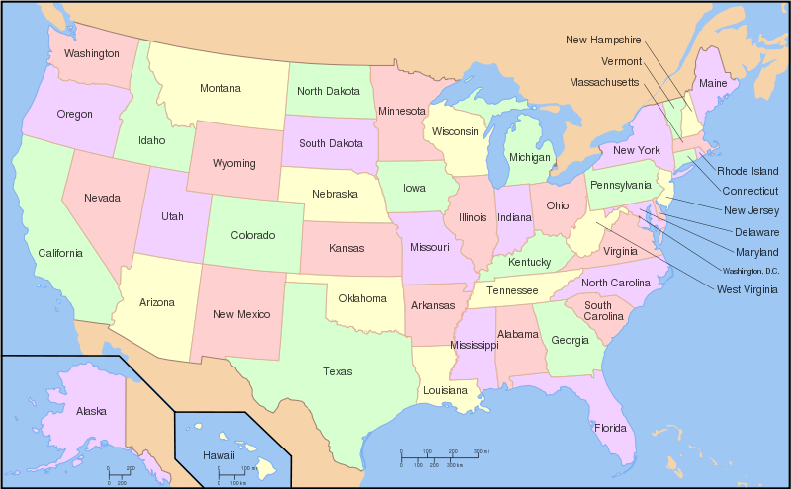
Potential Risk of Birth Defects
CDC established the U.S. Zika Pregnancy Registry
Zika virus–associated birth defects:
  51 (5%) of the 972 fetuses/infants from completed pregnancies with laboratory evidence of possible recent Zika virus infection
  24/250 (10%) with laboratory-confirmed Zika virus infection
  Birth defects were reported in 15% of fetuses/infants with confirmed Zika virus infection in the first trimester
CDC MMWR Weekly / April 7, 2017 / 66(13);366-373.
Notes:
More recent data from the US experience found that 10%

Slide 16
Preventing Zika in Pregnant Women

Slide 17

Avoid Traveling to Areas with Active Zika Transmission
Pregnant women should not travel to
areas with Zika
If a pregnant woman must travel, she should
  Talk with her healthcare provider before she goes
  Strictly follow steps to prevent mosquito bites during the trip
  Take steps to prevent sexual transmission
  Talk with her healthcare provider after she returns, even if she doesn’t feel sick
http://wwwnc.cdc.gov/travel/page/zika-information

Slide 18
Prevent Mosquito Bites
If a pregnant woman lives in or travels to an area with Zika, she should:
Wear long-sleeved shirts and long pants
Stay and sleep in places with air conditioning or that use window and door screens
Use EPA-registered insect repellents with one of the following active ingredients:
  DEET, picaridin, IR3535, oil of lemon eucalyptus or para-menthane-diol, or 2-undecanone
Once a week, empty and scrub, turn over, cover, or throw out items that hold water
www.cdc.gov/zika
Notes:
such as trash containers, tires, buckets, toys, planters, flowerpots, birdbaths or pools

Slide 19

Prevent Sexual Transmission of Zika Virus
A pregnant woman whose partner lives in or has traveled to an area with Zika should
use condoms correctly every time they have sex, or
abstain from sex for the duration of the pregnancy
www.cdc.gov/zika
Notes:
even if the pregnant woman’s partner does not have symptoms or feel sick.

Slide 20
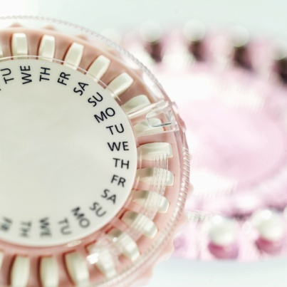
CDC Recommendations: Conception and Contraception

Slide 21
Pregnancy Planning and Access to Contraception
Preventing Zika infections during pregnancy
  Support women who want to delay or avoid pregnancy
If couples decide to wait to conceive, HCPs should discuss
  Strategies to prevent unintended pregnancy
  Use of the most effective contraceptive methods (including long-acting reversible contraception)
  Correct and consistent use of condoms, in addition to other birth control method used, in reducing the risk for STIs, including Zika

Slide 22
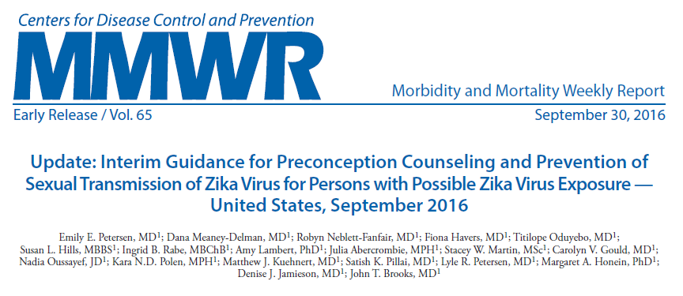
Zika Virus (ZIKV) Duration of Detection in Infected Persons
https://www.cdc.gov/mmwr/volumes/65/wr/pdfs/mm6539e1.pdf

Slide 23
Women and Their Partners Thinking about Pregnancy
Possible exposure via recent travel or sex without a condom with a partner infected with Zika
Women | Men
Wait at least 8 weeks after symptoms start or last possible exposure | Wait at least 6 months after symptoms start or last possible exposure
People living in or frequently traveling to areas with Zika
 | Women |  | Men
Positive Zika test | Wait at least 8 weeks after symptoms start |  | Wait at least 6 months after symptoms start
No testing performed or negative test | Talk with doctor or healthcare provider |  | Talk with doctor or healthcare provider

Slide 24
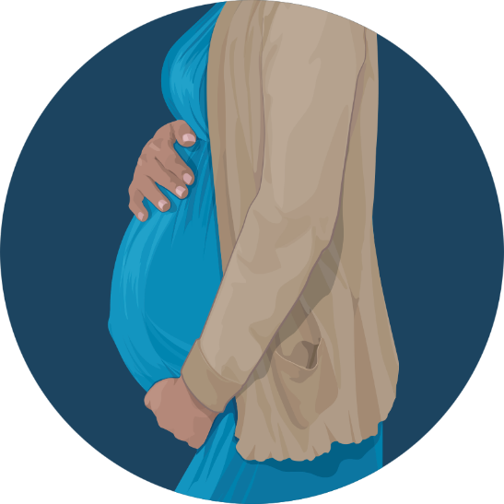
CDC Guidance: Pregnancy

Slide 25
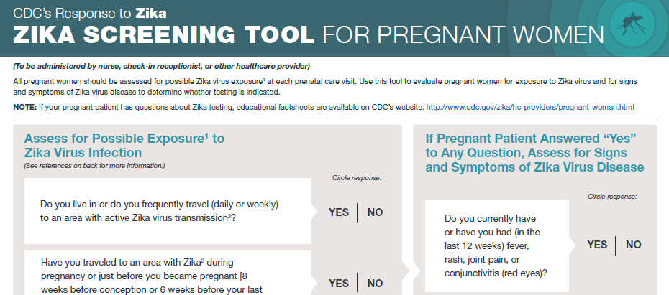
Assessing for Zika During Pregnancy
All pregnant women should be assessed for Zika exposure, signs, and symptoms at each prenatal care visit. They should be asked if they
  Traveled to or live in an area with active Zika transmission
  Had sex without a condom with a partner with potential exposure to Zika
Link: http://www.cdc.gov/zika/pdfs/zikapreg_screeningtool.pdf

Slide 26
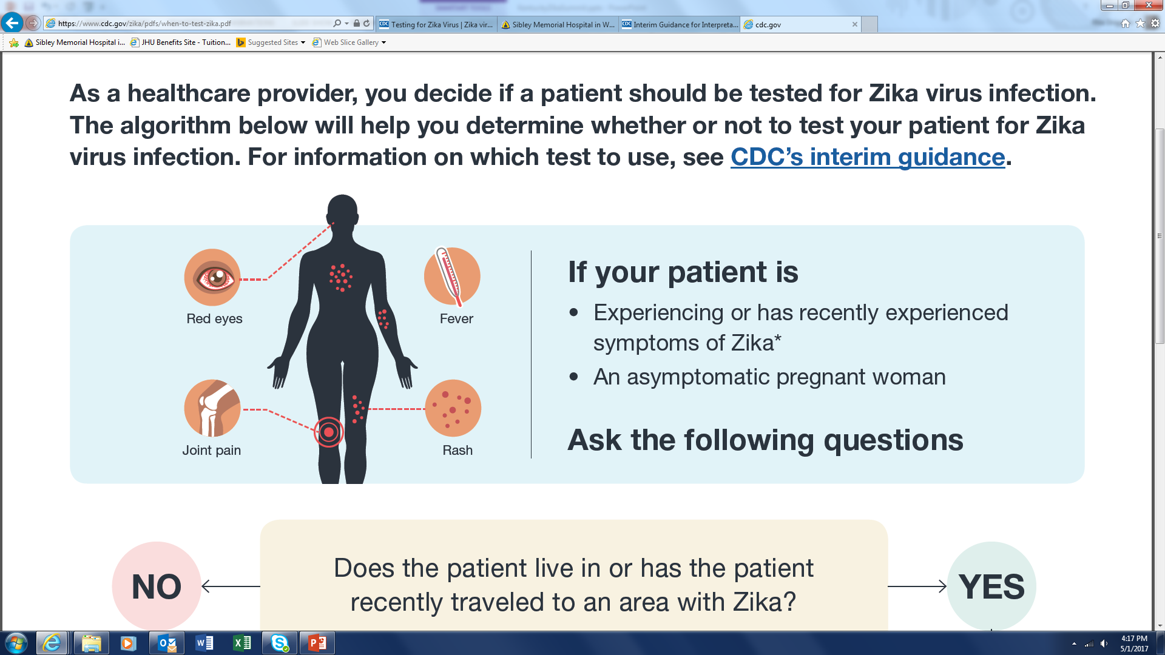
CDC Recommendations: Who should be tested during pregnancy
https://www.cdc.gov/zika/pdfs/when-to-test-zika.pdf

Slide 27
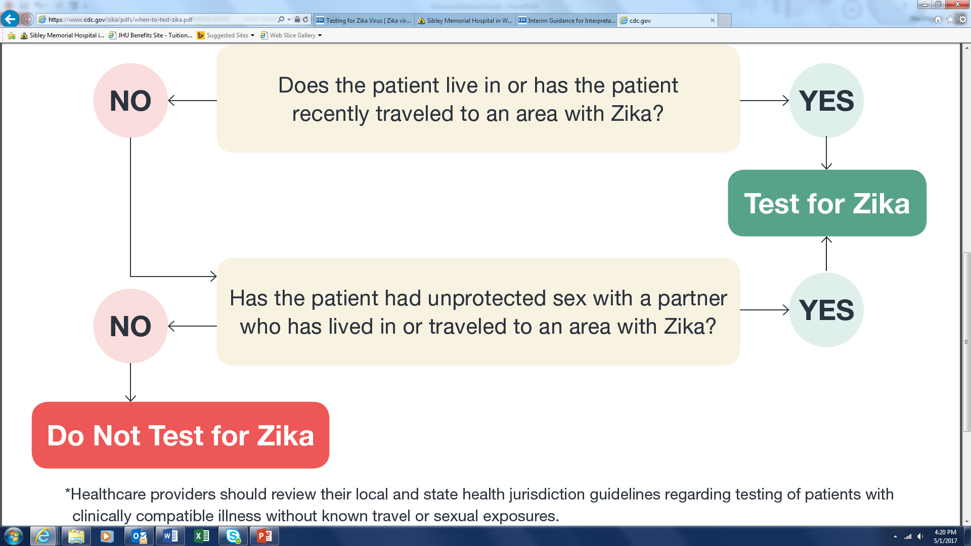
CDC Recommendations: Who should be tested during pregnancy
https://www.cdc.gov/zika/pdfs/when-to-test-zika.pdf

Slide 28
CDC Recommendations: Who should be tested
CDC does NOT recommend Zika virus testing for asymptomatic:
  Men
  Children
  Women who are not pregnant and are not planning to become pregnant
https://www.cdc.gov/zika/pdfs/when-to-test-zika.pdf
CDC Updates Guidance; May 5, 2017

Slide 29
Diagnostic Testing for Zika Virus
Molecular method
  Real-time reverse transcriptase-polymerase chain reaction (rRT-PCR) or nucleic acid testing (NAT) for viral RNA in body fluids or tissues
Serologic method
  Zika virus immunoglobulin M (IgM) enzyme-linked immunosorbent assay
  Plaque reduction neutralization test (PRNT) to detect neutralizing antibodies in serum

Slide 30
Limitations of Zika Tests
Presence of Zika virus RNA in serum and urine is relatively short-lived and negative results do not preclude infection
Testing for Zika virus IgM can result in false positive results because of cross-reacting antibodies against related flaviviruses and for nonspecific reasons
PRNT levels may not distinguish previous infection versus prior vaccination against a related flavivirus
Zika IgM antibodies may remain present for months after infection
CDC Updates Guidance; May 5, 2017

Slide 31
Updated Guidance: Symptomatic Pregnant Women
Evaluated <2 weeks after symptom onset
  Should receive Zika virus rRT-PCR testing of serum and urine
    Positive rRT-PCR result confirms diagnosis: recent maternal Zika virus infection
    Negative rRT-PCR result does not rule out Zika virus infection
      Zika IgM and dengue IgM antibody testing should be performed immediately on the same specimen or a subsequently collected specimen
Evaluated 2–12 weeks after symptom onset
  Should first have a Zika virus immunoglobulin (IgM) test
  If positive or equivocal, serum and urine rRT-PCR should be performed

Slide 32
Updated Guidance: Asymptomatic Pregnant Women
Living in areas without active Zika, evaluated <2 weeks after last possible exposure
  rRT-PCR testing should be performed
    If the rtRT-PCR test is negative, Zika IgM test should be performed 2–12 weeks after exposure
Living in areas without active Zika, evaluated 2–12 weeks after last possible exposure
  Should receive a Zika virus IgM antibody test
    If positive or equivocal, serum and urine rRT-PCR should be performed

Slide 33
Updated Guidance: Asymptomatic Pregnant Women (cont.)
Living in areas with active Zika
  Should receive Zika virus IgM antibody testing as part of routine obstetric care during the 1st and 2nd trimesters
    immediate rRT-PCR (NAT) testing of women who are IgM-positive or equivocal
  Consider NAT testing at least once during each trimester
CDC Updates Guidance; May 5, 2017

Slide 34
Updated Guidance: Testing Pregnant Women After 12 Weeks
For symptomatic and asymptomatic pregnant women with possible Zika virus exposure who seek care >12 weeks after symptom onset or possible exposure
IgM antibody testing might be considered
  A negative IgM antibody test or rRT-PCR result >12 weeks after symptom onset or possible exposure does not rule out recent Zika virus infection because IgM antibody and viral RNA levels decline over time
Given the limitations of testing beyond 12 weeks after symptom onset or possible exposure, serial fetal ultrasounds should be considered

Slide 35
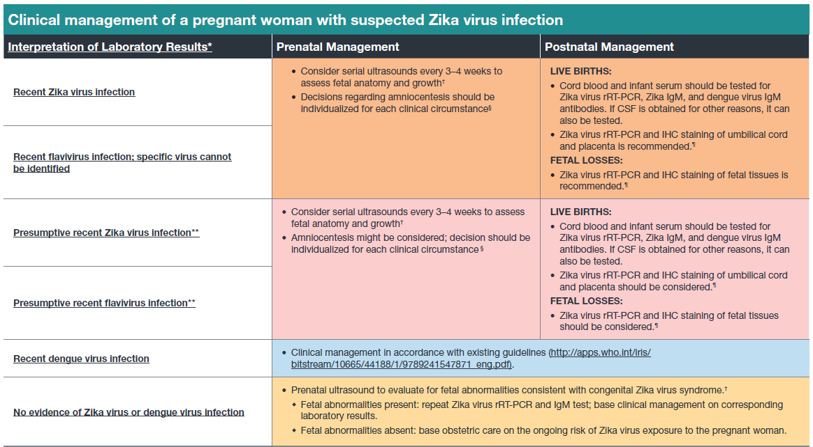
Clinical Management of Pregnant Women with Suspected Zika Infection
LIVE BIRTHS:
● Infant serum should be tested for
LIVE BIRTHS:
● Infant serum and urine should be tested for
Notes:
Please add link to slide

Slide 36
Prenatal Management: Confirmed or Presumptive Recent Zika Virus or Flavivirus Infection
Serial ultrasounds every 3-4 weeks to assess fetal anatomy and growth
Amniocentesis
  Individualized for pregnant women with confirmed recent Zika virus or flavivirus infection
  Can be considered for pregnant women with presumptive recent Zika virus or flavivirus infection
Insect repellent for at least 3 weeks after exposure
http://www.cdc.gov/mmwr/volumes/65/wr/mm6529e1.htm?s_cid=mm6529e1_e

Slide 37
Postnatal Management: Confirmed or Presumptive Recent Zika Virus or Flavivirus Infection
Live births
  Infant serum should be tested for:
    Zika virus rRT-PCR, Zika IgM, Dengue IgM
  If CSF is obtained for other reasons, also test
  Zika virus rRT-PRC and IHC staining of umbilical cord and placenta
Fetal losses
  Zika virus rRT-PRC and IHC staining of fetal tissues
http://www.cdc.gov/mmwr/volumes/65/wr/mm6529e1.htm?s_cid=mm6529e1_e

Slide 38
Couples planning to conceive and don’t live in areas with active Zika virus transmission
Avoid nonessential travel to areas with active Zika
Timing
  Women: wait at least 8 weeks from symptom onset (if symptomatic) or last possible exposure (if asymptomatic)
  Men: wait at least 6 months from symptom onset (if symptomatic) or last possible exposure (if asymptomatic)
Consider IgM testing of women before pregnancy*
  Not to determine if it is safe to become pregnant
  To help to help determine if recent infection has occurred during pregnancy
*CDC Updates Guidance; May 5, 2017

Slide 39
Couples who want to conceive: one or both live in Zika area
Symptomatic: test per guidelines
  Positive test
    Men: Wait 6 months from symptom onset
    Women: Wait 8 weeks from symptom onset
Counseling
  Fetal consequences Zika virus infection during pregnancy
  Review factors that might influence pregnancy timing
    Unknown duration of Zika virus outbreak
    Fertility/age/reproductive history
    Medical history
    Personal values and preferences

Slide 40
Couples with one or both living in Zika area
For couples who choose to conceive
  Consider IgM testing of women before pregnancy*
  Stress use of mosquito prevention strategies while attempting pregnancy and during pregnancy
For couples who decide to wait to attempt conception
  strategies to prevent unintended pregnancy
  most effective contraceptive methods (i.e., long-acting reversible contraception)
  provide contraception or referral to appropriate providers for contraception care
*CDC Updates Guidance; May 5, 2017

Slide 41

Special considerations for women undergoing fertility treatment
No reports of Zika virus transmission through ART
Transmission through gametes or embryos theoretically possible
Follow the testing and timing recommendations as described above
  Recommendations might need to be adjusted depending on individual circumstances

Slide 42
Couples who aren’t pregnant and aren’t planning to become pregnant in the near future
If one partner has Zika exposure, to maximally reduce their risk of sexually transmitting Zika virus to the uninfected partner
  use condoms or abstain from sex for at least 6 months or 8 weeks, respectively after the man’s or woman’s symptom onset (if symptomatic) or last possible Zika virus exposure (if asymptomatic)
Discuss strategies to prevent unintended pregnancy

Slide 43
Standard Precautions to Prevent the Spread of Zika Virus and Other Infectious Agents During Healthcare Delivery

Slide 44
Zika Virus Disease in Healthcare Settings
No reports to date of transmission of Zika virus from infected patients to healthcare personnel (HCP) or other patients in healthcare settings
Zika virus has been detected in blood, amniotic fluid, urine, saliva, and genital fluids (including semen and vaginal fluids)
HCP working in these settings must adhere to Standard Precautions
44
Notes:
We do not know the long-term health outcomes for infants and children with Zika virus infection. Therefore, you should protect your child (and yourself) from this disease by taking steps to prevent mosquito bites.
To protect your child from mosquito bites, the CDC recommends:
Dress your child in clothing that covers arms and legs.
Cover crib, stroller, and baby carrier with mosquito netting.
Do not use insect repellent on babies under 2 months of age.
Do not use products containing oil of lemon eucalyptus or para-menthane-diol on children younger than 3 years old.
In children older than 2 months, do not apply insect repellent onto a child’s hands, eyes, mouth, or to irritated or broken skin.
Never spray insect repellent directly on a child’s face. Instead, spray it on your hands and then apply sparingly, taking care to avoid the eyes and mouth.

Slide 45
Standard Precautions: Personal Protective Equipment (PPE)
Gloves, gowns, face masks, face shields, goggles
HCPs must assess their risk for exposure and select appropriate PPE
Examples of obstetric procedures that require increasing amount of PPE
  Vaginal exam particularly during amniotomy
  Vaginal delivery including manual removal of placenta
  Operative procedures

Slide 46
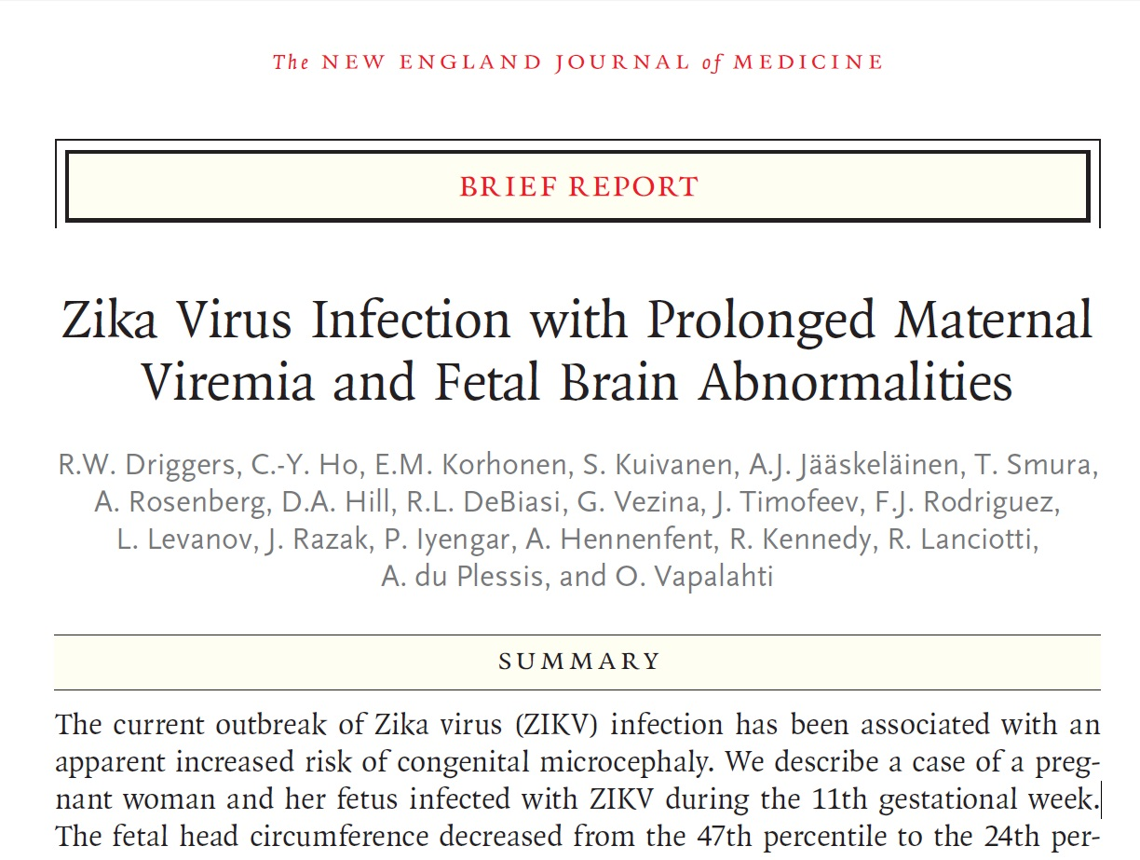
Prenatal Diagnosis of ZIKV
Notes:
In March, we reported on the earliest prenatal diagnosis of congenital Zika virus in the world, and the first case in the U.S.

Slide 47
Prenatal Diagnosis of ZIKV
13
16
17
47
Notes:
33 year-old woman
11th gestational week: on holiday in Mexico, Guatemala and Belize with her husband in late November 2015
Recalled being bitten by mosquitoes

Slide 48
Prenatal Diagnosis of ZIKV
13
16
17
48
Notes:
One day after arrival to her current residence in USA, she became ill with ocular pain, myalgia and mild fever , lasting for 5 days.
On 2nd day of fever, she developed a rash
Initially, the maculopapular rash appeared in the neck and chest, from where it spread towards the face and central parts of the body. Ultimately, the rash spread centripetally to the extremities, including fingers and toes. The rash was not itchy, except when disappearing.

Slide 49
Prenatal Diagnosis of ZIKV
13
16
17
49

Slide 50
Prenatal Diagnosis of ZIKV
13
16
17
50
Notes:
At 16 weeks, the patient traveled back to her home (Finland) for the holidays.
It was around this time that reports of Zika and microcephaly began surfacing.
She sought out Zika testing at the University of Helsinki

Slide 51
Prenatal Diagnosis of ZIKV
13
16
17
51
Notes:
When she returned to the US, Zika testing was sent to the CDC

Slide 52
Prenatal Diagnosis of ZIKV
13
16
17
52
Notes:
At the end of her 19th week of gestation, the patient was informed of her positive Zika results from the CDC.
She was referred to our center.
Amniocentesis was performed and sent to the CDC. It later returned positive for ZIKA RNA.

Slide 53
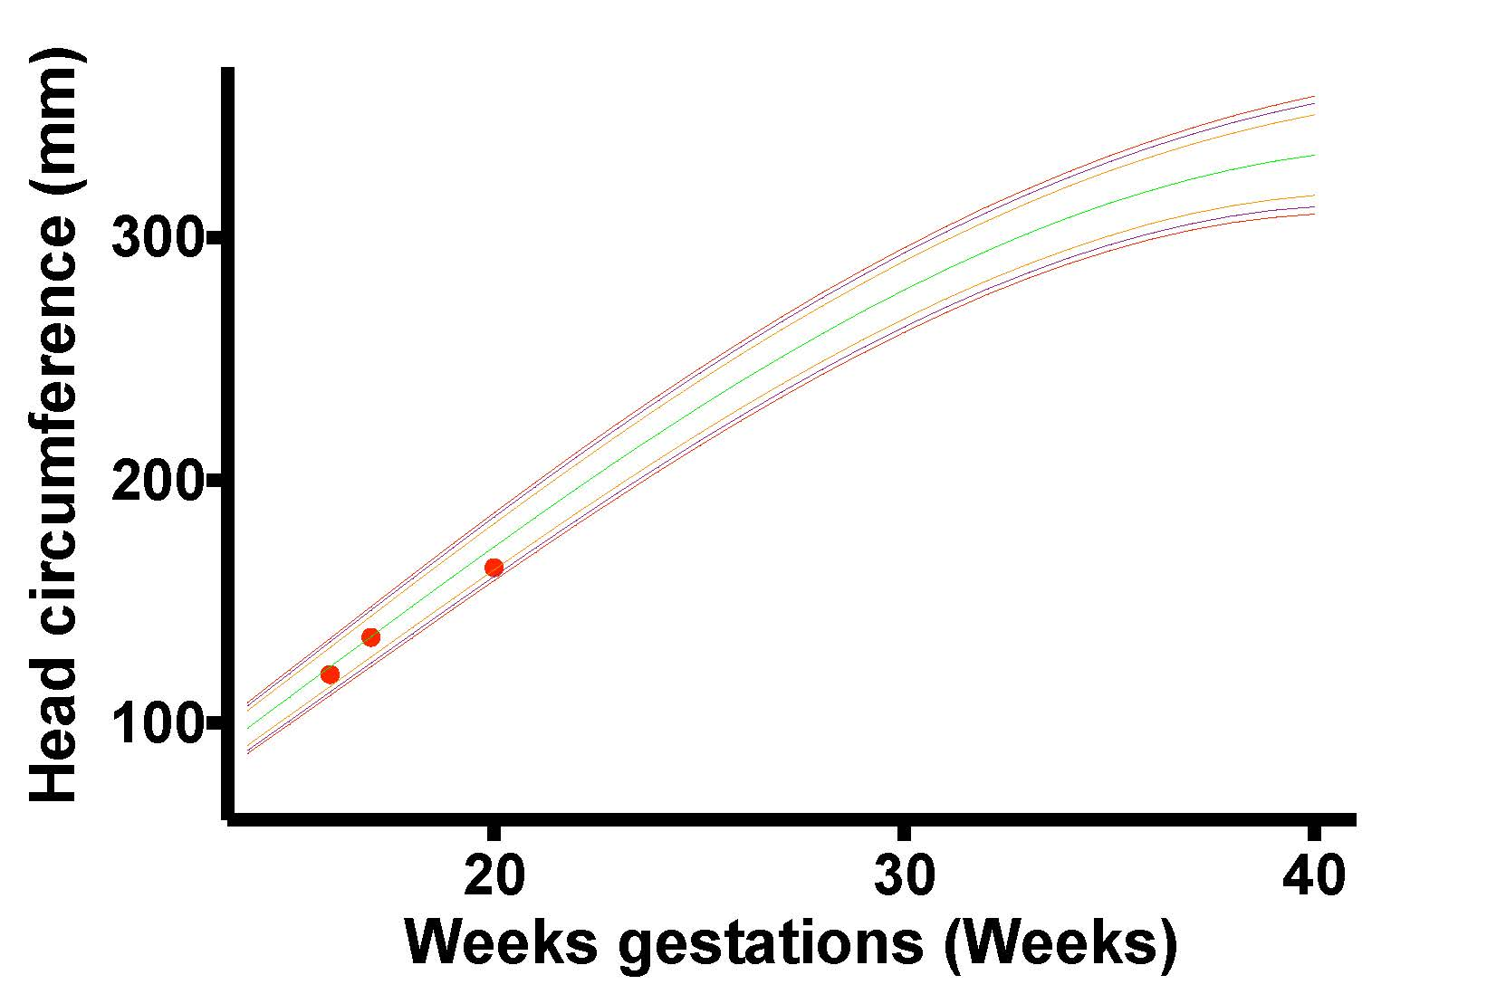
Prenatal Diagnosis of ZIKV
Decrease in centile from 47th at 17 weeks to 24th percentile at 20 weeks

Slide 54
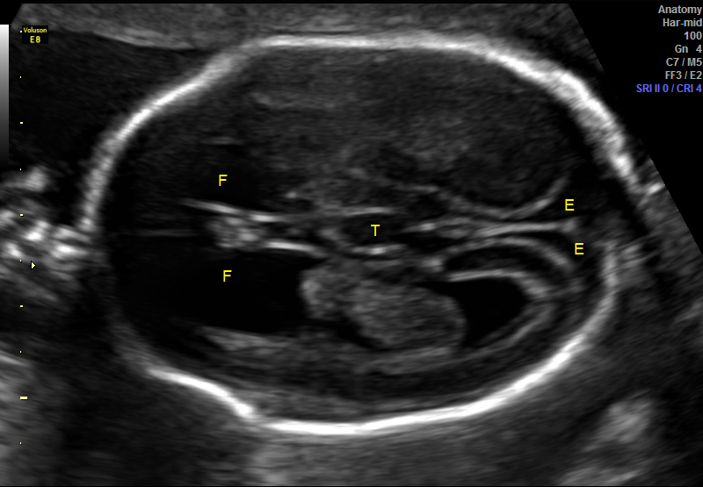
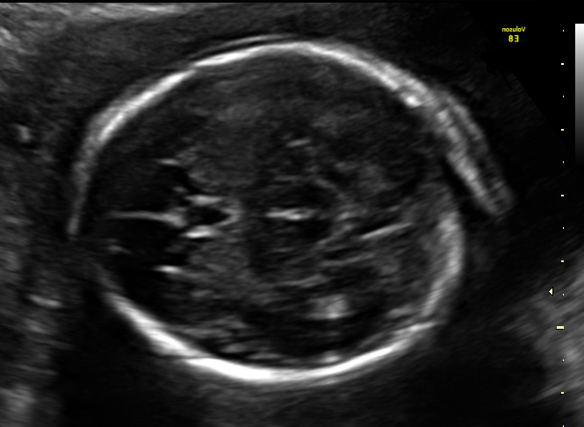
Prenatal Diagnosis of ZIKV
Notes:
The cerebral mantle appeared thin with increased extra-axial spaces.
Both frontal horns were enlarged with heterogeneous, predominantly echogenic material present in the frontal horn and body of the left lateral ventricle, concerning for intraventricular hemorrhage.
Dilation and upward displacement of the 3rd ventricle, dilation of the frontal horns of the lateral ventricles, concave medial borders of the lateral ventricles, and absence of the cavum septum pellucidi suggested agenesis of the corpus callosum.
No parenchymal calcifications were seen.
The remainder of the fetal anatomy was unremarkable.

Slide 55
Prenatal Diagnosis of ZIKV
Notes:
Fetal MRI performed the following day and confirmed the ultrasound findings.
In addition:
Diffuse atrophy of the cerebral cortical mantle most severe in the frontal and parietal lobes, with anterior temporal and occipital lobes least affected
Where the cortical mantle was abnormal, all 3 layers normally identifiable by MRI at this gestational age (cortical plate, subplate, and combined ventricular/subventricular zones) were atrophic

Slide 56
Prenatal Diagnosis of ZIKV
Notes:
The corpus callosum was significantly shorter than expected for gestational age, consistent with hypoplasia or atrophy.
The lateral ventricles were mildly enlarged As was the third ventricle (transverse diameter measured 2.5 mm with average measurement at gestational age 1.75 mm, expected range: 1.1 to 2.3 mm).¹⁸
The fourth ventricle was normal.
The volume of the choroid plexus was unusually prominent, without evidence of hemorrhage.
No focal destructive lesions were identified within the cerebral cortex or white matter.
The cerebellum was unremarkable in appearance and size.

Slide 57
Prenatal Diagnosis of ZIKV
13
16
17
57
Notes:
Given the grave prognosis, the patient elected to terminate the pregnancy at 21 weeks gestational age.

Slide 58
Neuropathology
Gross examination: normal fetal anatomy and severe autolysis
Gross evaluation of brain
  30 grams ( reference range 45.0 +/- 12.0 grams)
  No apparent gross abnormalities (limited by autolysis)
Placenta
  Several non-specific histomorphologic changes and chronic villitis
  Pigmented macrophages
  Focal calcifications
Notes:
A postmortem examination was performed with materials collected for additional virologic study.
Placenta:
- occasional pigmented macrophages in the decidua
focal calcifications along the decidual:chorionic junction.
Many villi were edematous, but overall villous development was appropriate for gestational age.
Consistent with the low grade pattern of chronic villitis consisting of prominent Hofbaur cells there were scattered avascular villi with prominent perivillous fibrin and intravillous hemosiderin. Small villous calcifications (linear subtrophoblastic calcium) were present. Occasional villous vessels had endoluminal apoptotic debris.
Features of fetal thrombotic vasculopathy, viral cytopathic changes and chorioamnionitis were not observed.
Classic histologic features
Perivascular inflammatory infiltrates
Viral inclusions
Ventriculitis

Slide 59
Neuropathology
  Abundant apoptosis primarily affecting intermediately differentiated post-migratory neurons in the neocortex
Parietal cortex
Unaffected occipital cortex
Notes:
Microscopic analysis
Unaffected occipital cortex is thicker than parietal cortex (bars)
Focal early mineralization seen in association with apoptotic neurons

Slide 60
Neuropathology
  Well-differentiated neurons of basal ganglia/limbic regions and primitive cells in germinal matrix appeared unaffected
Basal ganglia
Germinal matrix of ganglionic eminence
Notes:
In contrast, the well-differentiated neurons of the basal ganglia and limbic regions as well as cells in the germinal matrix appeared unaffected

Slide 61
Neuropathology
Subventricular zone and white matter showed severe volume loss
Cortex
Subcortical matter
White matter
  Axonal rarefaction
  Macrophage infiltrates
CD68 immunostain
Notes:
In addition to the cortical neuronal abnormalities, the subventricular zone and white matter showed severe volume loss with extensive axonal rarefaction and macrophage infiltrates highlighted by CD68 immunohistochemistry
This pattern correlates with the atrophy of the subplate seen on prenatal imaging.

Slide 62
ZIKV viral loads
Fetal
  Highest in fetal brain, membranes, umbilical cord, and placenta
  Muscle > liver > lung > spleen
Maternal
  Serum positive (low viral load) day before delivery
  Serum, peripheral blood mononuclear cells, saliva, and urine negative 11 and 13 days after delivery
Spouse
  ZIKV IgG and IgM positive 5 weeks after travel
  Sera ZIKV RNA negative 5 and 11 weeks after travel
  Urine ZIKV RNA negative 11 weeks after travel
  Semen ZIKV RNA negative at 10 and 12 weeks after travel

Slide 63
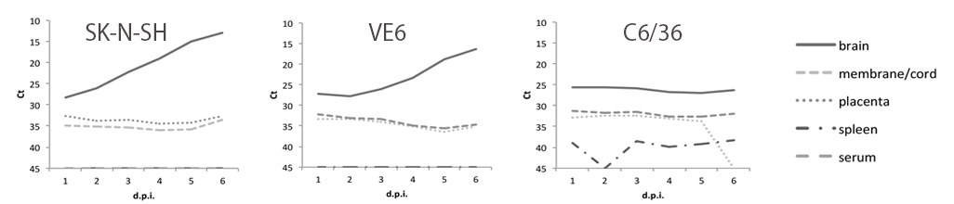
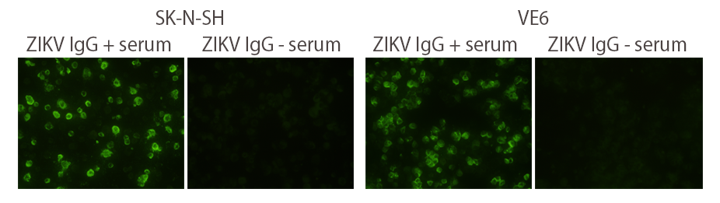
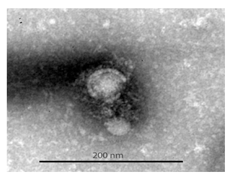
Viral Replication
Demonstrating presence of infectious ZIKV
Notes:
To demonstrate the presence of infectious pathogen (ZIKV) in the fetal samples, human neuroblastoma cells (SK-N-SH), Vero E6 cells (monkey kidney epithelial cells commonly used for arbovirus isolation) and C6/36 mosquito cells were inoculated with the fetal tissue samples.
ZIKV replication was detected by ZIKV RT-qPCR in fetal brain-inoculated SK-N-SH and Vero E6 cells, but not in C6/36 mosquito cells.
The ZIKV RNA quantities increased rapidly in human neuroblastoma (SK-N-SH) cells after the first day of inoculation, whereas in Vero E6 cells, viral RNA loads started to increase after day 4 post inoculation
Viral replication was not detected in cells inoculated with spleen, fetal membranes, umbilical cord or placenta samples.
The tissue-inoculated SK-N-SH and Vero E6 cells were further demonstrated to express ZIKV antigens by reactivity with sera of ZIKV-infected human sera in immunofluorescence staining and to produce particles resembling flaviviruses by electron microscopy

Slide 64
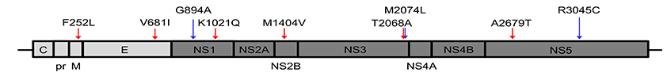
ZIKV Genome Sequencing
Complete ZIKV genome sequenced from SK-N-SH cell supernatant
Phylogenetic analysis
  Member of Asian genotype
  Closely related to two ZIKV sequences from Guatemala patients presenting with mild illness
  8 amino acid differences, 5 were specific to this strain
Notes:
Complete ZIKV genome was sequenced from SK-N-SH cell supernatant collected 5 days after inoculation with fetal brain sample.
Phylogenetic analysis indicated that this virus strain (designated ZIKV_FB-GWUH-2016; KU870645) was a member of the Asian genotype and closely related to two ZIKV sequences from Guatemalan patients presenting mild illness (Fig)
FB-GWUH-2016 strain had 23-51 nucleotide (nt) and 8-14 amino acid (aa) differences (99.6-99.8% similarities) to the ZIKV strains detected previously in the Americas.
The positions of aa differences in ZIKV polyprotein are shown in Figure
Out of the 8 aa differences between FB-GWUH-2016 and the Guatemalan strains, 5 were specific for the FB-GWUH-2016 strain (i.e. have not been detected in other ZIKV strains sequenced so far).
One aa substitution was a reversion towards the African ZIKV-genotype. Three amino acid substitutions were common for FB-GWUH-2016 and the Guatemalan strains, but distinct from all other ZIKV strains.

Slide 65
Discussion
Microcephaly and intracranial calcifications are late findings
  Cortical atrophy
  Ventriculomegaly
  Dysgenesis of the corpus callosum
Persistent ZIKV viremia/RNAemia in the mother
  Virus replication in fetus and/or placenta
  Diagnostic modality for ongoing fetal infections
Histopathological findings
  Loss of intermediately differentiated post-migratory neurons through an apoptotic mechanism
  Preservation of more differentiated neurons in basal ganglia, limbic region, dorsal spine, primitive cells in germinal matrix
Notes:
Significance of our study:
- Microcephaly and intracranial calcifications are late findings
Since the fetus and placenta harbored high viral loads, we believe it likely that the persistent ZIKV viremia/RNAemia in the mother is a consequence of virus replication in the fetus or placenta.
Therefore, in addition to ZIKV diagnostics already in place, highly sensitive RT-qPCR methods can potentially serve as a diagnostic modality for ongoing placental and/or fetal infections in pregnant women.
Notably, in this patient, the ZIKV RNA levels were higher in the maternal serum than in the amniotic fluid. The dynamics of ZIKV RNA in sera of infected pregnant women are obviously not well understood, and will need to be assessed in larger studies.
This paper is an early foray into the histopathological findings associated with ZIKV in the midgestational fetal brain.
The overwhelming findings were of loss of intermediately differentiated post-migratory neurons through an apoptotic mechanism.
There appeared to be preservation of more differentiated neurons in basal ganglia, limbic region and dorsal spinal cord. The germinal matrix cells also appeared spared. Of note, the germinal matrix consists predominantly of glioblasts at mid-gestation with the majority of the neuroblasts having already migrated out of the zone.
While we were unable to evaluate neuronal precursor subtypes other than calretinin-expressing interneuron lineage cells, selective neuronal vulnerability to ZIKV injury would be an intriguing concept that requires further investigation.
Our report is the first study to demonstrate successful isolation of infectious ZIKV from human fetal tissues. Obtaining a ZIKV isolate directly from fetal brain, with demonstration of the mother's acute infection and persisting ZIKV RNA positivity in serum, fulfills the second Koch's postulate on pathogen isolation from diseased organ and provides further evidence of causal relationship between congenital ZIKV infection and fetal brain damage. While several fetal organs showed presence of ZIKV RNA, and high viral loads were found in the placenta, ZIKV could only be isolated from brain tissue that had the highest ZIKV RNA load among all organs. The virus isolation was successful with the VeroE6 cells that are commonly used for arbovirus isolation; however, the virus grew more readily in a human neuroblastoma cell line (SK-N-SH). This suggests a predilection of the ZIKV strain for human neural lineage cells, and potentially for cells that are less differentiated. Interestingly, a recent study utilizing a sophisticated human stem cell culture system demonstrated a high ZIKV infection rate in cortical neural progenitor cells, but not in embryonic or pluripotent stem cells.³⁰ The findings are consistent with our observation in human fetal brain and neuroblastoma cell line that less differentiated neuronal lineage cells may be most susceptible to ZIKV infection. The phylogenetic analysis of the full ZIKV genome showed that the strain isolated (FB-GWUH-2016) in this case is closely related to Guatemalan ZIKV strains. This is consistent with the anamnestic knowledge on the likely geographical origin of the infection. The high frequency of non-synonymous vs. synonymous substitutions in FB-GWUH-2016 genome (as compared to Guatemalan strains from patients with mild illness) (Supplementary Figure S4) raises an intriguing question whether the virus has evolved genetically to adapt for efficient replication in brain tissue. The 8 amino acid substitutions seen between FB-GWUH-2016 and Guatemalan ZIKV strains are potential viral determinants for ZIKV adaptation to fetal brain (or the neuroblastoma cell line). Of note, none of the amino acid changes were identical to previously reported alterations in ZIKV genome sequenced from formalin-fixed fetal brain tissue.¹⁰

Slide 66
Discussion
Virus isolation
  Suggests a predilection of ZIKV strain for human neural lineage cells and potentially for less differentiated cells
First to demonstrate isolation of infectious ZIKV from human fetal tissues
Fulfilled Koch’s second postulate supporting causal relationship
  Zika RNA found in serum of mother following acute infection
  ZIKV isolated from fetal brain
Phylogenetic analysis
  Closely related to Guatemalan strains
  8 amino acid substitutions potential viral determinants for ZIKV adaptation to fetal brain
Notes:
Significance of our study:
While we were unable to evaluate neuronal precursor subtypes other than calretinin-expressing interneuron lineage cells, selective neuronal vulnerability to ZIKV injury would be an intriguing concept that requires further investigation.
Our report is the first study to demonstrate successful isolation of infectious ZIKV from human fetal tissues.
Obtaining a ZIKV isolate directly from fetal brain, with demonstration of the mother's acute infection and persisting ZIKV RNA positivity in serum, fulfills the second Koch's postulate on pathogen isolation from diseased organ and provides further evidence of causal relationship between congenital ZIKV infection and fetal brain damage.
The virus isolation was successful with the VeroE6 cells that are commonly used for arbovirus isolation; however, the virus grew more readily in a human neuroblastoma cell line (SK-N-SH).
This suggests a predilection of the ZIKV strain for human neural lineage cells, and potentially for cells that are less differentiated.
The phylogenetic analysis of the full ZIKV genome showed that the strain isolated (FB-GWUH-2016) in this case is closely related to Guatemalan ZIKV strains. This is consistent with the anamnestic knowledge on the likely geographical origin of the infection. The high frequency of non-synonymous vs. synonymous substitutions in FB-GWUH-2016 genome (as compared to Guatemalan strains from patients with mild illness) raises an intriguing question whether the virus has evolved genetically to adapt for efficient replication in brain tissue. The 8 amino acid substitutions seen between FB-GWUH-2016 and Guatemalan ZIKV strains are potential viral determinants for ZIKV adaptation to fetal brain (or the neuroblastoma cell line). Of note, none of the amino acid changes were identical to previously reported alterations in ZIKV genome sequenced from formalin-fixed fetal brain tissue.

Slide 67
More questions than answers
Does prior infection confer immunity?
What if my newborn contracts Zika?
When during pregnancy Zika virus infection poses the highest risk to the fetus?
67
Notes:
As it stands now, we have many more questions than answers about Zika virus especially as it relates to pregnancy. The CDC issues weekly updates in their MMWR to try to keep us informed. Thank you for your attention. I welcome your questions.

Slide 68
ZIKV - More questions than answers
Thank you!
Notes:
As it stands now, we have many more questions than answers about Zika virus especially as it relates to pregnancy. The CDC issues weekly updates in their MMWR to try to keep us informed. Thank you for your attention. I welcome your questions.

