Slide 1
Pet and Animal Emergency Planning

Slide 2
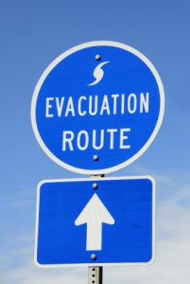
Planning for animal evacuation
If you must leave your residence, have a plan for your family pets;
Go online and locate several "pet-friendly" hotels in and out of your area;
Identify friends or relatives outside your area where you and your pets can stay;
If there is a disaster pending, evacuate early with your pets, working animals and livestock; don't wait for a mandatory evacuation order; and
Animals should have leg bands or tattoos, microchips or identification tags with their name as well as your address and phone number.

Slide 3
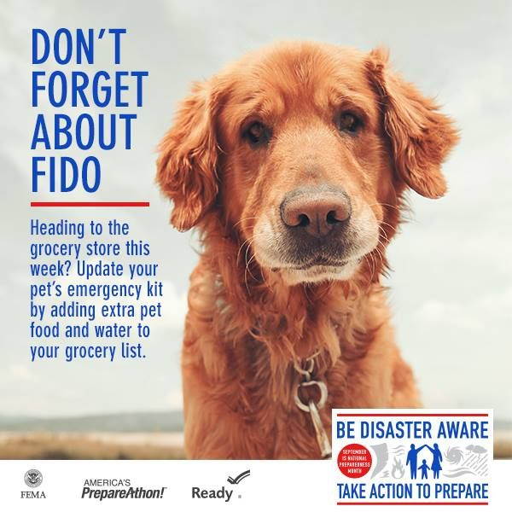
Plan for Your Risks
There are actions that should be taken before, during and after an event that are unique to each hazard. Identify the hazards that have happened or could happen in your area and plan for the unique actions for each. Local Emergency management offices can help identify the hazards in your area and outline the local plans and recommendations for each. Share the hazard-specific information with family members and include pertinent materials in your family disaster plan.

Slide 4
Tailor your plan to your needs
As you prepare, tailor your plans and supplies to your specific daily living needs and responsibilities. Most or all individuals have both specific personal needs as well as resources to assist others. You and your household and others you help or rely on for assistance should work together.
As part of tailoring your plans, consider working with others to create networks of neighbors, relatives, friends and co-workers who will assist each other in an emergency. Discuss your needs and responsibilities and how people in the network can assist each other with communication, care of children, pets, or specific needs like the operation of durable medical equipment. Create your own personal network for specific areas where you need assistance.

Slide 5
Putting together an animal emergency kit
Three weeks worth of water and food stored with a can opener in a waterproof container;
Toys, treats and bedding because familiar items may reduce stress for your pet;
Medications, medical records and your veterinarian's name and telephone number;
Current photos of you with your family pets;
Sturdy leashes, harnesses, and/or carriers to move pets safely and securely;
Litter, litter box, newspapers, paper towels, plastic trash bags and household chlorine bleach for sanitation; and
First aid supplies such as cotton bandage rolls, tape, scissors, antibiotic ointment, flea/tick prevention, latex gloves, alcohol, saline solution as well as a pet first aid reference book.

Slide 6
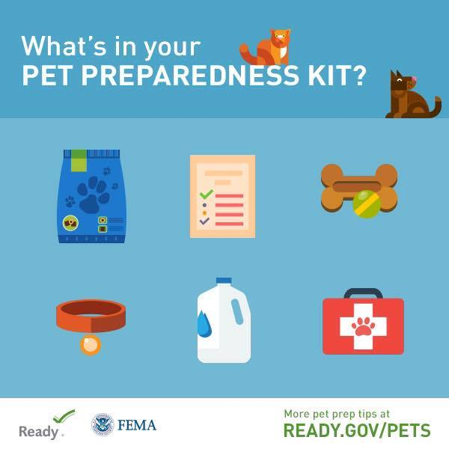
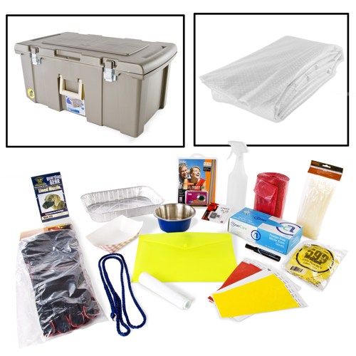
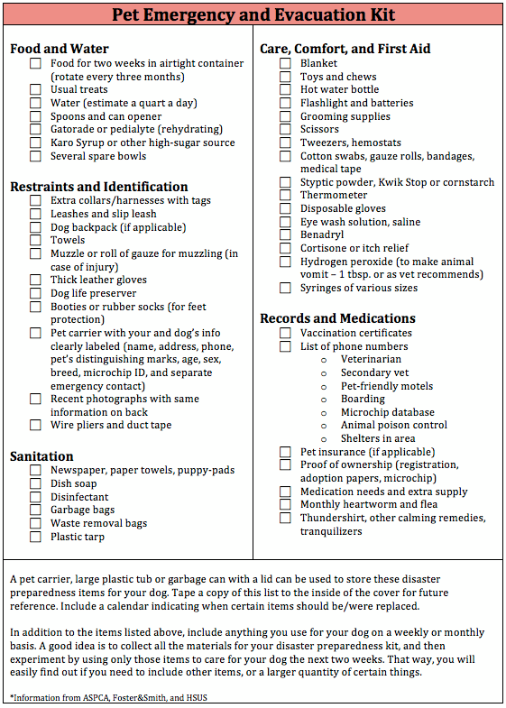
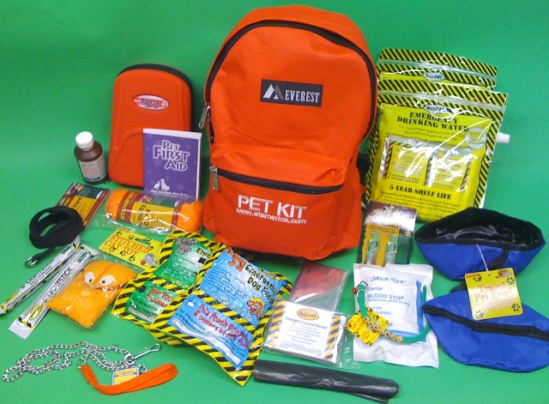

Slide 7
Items to consider
Pet food
Bottled water
Medications
Veterinary records
Cat litter/pan
Manual can opener
Food dishes
First aid kit and other supplies
Make sure you have a secure pet carrier, leash or harness for your pet so that if he panics, he can't escape.

Slide 8
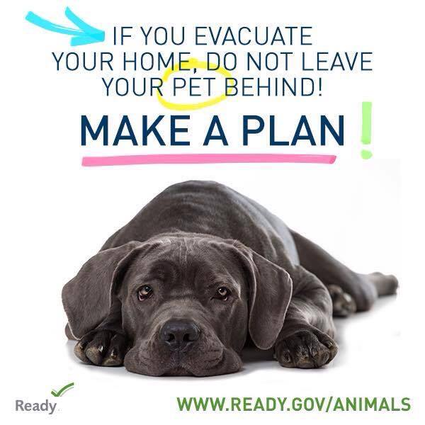

Slide 9
Protect your Pet during disasters
Bring your pets inside immediately.
Have newspapers on hand for sanitary purposes. Feed animals moist or canned food so they will need less water to drink.
Animals have instincts about severe weather changes and will often isolate themselves if they are afraid. Bringing them inside early can stop them from running away. Never leave a pet outside or tied up during a storm.
Separate dogs and cats. Even if your dogs and cats normally get along, the anxiety of an emergency situation can cause pets to act irrationally. Keep small pets away from cats and dogs.
In an emergency, you may have to take your birds with you. Talk with your veterinarian or local pet store about special food dispensers that regulate the amount of food a bird is given. Make sure that the bird is caged and the cage is covered by a thin cloth or sheet to provide security and filtered light.
If you evacuate your home, DO NOT LEAVE YOUR PETS BEHIND! Pets most likely cannot survive on their own and if by some remote chance they do, you may not be able to find them when you return.
If you are going to a public shelter, it is important to understand that animals may not be allowed inside. Plan in advance for shelter alternatives that will work for both you and your pets; consider loved ones or friends outside of your immediate area who would be willing to host you and your pets in an emergency.
Make a back-up emergency plan in case you can't care for your animals yourself. Develop a buddy system with neighbors, friends and relatives to make sure that someone is available to care for or evacuate your pets if you are unable to do so. Be prepared to improvise and use what you have on hand to make it on your own for at least three days, maybe longer.

Slide 10
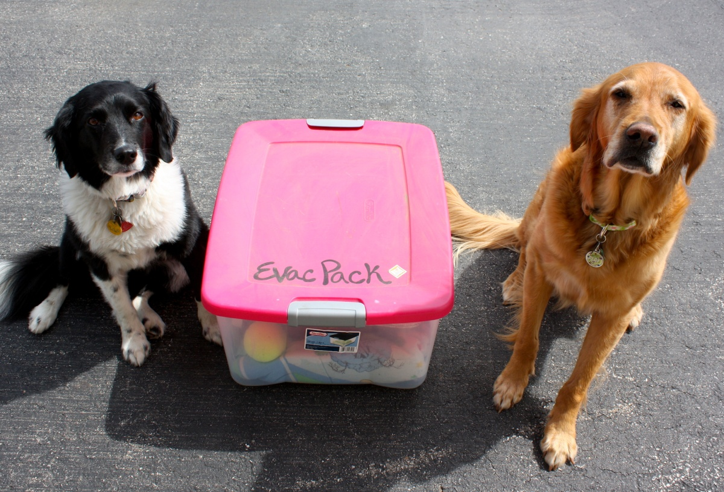

Slide 11
Caring for your Pet after a disaster
If you leave town after a disaster, take your pets with you. Pets are unlikely to survive on their own.
In the first few days after the disaster, leash your pets when they go outside. Always maintain close contact. Familiar scents and landmarks may be altered and your pet may become confused and lost. Also, snakes and other dangerous animals may be brought into the area with flood areas. Downed power lines are a hazard.
The behavior of your pets may change after an emergency. Normally quiet and friendly pets may become aggressive or defensive. Watch animals closely. Leash dogs and place them in a fenced yard with access to shelter and water.

Slide 12
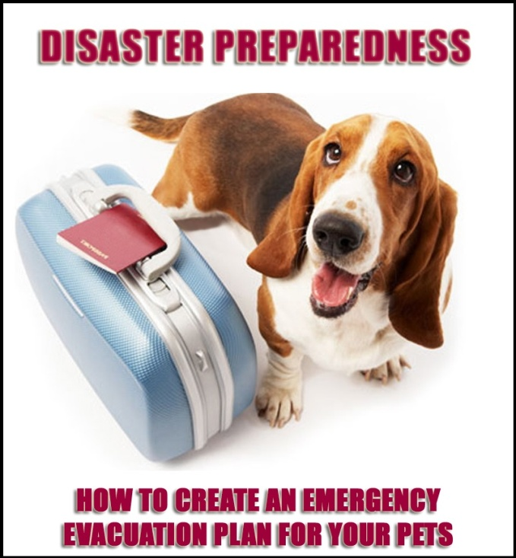

Slide 13
Planning for safe animal transportation
Get family pets used to being placed in a carrier or crate;
Prepare to move birds, snakes, lizards, ferrets and "pocket pets" like hamsters and gerbils in secure cages or carriers;
Prepare for extreme weather conditions. Include blankets, ice packs, heating pads and a water mister in your kit;
Obtain "Pets Inside" stickers at www.ASPCA.org and place stickers on doors or windows with the number and types of pets in your home and a phone number where you can be reached. If time permits, remember to write "Evacuated with Pets" across the stickers if you flee with your pets.

Slide 16
Thank You!
Frank Ruggiero
Deputy Director
Jessamine County Animal Care & Control
fruggiero@jessamineco.com

