Slide 1
Project CARAT: Coordinating and Assisting the Reuse of Assistive Technology

Slide 2
What is CARAT?
CARAT is a project that collects, refurbishes, and redistributes assistive technology and durable medical equipment to improve the health and quality of life of individuals with disabilities in the Commonwealth.

Slide 3
What is CARAT?
“Closing the Gap” service
Not trying to replace DME dealers
Equipment provided typically for:
Individuals who are underinsured
Individuals who cannot meet their copays for AT/DME
Items not covered by insurance
Temporary needs, while waiting for permanent equipment
When need replacement equipment “between” allowable time periods
When AT/DME is lost in a disaster (fire, flood, etc.)

Slide 4
How did CARAT start?
Health Resources and Services Administration (HRSA) Grant # D04RH23586
Office of Rural Health Policy
Rural Health Care Services Outreach Grant
3 years – May 2012 through April 2015
Covered 56 counties in rural eastern Appalachian KY
Two refurbishing sites, Thelma and Hazard
Original Partners:
KARRN- Kentucky Appalachian Rural Rehabilitation Network
OVR
UK PT Program
KATS Network

Slide 5
CARAT Now
Funding through KATS NETWORK
In-Kind contributions from partners
Covers all 120 counties in KY
Two new refurbishing sites in Paducah & Louisville
The 2 original sites continue to flourish in Thelma & Hazard
New Partners include: Lourdes Hospital, Paducah; CAL Murray; West KY Community & Technical College, Paducah & Spalding University/ Entech, Louisville

Slide 6
CARAT a solution to Problems:
Medically underserved communities- both urban and rural
Insurance Barriers
DME/AT not covered
Co-pay too expensive
Unreasonable deductibles
AT/DME needed for short term
Natural Disaster resource for replacement DME and cleaning/refurbishing damaged DME

Slide 7
Project Goals:
Expand and grow AT/DME reutilization program throughout Kentucky
Develop network of partners to allow for effective collection, refurbishing, and redistribution of AT/DME
Raise community awareness of AT/DME & Project CARAT

Slide 8
THE ROAD TO LONG TERM SUCCESS
Building capacity to provide AT/DME
Expansion of the Refurbishing Program
Added new sites to meet needs of target population
Addition of centrally located site (Spalding/EnTech, Louisville) and far western (Lourdes Hospital, Paducah)
Service Learning Approach
Students do the work
Educational Benefit
Better prepared to function in their jobs

Slide 9
UK PT Program: Students have a better understanding of the types of AT and DME available when they enter the workforce. Students are able to assess, repair, and clean AT/DME. Students have AT/DME available for free Clinic.
Students Cleaning Wheelchairs

Slide 10
CDPVTC Program: Students learn skills in cleaning AT/DME. Students develop basic work skills, such as taking direction, being on time, getting along with coworkers, etc. Students have the opportunity to give back.
Project CARAT Room at CDPVTC

Slide 11
Kentucky Assistive Technology Locator
www.katsnet.at4all.com
Lists all equipment available for reuse

Slide 12
So, what does CARAT have?
Manual wheelchairs
Power wheelchairs
Scooters
Shower chairs
Walkers
Canes
Crutches
Hospital Beds

Slide 13
Roles of Partners: *Identifying individuals who need AT/DME *Finding used AT/DME *Storing DME *Transporting DME *Distributing DME *Refurbishing Center *Raise public awareness
Lourdes Hospital’s in kind donation of space for CARAT

Slide 14
SUSTAINABILITY
Involvement of the Larger Community
Continue to find ways to let people know about the project
Identify new potential partners/partner groups
Demonstrate value to Medicaid, Medicare, private insurers and hospitals
Cost savings and return on investment to insurance and hospitals
Media
Share
Success Stories

Slide 15
Return on Investment
Other Benefits:
Increased independence
Remain at HOME – not assisted living
Fewer ER Visits
Earlier discharge from hospitals
Reduce need for rehabilitation facility admissions
Avoided Costs
Landfill/ Positive environmental Impact
Lost Work Time

Slide 16
SUSTAINABILITY
Addressing Identified Barriers
SPACE
NETWORK DEVELOPMENT
Maintain the appropriate flow of AT/DME
TRANSPORTATION
PROFESSIONAL STAFF TIME

Slide 17
Statistics
Project CARAT has served over 160 consumers.
Project CARAT has received over 1,600 donated items.
Since 2012, CARAT has helped 308 people in Kentucky by providing them with 706 pieces of free medical equipment valued at over $298,000.

Slide 18
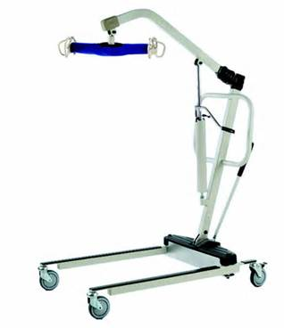
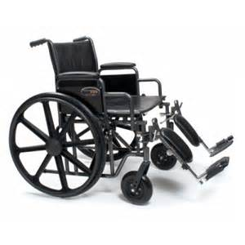
Courtney: Equipment lost due to fire. Approximate value: lift: $700 shower bench: $125 wheelchair: $550 TOTAL: $1375
Some of her equipment

Slide 19
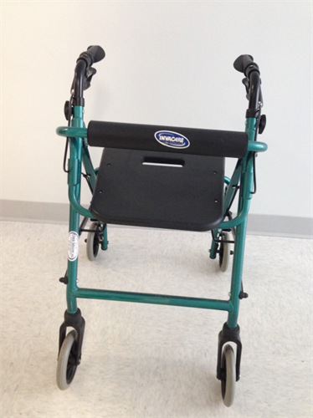
Dignity/ Independence: Allowed consumer’s grandmother independence to make her own choices in her home: to go to bathroom alone, get out of bed without asking for help, go into kitchen. Value Priceless: RETAIL: $70 to $240
Rollator

Slide 20
Project CARAT contacts
If you have equipment to donate or need some assistive technology or durable medical equipment, contact Project CARAT by telephone at
800-327-5287
or visit our website at
ProjectCARAT.org.

Slide 21
Sheila Levy
Sheila Levy, the Outreach Coordinator can also be contacted by telephone (502-254-1939, extension 233) or by email (Sheila.Levy@ky.gov) anytime if you have input about the project, other agencies to contact, speaking opportunities, or would like to make a donation to Project CARAT.

