Slide 1
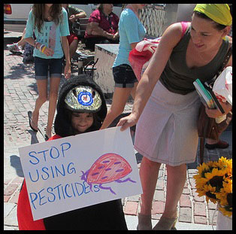
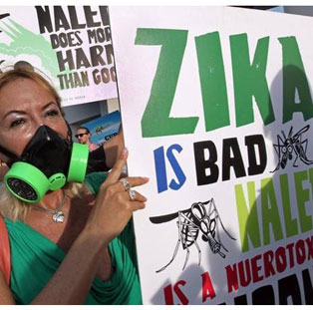
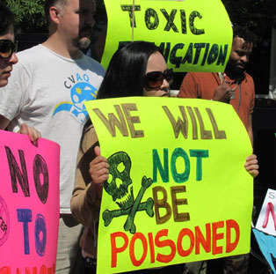
A Risk Communications Approach to Talking About Zika and Pesticides
By Richard Levine

Slide 2
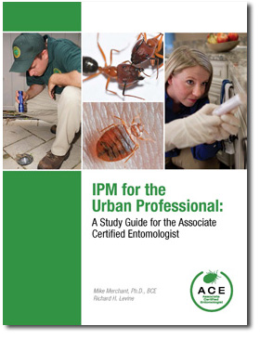
Richard Levine
– Co-author of IPM for the Urban Professional: A Study Guide for the Associate Certified Entomologist
– Managed communications program at Entomological Society of America from 2006-2016.
– Background in agricultural issues, science writing, and risk communications.

Slide 3
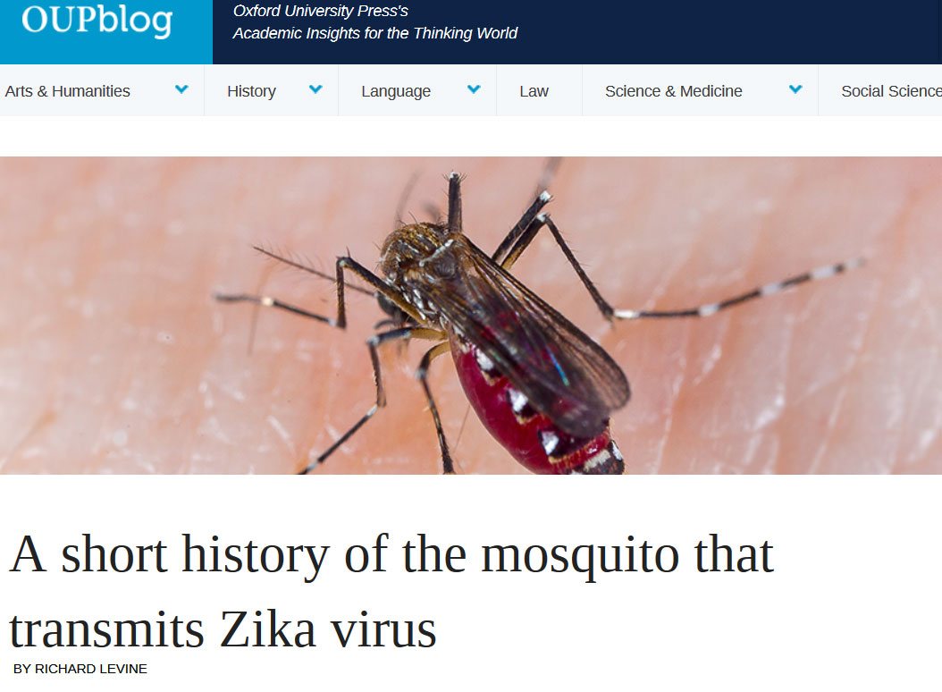
https://blog.oup.com/2016/02/history-zika-virus-mosquito/

Slide 4
Topics of this Presentation
1) General rules of science communications; how to make complex scientific issues easier for non-scientists to understand.
2) How to use Risk Communications to speak about contentious issues when people are frightened or concerned.
3) Examples related to Zika, pesticides, and other relevant issues.

Slide 5
General Science Communication Rules
– Avoid scientific/technical language and jargon, use plain language.
– Try to use simple explanations, comparisons, stories, and real-life examples that everyone can relate to.
– Try to keep it so simple that even a 14-year-old child can understand.

Slide 6
Avoid Technical Terms and Jargon
Avoid
- Proboscis
- Oviposits
- Ecdysis
- Sclerotized
Use instead
- Beak, mouth, mouth part
- Lays eggs, deposits eggs - Sheds skin, molts - Hardened

Slide 7
Simple Explanations, Real-life Examples
Acute toxicity vs. chronic toxicity
Acute toxicity = short-term toxic effect. Chronic toxicity = long-term effects of a substance.
“For example, the acute toxicity of smoking a single cigarette is relatively low (though it might make a ﬁrst-time user ill). However, there is a signiﬁcant risk of chronic toxicity to a person who smokes cigarettes for many years (cancer, heart disease, etc.).”

Slide 8
Comparisons
Parts per Million (PPM) or Parts per Billion (PPB)
- One part per billion is one second in 32 years.
- One part per billion is one inch in 16,000 miles.
- One part per million is one second out of 12 days.
- One part per million is one inch in 16 miles.

Slide 9
Comparisons
Malaria Example
“Nearly half of the world's population is at risk of malaria. In 2015, there were roughly 212 million malaria cases and an estimated 429,000 malaria deaths.”
- The World Health Organization (December 2016)
Each 75 seconds, someone dies from malaria.

Slide 10
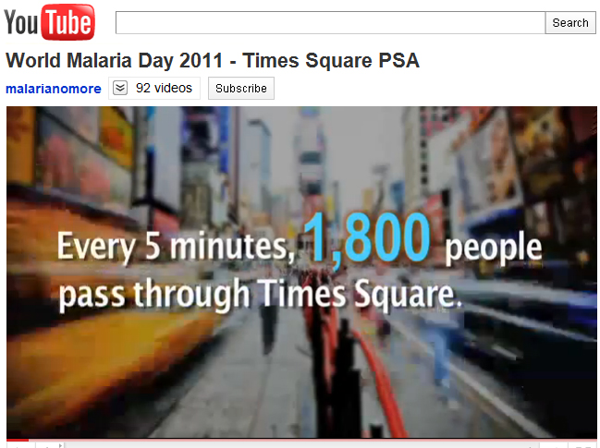
Comparisons

Slide 11
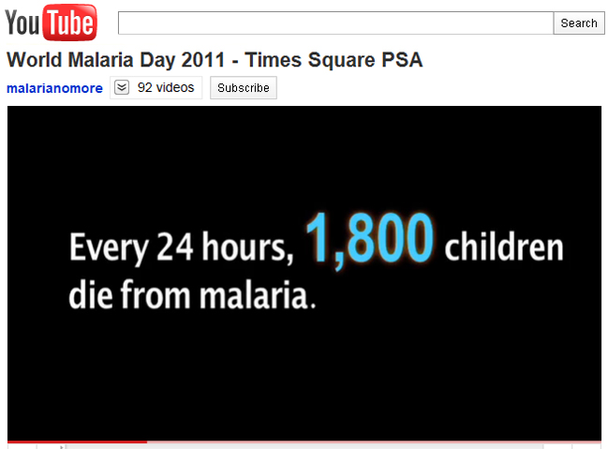
Comparisons

Slide 12
Risk Communications

Slide 13
Risk Communications
Risk communications are a collection of techniques developed by social scientists in order to effectively communicate controversial or sensitive information with people who feel threatened, frightened, or otherwise concerned.
People who feel threatened or concerned are often emotional and will interpret information differently than they would otherwise.
In these cases, data and facts are not enough. Instead, one must first establish a sense of trust and empathy with the audience.

Slide 14
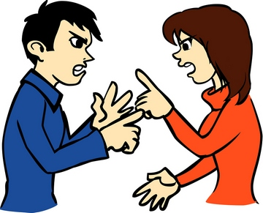
Results of failed risk communication
Frustrated scientists, regulators, and industrialists think the public makes irrational or ignorant judgments.
The public thinks that risks are under-estimated to serve someone else’s purposes, not their own.
NOTE: This slide was “borrowed” from Kaci Buhl, Oregon State University.

Slide 15
When people are upset they …
- Often distrust others, and may perceive them to be dishonest, uncaring, and/or incompetent (Trust determination theory). - Have difficulty hearing, understanding, and remembering (Mental noise theory).

Slide 16
Risk Communications Basics
Communicate effectively by …
Using general science communication rules (avoiding technical language and jargon, using plain language).
In addition, it is crucial to establish: - trust - empathy - credibility - transparency
Notes:
You can provide all the facts and data in the world, but it won’t be enough.

Slide 17
Notes:
If you jump the force of gravity will cause you to fall at approximately 32 feet per second until you collide with the concrete below, which would result in broken bones, damage to the brain, loss of blood, ……. Instead, empathy must be established? Why are you sitting there? Your girlfriend left you? Man, I’m sorry to hear that. I can understand what you’re going through…

Slide 18
Establishing Trust and Empathy
People don’t care how much you know until they know how much you care.
Perception is reality.
You don’t get a second chance to make first impressions (including clothing, body language, and general appearance).
Notes:
Body language and appearance can be important for the third point.

Slide 19
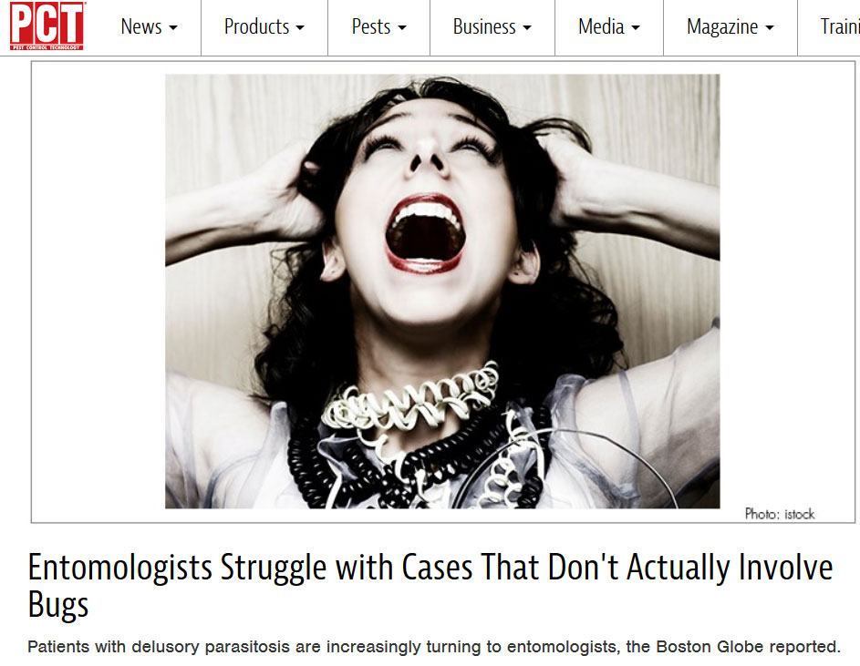
Delusory Parasitosis

Slide 20
Delusory Parasitosis Example
Remember, Perception is Reality …
"I have been suffering bites from some type of parasite which apparently lives under my skin. I have been to several doctors who want to see the bugs and cannot see them. However, they are very real!!!! I also found them in the bottom of a dishpan ... This one I KNOW is a parasite as I actually watched two of them emerge from my chest after soaking in a bath.”
- Actual email message sent to Entomological Society of America

Slide 21
Delusory Parasitosis Example
Response to email message:
“Medical entomologists have told me that sometimes people have allergies, or microfibers in their pores that cause irritation and they think they are being bitten by insects. Perhaps you should see a dermatologist … Please do not take this the wrong way, but there is something called “Delusionary Parasitosis” that sometimes affects people, especially when they are under stress. In fact, my step-brother once suffered from it after his mother died when he was young …”

Slide 22
Establishing Credibility
Education, publications, research, projects awards, titles, etc.
For scientists and subject-matter experts, credibility is usually easier to establish than empathy.
- For others, the opposite is usually true, but credibility can be established by citing higher sources. - Women often seem more empathetic than men, depending on culture.

Slide 23
Cite Higher Sources
“According to the EPA, these products are safe for people and the environment when used correctly .”
“According to the World Health Organization …”
“According to the U.S. Centers for Disease Control …”

Slide 24
Avoid Negatives
- Avoid sounding arrogant or condescending.
- Do not attack opposition or belittle their concerns.
Choose language carefully, avoid scary terms and words if possible (dangerous, toxic, poison, etc.).
- Do not use humor or try to be flippant. - Avoid using negative words like “no, not, never, nothing, nobody, none, etc.” - Do not repeat negative statements.
Notes:
Arrogant – If only you’d gone to Harvard and studied toxicology, then you might understand… Humor – After 27 years of marriage I can assure you this doesn’t work. If you don’t believe me, try making a joke after your wife asks you to take out the garbage for the seventh time.

Slide 25
Do Not Repeat Negative Statements
QUESTION: Why are you spraying chemicals that poison the environment and our children?
BAD ANSWER: We are NOT poisoning the environment and we are NOT harming children …”
GOOD ANSWER: “Our products are perfectly safe when used as directed …”
GOOD ANSWER: “According to the EPA, these products are safe for people and the environment ... “
Notes:
Like answering “Do you still beat your wife?”

Slide 26
Negative Dominance Theory
- Negative information carries much more weight than positive information.
- At least three positives are needed to counteract one negative.
N = 3P
One Negative = Three Positives
(To overcome negatives = 4P)
Notes:
Think of Trump, Clinton or someone else. … 1 Donated money to a charity, 2 gave blood at the local red cross, 3) adopted a homeless puppy.

Slide 27
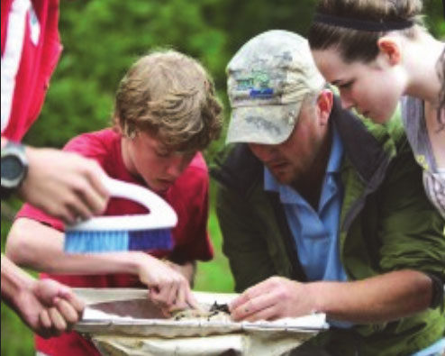
Avoid Scary Language and Images
- Cold - Sterile - Lab suits - Steel and glass - Equipment - Machines - Technology - Foreign - Unfamiliar
- Warm - Outdoors - Women - Children - Green - Plants - Nature - Familiar
Notes:
Think of this when designing brochures, websites, etc.

Slide 28
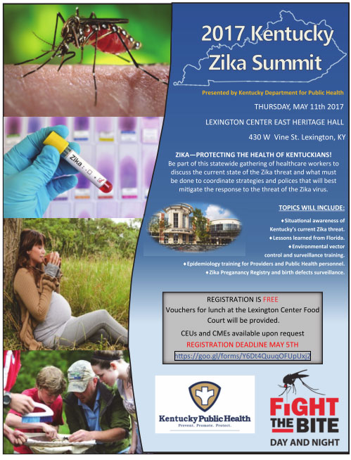
Notes:
Think of this when designing brochures, websites, etc.

Slide 29
Possible Contentious Issues for Mosquito Control Personnel
- Pesticide sprays (backpack fogging, vehicle mounted sprayers, aerial spraying) - Larvicides - Genetically modified mosquitoes - Wolbachia-infected mosquitoes
- Environmental issues (honey bees and other non-target organisms)

Slide 30
Anti-pesticide Activist Organizations
- Greenpeace
- Friends of the Earth
- Center for Food Safety
- Pesticide Action Network
- Union of Concerned Scientists
- NoSpray.org
- Organic Consumers Association
- Center for Biological Diversity - Beyond Pesticides - Institute for Agriculture and Trade Policy
- Beyond Toxics
- EarthFirst
- Environmental Defense
- Food and Water Watch
- Environmental Working Group
- Natural News
- Our Stolen Future
- The Ruckus Society
- Hundreds more...
Notes:
Why are people scared? This should explain it partially.

Slide 31
Anti-pesticide Activists on Social Media

Slide 32
Aerial Spraying in South Carolina
August 2016
Notes:
Summerville, SC. Some beekeepers claimed they were not notified prior to spraying. Not pointing fingers here. The take-away lesson is that it made the news and made people concerned.

Slide 33
Spraying in Northern Kentucky
Notes:
Perception is reality. People did not have a sense of transparency. In this and the SC case, the community did not feel that it was properly prepared for the spraying.

Slide 34
Spraying in Northern Kentucky
- This is not just about pesticides. - Privacy issues. - Transparency issues. - “If those pesticides are so safe, why didn’t you tell us you were spraying them?
Notes:
Perception is reality. People did not have a sense of transparency. In this and the SC case, the community did not feel that it was properly prepared for the spraying.

Slide 35
Establishing Trust and Empathy
QUESTION: Why are you spraying chemicals that poison the environment and our children?
"As someone who applies pesticides and may be exposed to them, I take safety very seriously ...“ "As a mother of two children, I can see why people might be worried. However ..."
"As an avid fisherman, I care a great deal about the environment, and therefore ..."

Slide 36
Bifenthrin Adulticide
- If applied correctly, it should not impact pollinators and other beneficial insects, especially if flowers are not sprayed. - It is sprayed in foliage where adult Aedes mosquitoes gather, which is effective because their range is only 50-150 yards in their lifetime.

Slide 37
Permethtrin
- Permethrin is safe for humans and most mammals (excluding cats).
- It is an effective repellent against mosquitoes and ticks, and the U.S. military uses it to treat soldiers’ uniforms. - It is used in pet shampoos and spot-treatments to protect dogs from ticks. - It has been used for decades in shampoos used to treat head lice (although resistance is occurring and it’s not as effective as it once was).

Slide 38
Pyriproxyfen larvicide
PROBLEM: In February 2016 activists groups in South America claimed that Zika was caused by pyriproxyfen, not from mosquitoes. Some media outlets reported it as well, and one state in Brazil banned the larvicide.
- According to the WHO and the EPA, pyriproxyfen has not been linked to birth defects and is safe to use in drinking water. It has been used since the 1990s without being linked to microcephaly.
- It’s an insect growth regulator, not a nerve toxin. It works by interfering with insect-specific hormones that humans do not share, so we are not affected by it. It is also used on dogs and cats to control fleas.
Notes:
IGR disrupt the molting process. Insects need to molt to grow, just like snakes have to shed their skins.

Slide 39
Bt Larvicide
- Another larvicide called Bt is a microbial product, not a synthetic chemical. It is derived from a bacterium that has been used by organic farmers for decades to protect their crops from insects.
- Bt affects mosquito larvae, but is safe for fish, plants, and people. It is even safe to use in drinking water.
- Insects that are not aquatic are not affected by Bt or pyriproxyfen because they do not live in the water where these larvicides are applied.

Slide 40
Genetically modified mosquitoes
- These are not used in Kentucky, but questions may arise, as they are being tried in the Florida Keys, Brazil, and other places. - Male mosquitoes that are unable to reproduce are raised in the lab and released into the wild. When they mate with females, their offspring do not live. - This method has proven effective in trials and reduces the need for chemical insecticides. - ONLY male mosquitoes – which do not bite people – are raised in the lab and released.

Slide 41
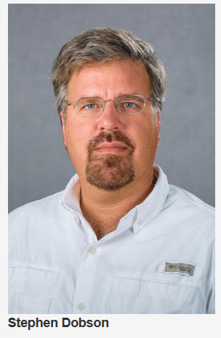
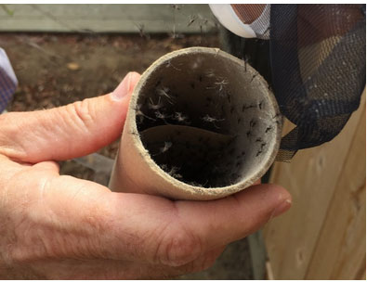
Wolbachia-infected Mosquitoes

Slide 42
Wolbachia-infected Mosquitoes
- Wolbachia is a bacterium that can affect the ability of some insects to mate successfully.
- Mosquitoes infected with Wolbachia are being raised in the lab of University of Kentucky Professor Stephen Dobson, and they have been released in Kentucky and other states. - These mosquitoes are regulated by the EPA. - If successful, this project could reduce the need for chemical insecticides.

Slide 43
Risk Communications in this Presentation?

Slide 44
Conclusion
- Keep it simple.
- Don’t be arrogant. - Try to understand where people are coming from and show them respect. - Remember that facts and data are not enough to be convincing. - Practice and prepare. Think of future scenarios and how you might answer. Take courses on media training or interpersonal communication, if possible.

Slide 45
Further Reading
"Communication in Risk Situations - Responding to the Challenges"
Association of State and Territorial Health Officials
http://tinyurl.com/n8x9x3k
"Risk Communication in the Age of Zika"
World Health Organization
http://tinyurl.com/makutjt
Crisis & Emergency Risk Communication
U.S. Centers for Disease Control and Prevention
https://emergency.cdc.gov/cerc/

Slide 46
Q&A and Discussion
THANK YOU, KENTUCKY!
Richard Levine
https://www.linkedin.com/in/richard-levine-cpmd
Twitter: @Rich_Lev email: rich.levine@verizon.net

