Slide 1
Zika Virus KOIN/KFNC ITV November 1, 2016
Anna Yaffee, MD, MPH
Epidemic Intelligence Service Officer
Kentucky Department for Public Health

Slide 2
Outline: Zika Virus
Epidemiology
Transmission
Clinical Effects
Testing and Reporting
Prevention

Slide 3
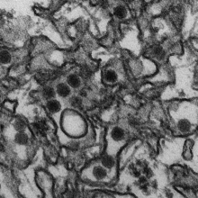
Zika Virus (ZIKV)
Flavivirus first discovered in 1947 in Zika forest, Uganda
First human cases noted in 1952
In 2015, first confirmed Zika virus infection in Brazil
https://en.wikipedia.org/wiki/Zika_virus

Slide 4
ZIKV EPIDEMIOLOGY

Slide 5
Geographic distribution ZIKV 1947-2007
http://www.ncbi.nlm.nih.gov/pmc/articles/PMC2819875/
Notes:
Approximate known distribution of Zika virus, 1947–2007.
Red circle represents Yap Island. Yellow indicates human serologic evidence; red indicates virus isolated from humans; green represents mosquito isolates.

Slide 6
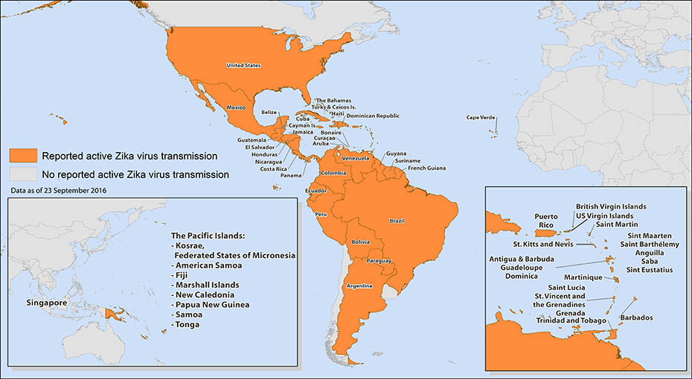
Areas with Active ZIKV Transmission
Notes:
http://www.cdc.gov/zika/geo/active-countries.html

Slide 7
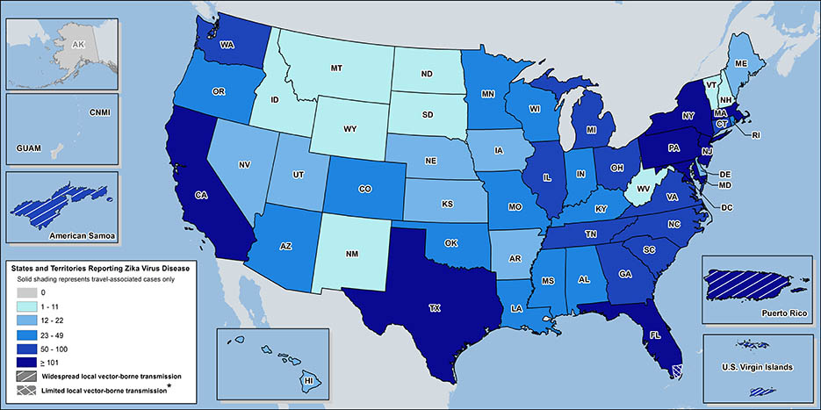
ZIKV Cases in United States
Notes:
JANUARY
Became nationally notifiable condition
Imported transmission to the U.S.
FEBRUARY
WHO declared public health emergency of international concern
Sexual transmission in TX
MARCH
First case of Zika in KY
April
All cases in U.S. remain travel-associated
CDC concludes Zika causes microcephaly and other birth defects

Slide 8
Zika in Kentucky
As of 31 OCTOBER 2016:
29 confirmed cases
All cases are travel-associated
No cases of local transmission

Slide 9
ZIKV TRANSMISSION

Slide 10
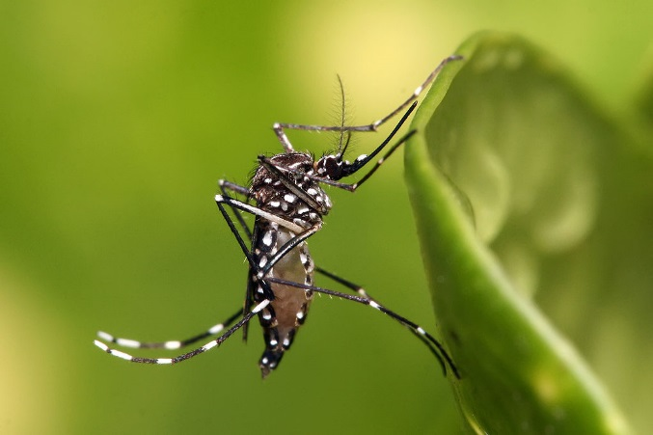
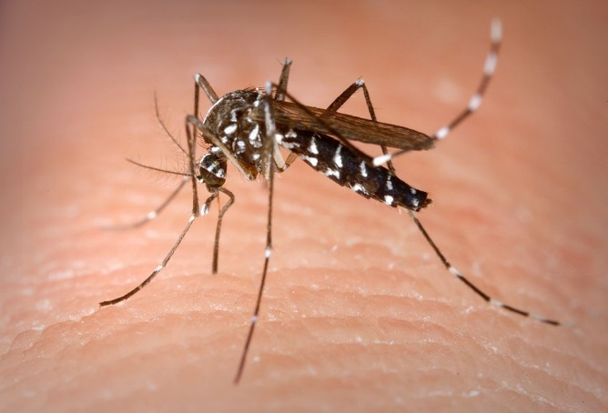
ZIKV Transmission
Arthropod-borne
Aedes aegypti – main vector
Rare in KY (1 in 5000 mosquitoes)
Aedes albopictus – alternate vector
Common in KY
Less efficient transmission, unknown if transmission could be sustained in the US until mosquito season
Photo credit: https://en.wikipedia.org/wiki/Aedes_aegypti, https://en.wikipedia.org/wiki/Aedes_albopictus

Slide 11
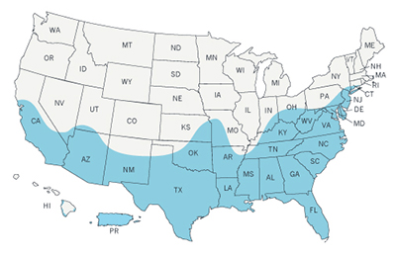
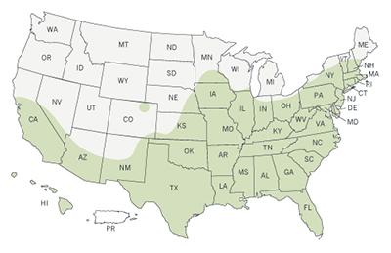
Mosquito Range in US
Aedes aegypti
Aedes albopictus

Slide 12
ZIKV Transmission
Photo credit: http://emergency.cdc.gov/coca/ppt/2016/01_26_16_zika.pdf

Slide 13
Other Methods of ZIKV Transmission
Mother to Child:
During birth, or during fetal development
?Breastfeeding – currently no reported cases
Sexual Transmission:
Infected persons can spread through intercourse to partners
Virus remains in semen longer than blood
Blood Transfusion:
Reported in Brazil, under investigation
No cases confirmed in U.S.
2.8% blood donors positive during French Polynesia outbreak 2013-2014
?Infected Secretions
http://www.cdc.gov/zika/transmission/index.html

Slide 14
ZIKV CLINICAL EFFECTS

Slide 15
ZIKV Clinical Syndrome
Most people asymptomatic
Incubation period few days to weeks
Self-limited mild illness
Maculopapular rash, fever, arthralgia, conjunctivitis
Rare neurologic complications
Guillain-Barré syndrome (GBS)
Microcephaly
Supportive care
Immunity?
http://www.cdc.gov/zika/symptoms/index.html

Slide 16
ZIKV and Pregnancy
Pregnant women can be infected with Zika virus
Through the bite of an infected mosquito
Can be spread by sexual acts
A pregnant woman can pass Zika virus to her fetus
Can be passed during pregnancy or at delivery
Notes:
http://www.cdc.gov/zika/pregnancy/question-answers.html (as of page update April 19th, 2016)

Slide 17
Adverse Fetal Outcomes
Associated with adverse pregnancy and birth outcomes
Infection passed to fetus during pregnancy can cause:
Microcephaly
Other severe brain defects
Defects of the eye
Hearing deficits
Impaired growth
Notes:
http://www.cdc.gov/zika/pregnancy/index.html (as of April 29th when page updated)

Slide 18
Microcephaly
Birth defect – baby’s head is smaller when compared to babies of the same sex and age
Not common
State birth defects tracking registry estimated 2-12 babies per every 10,000 live births (2006-2010)
Can be isolated or in combination with other defects
Notes:
http://www.cdc.gov/zika/pregnancy/index.html (as of April 29th when page updated)

Slide 19
Causes of Microcephaly
Microcephaly can be caused by:
Infections (Zika, rubella, cytomegalovirus, or toxoplasmosis) during pregnancy
Exposure to toxins (drugs or alcohol) during pregnancy
Interruption of blood supply to baby’s brain during development
Lack of nutrients
Notes:
http://www.cdc.gov/zika/pregnancy/index.html (as of April 29th when page updated)

Slide 20
Diagnosis of Microcephaly
During pregnancy
Ultrasound late second trimester or early third
After birth
Anthropometric measurements of neonate
Head circumference should be re-measured 24 hours after delivery
MRI of baby’s brain
Notes:
http://www.cdc.gov/zika/pregnancy/index.html (as of April 29th when page updated)

Slide 21
Treatment of Microcephaly
No treatment
Lifelong condition
Mild microcephaly
Need monitoring for developmental delays
Routine check-ups
Severe microcephaly
Need care and treatment focused on other health problems
Speech, occupational, and physical therapies needed
Medications to treat seizures
Notes:
http://www.cdc.gov/ncbddd/birthdefects/microcephaly.html (microcephaly - as of April 7 2016 page update)

Slide 22
Remaining Questions…
If a pregnant woman is exposed
How likely she is to get Zika?
If a pregnant woman is infected
How the virus will affect her or her pregnancy?
How likely it is that Zika will pass to her fetus?
If the fetus is infected, will the fetus develop birth defects?
At what point in pregnancy does the infection cause harm to the fetus?
Will the baby have birth defects?
Does sexual transmission of Zika virus pose a different risk of birth defects than mosquito-borne transmission?
Notes:
http://www.cdc.gov/zika/pregnancy/question-answers.html (as of April 29th – updated page)

Slide 23
Zika and Future Pregnancies
Based on the available evidence, Zika is not expected to pose a risk for birth defects in future pregnancies
Notes:
http://www.cdc.gov/zika/pregnancy/question-answers.html (as of page update on April 19th)

Slide 24
U.S. Zika Pregnancy Registry
CDC established US Zika Pregnancy Registry
Collaborating with state health departments
To collect information about Zika virus infection
During pregnancy
Congenital Zika virus infection
Each data point collected as part of the Registry adds to what we know about Zika
Helps guide messages for the public
Updates to clinical guidance
Updates to prevention efforts

Slide 25
Role of Healthcare Professionals
Know your resources
Order appropriate tests
Report all cases of Zika
Educate your patients!

Slide 26
ZIKV TESTING AND REPORTING

Slide 27
Recommendations for Testing
History of travel to Zika-affected area AND:
Symptomatic within two weeks of travel
Travel during pregnancy or 8 weeks before conception
Infants born to female with positive or inconclusive test for Zika virus
History of exposure to Zika such as unprotected sex with Zika positive patient AND symptomatic or pregnant
Notes:
CDC will test patients (both males and females, pregnant and non-pregnant) who are symptomatic and have traveled to affected countries within the past two weeks. Please use the same guidelines for symptoms listed in the MMWR article to determine whether a patient meets the criteria for symptoms – i.e. 2 out of 4 of the symptoms described. – Personal communication with CDC, 2FEB2016)

Slide 28
Zika Testing Process
Current testing at DLS:
If patient is symptomatic or has had symptoms within 14 days
RT-PCR on urine and blood
If patient has never been symptomatic but had possible exposure 2-12 weeks prior to testing
IgM on blood
Current testing at CDC:
PRNT
Current testing at commercial labs:
RT-PCR on urine and blood; IgM on blood

Slide 29
Zika Lab Interpretation
PCR only accurate within 14 days of symptom onset
IgM antibodies expected 2-12 weeks after virus exposure
Negative IgM suggests a recent infection did not occur but not definitive
All results should be clinically/epidemiologically correlated due to risk of IgM false positives
Closely related flaviviruses (dengue, chikungunya, yellow fever/vaccine, Japanese encephalitis/vaccine)
Risk of false positive – difficulty in counseling regarding pregnancy; detection of ZIKV does not indicate definite harm

Slide 30
Report case
Priority notification within one business day
Call local health department
Submit EPID200 form
KDPH will initiate investigation and prevention efforts, report to CDC via ArboNET and U.S. Zika Pregnancy Registry

Slide 31
ZIKV PREVENTION

Slide 32
Mosquito Prevention and Control
Reduce contact between humans and mosquitos
Remove mosquito breeding sites
Especially important to protect exposed persons for three weeks after travel/exposure

Slide 33
Protect Yourself and Others
Key aspects of protection:
Long sleeves and pants
Openings to home sealed
EPA-registered insect repellent
Notes:
Larvicides – target larvae in the breeding habitat before they can mature into adult mosquitoes and disperse – applied directly to the water
Adultides – sprayed and dispense aerosol droplets that stay aloft and kill flying mosquitoes on contact

Slide 34
Environmental Protection Agency Registered Insect Repellent

Slide 35
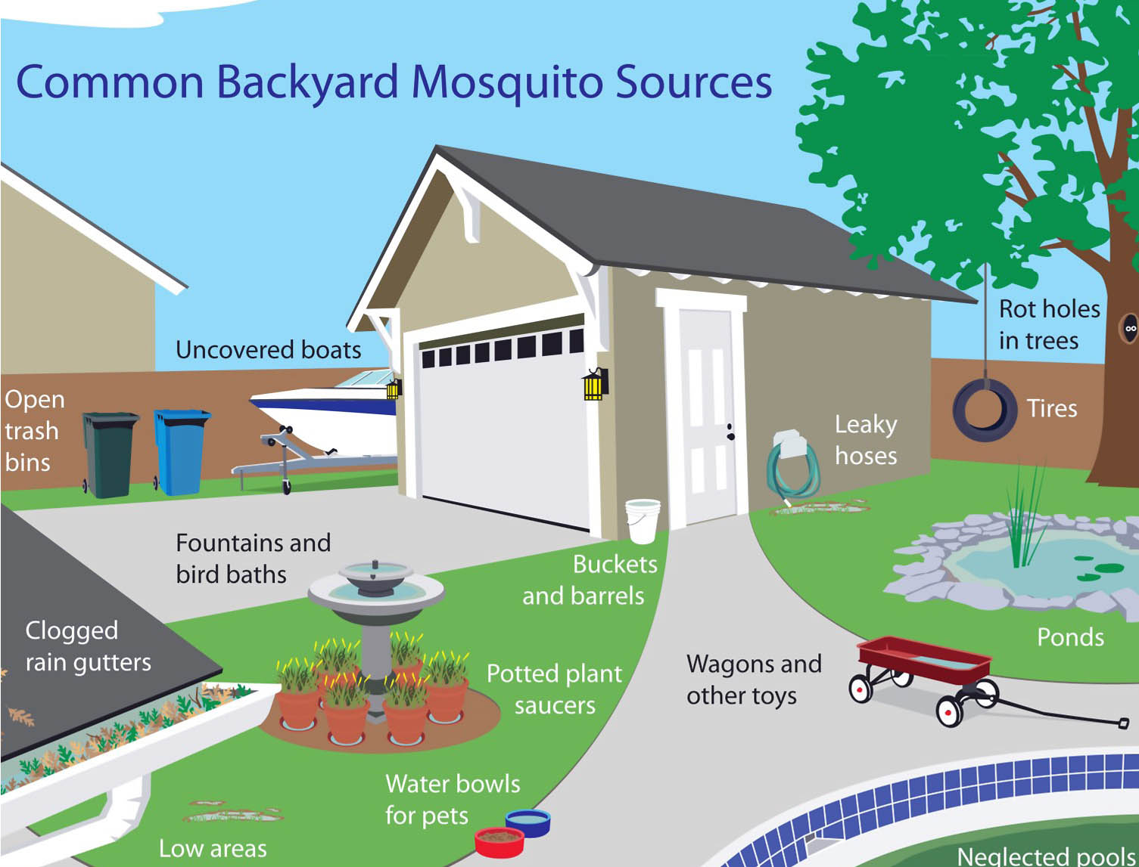
Mosquitos in Your Backyard

Slide 36
Mosquitos in Your Backyard

Slide 37
Prevent Mosquitoes Before They Bite
Key aspects for prevention include:
Identify and eliminate potential breeding sites in your community
Educate public on the need to reduce breeding sites around their home
Explore the use of larvicides and adulticides when needed
Notes:
Larvicides – target larvae in the breeding habitat before they can mature into adult mosquitoes and disperse – applied directly to the water
Adultides – sprayed and dispense aerosol droplets that stay aloft and kill flying mosquitoes on contact

Slide 39
Prevention of Sexual Transmission
All travelers should wear condoms after departure from Zika-affected area
Females: 8 weeks
Males: 6 months
For the duration of pregnancy/partner’s pregnancy

Slide 40
Education can Prevent Local Transmission!
Educate all travelers to use mosquito repellent during travel and for three weeks after return from travel.
Educate travelers to wear condoms after departure from Zika-affected area.
Educate pregnant women to postpone travel to any area with active Zika virus transmission.
Educate healthcare providers to contact their local or state health department about testing patients with compatible travel history and symptoms for Zika.
Educate prevention and control measures: Removal and modification of mosquito breeding sites and reducing contact between mosquitoes and people.
Educate couples planning to conceive to postpone after travel to a Zika-affected area.

Slide 41
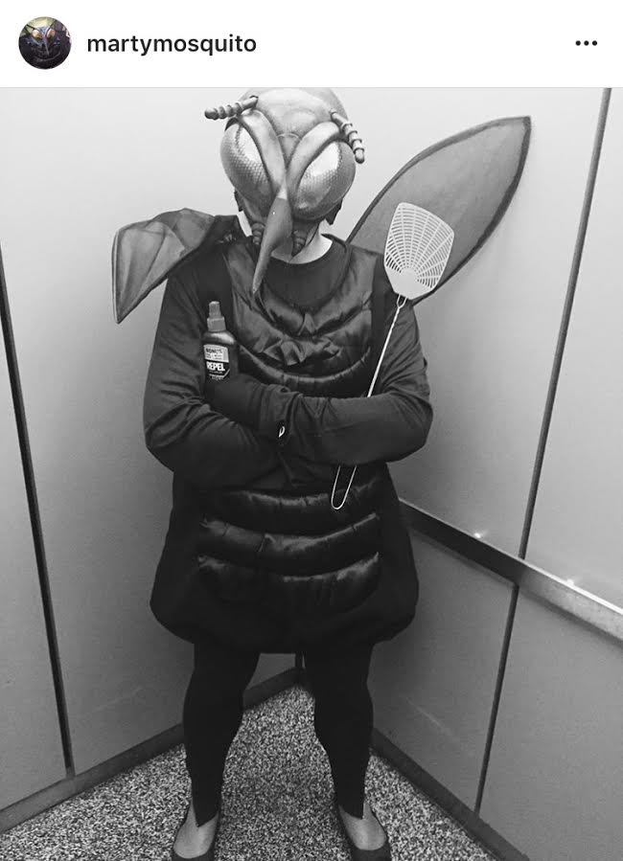
Thank you!
Anna Q. Yaffee, MD, MPH
LCDR, U.S. Public Health Service
CDC Epidemic Intelligence Service Officer
Kentucky Department for Public Health
Email: annaq.yaffee@ky.gov
Telephone: 502-564-3418 x4316
KDPH Zika Surveillance Team:
Katie Myatt
Sandy Kelly
Anna Yaffee

