Slide 1
The US Zika Pregnancy Registry and Zika-Related Birth Defects Surveillance
Kentucky Zika Summit
May 11, 2017
Judy Theriot, MD, CPE
Commission for Children with Special Health Care Needs
Medical Director

Slide 2
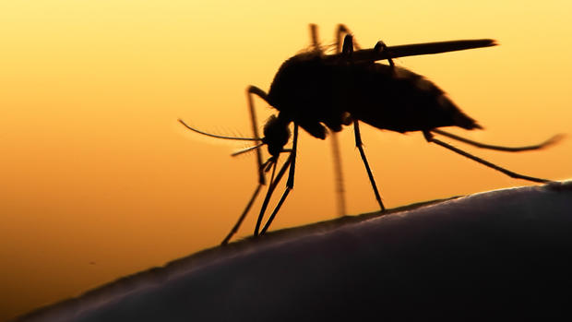
Objectives
Describe the US Zika Pregnancy Registry (USZPR)
Describe Zika-Related Birth Defects Surveillance (ZBDS)
Define Zika-related birth defects
Understand the similarities and differences between the USZPR and ZBDS
Understand the prevalence of Zika in the US and in Kentucky

Slide 3

Importance of Collecting Surveillance Data About Zika Virus and Its Effects
Track the spread of Zika in the United States and territories
Address questions about timing, risk, and the spectrum of outcomes linked with Zika during pregnancy
Update recommendations for clinical care
Plan for services for pregnant women and families affected by Zika virus
Connect families to local health and social services in their community
Improve prevention of Zika virus infection during pregnancy

Slide 4
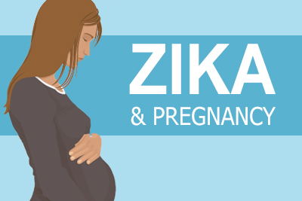
US Zika Pregnancy Registry

Slide 5
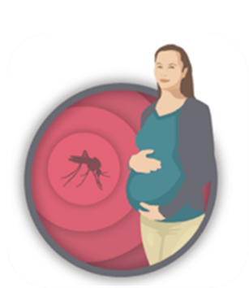
US Zika Pregnancy Registry (USZPR)
CDC established the US Zika Pregnancy Registry to:
  Learn more about the effects of Zika exposure during pregnancy and adverse outcomes
  Learn more about the growth and development of infants born to Zika-positive mothers
Notes:
CDC has funded 45 jurisdictions in the US to establish or enhance Zika-related birth defects surveillance systems that monitor brain abnormalities, including microcephaly, and central nervous system defects, to better understand Zika exposure during pregnancy and adverse outcomes.
USZPR casts a wider net than ArboNET and National Notifiable Diseases Surveillance System as it pertains to Zika, because the registry includes symptomatic and asymptomatic pregnant women with positive, equivocal, or inconclusive Zika test results with or without symptoms. It also includes all infants born to these women, not only those with identified congenital infection, and they will be followed for 1 year.
Pregnant women with any lab evidence of possible Zika virus infection should be reported to the US Zika Pregnancy Registry.

Slide 6
ArboNET
ArboNET is a national arboviral surveillance system managed by CDC and state health departments, it collects data only on laboratory confirmed cases
USZPR gathers much more information related to Zika
  It includes symptomatic and asymptomatic pregnant women with positive, equivocal, or inconclusive Zika test results
  It includes all infants born to these women, not only those with identified congenital infection
  Infants will be followed for 1 year
Notes:
CDC manages the collection of data through ArboNET in collaboration with state and territorial health departments. ArboNET is a national arboviral surveillance system that collects information on laboratory-confirmed Zika virus disease cases reported from US states and territories.

Slide 7
What are the inclusion criteria for the USZPR?
  Pregnant women in the United States with laboratory evidence of Zika virus infection (positive or inconclusive test results, regardless of whether they have symptoms) and periconceptionally, prenatally, or perinatally exposed infants born to these women
  Infants with laboratory evidence of congenital Zika virus infection (positive or inconclusive test results, regardless of whether they have symptoms) and their mothers

Slide 8

What information is included in USZPR?
  Maternal Health History
    Demographics, Maternal Zika Virus History, Exposure History, Maternal Health History, Pregnancy Information, Prenatal Imaging and Diagnostics
  Neonatal Assessment
    DOB, Gender, Gestational age, Physical Examination, Imaging and Diagnostics such as hearing screen, retinal exam, head ultrasound, Postnatal Infection and Cytogenetic Testing Results
  Infant Follow-up at 2, 6, and 12 months
    Demographics, Weight, Length, Head Circumference, Abnormal Clinical Findings
Notes:
Infant:
Demographics – DOB, sex, and gestational age;
Physical Examination – birth head circumference, weight, length, presence of microcephaly at birth, etc.
Imaging and Diagnostics completed before hospital discharge – hearing screen, retinal exam, and imaging results
Postnatal Infection and Cytogenetic Testing Results

Slide 9

What is the role of healthcare providers?
Collect Data on Pregnant Women and Their Infants
  Completing the Maternal History, Neonate Assessment, and Infant Follow-up US Zika Pregnancy Surveillance forms
Report Zika-related Adverse Events Such as Spontaneous Abortion or Termination
  By contacting the Kentucky Birth Surveillance Registry’s (KBSR) Infant Zika Nurse Coordinator at 1-800- 843-5877 Ext. 3103
Report Suspected New Zika Cases
  By contacting Kentucky Department for Public Health’s Reportable Diseases Section at 1-502-564-3261
Notes:
So what is the role of healthcare providers? Well healthcare providers can participate in the registry by assisting with the collection of data on these pregnant women and their infants by completing the 3 USZPR surveillance tools that were just discussed.
In addition, healthcare providers should report any zika-related adverse events such as a spontaneous abortion of termination to Kentucky’s Birth Surveillance Registry Infant Zika Nurse Coordinator at the number provided.
And furthermore healthcare providers can participate in the registry by reporting any suspected new Zika cases to Kentucky’s Department for Public Health’s Reportable disease section at the number provided.

Slide 10
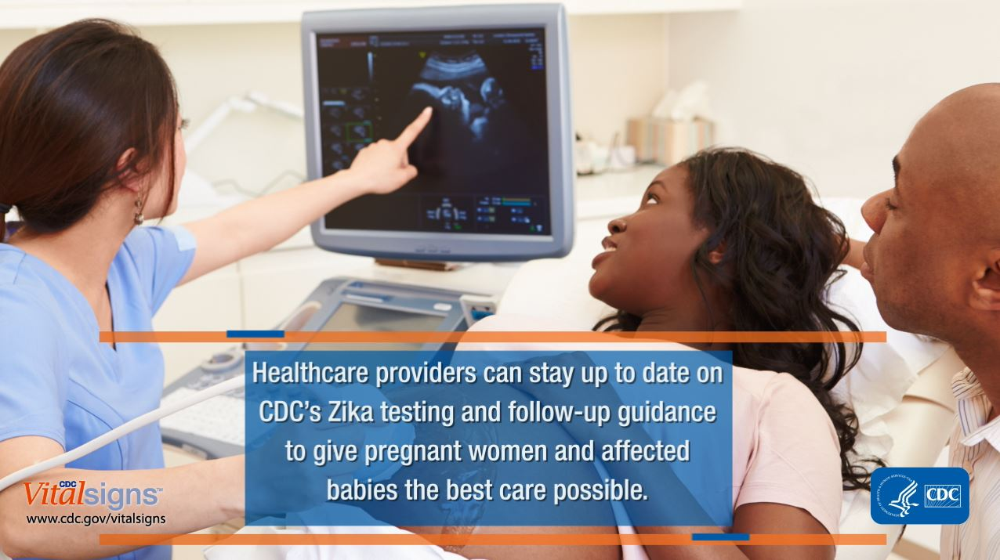

Slide 11
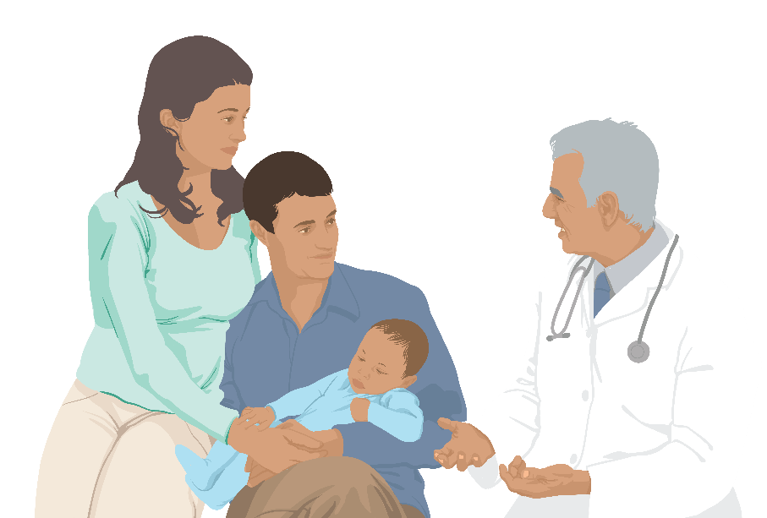
What is the role of Kentucky’s Department for Public Health?
Within the Kentucky Department for Public Health, the Division of Epidemiology & Health Planning and the Division of Maternal & Child Health are collaborating by:
Coordinating Zika virus testing
Ensuring data collection and reporting to CDC, KBDS, DPH Reportable Diseases
Providing guidance and support to healthcare providers and birthing hospitals
Ensuring referrals to CCSHCN and early intervention services for infants
Notes:
Coordinates Zika Testing and Approval
KDPH’s Reportable Disease Section works with local health departments to ensure approval for Zika testing is granted for individuals meeting testing criteria
Ensures Data Collection and Reporting to the CDC
The KDPH Reportable Disease Section works with healthcare providers to ensure completion of the Maternal History form.
The KBSR Infant Zika Nurse Coordinator works with birthing hospitals and the infant’s Primary Care Provider (PCP) to ensure completion of the Neonate Assessment Form and the Infant Follow-up forms
Provides Support to Healthcare Providers and Birthing Hospitals
KDPH Reportable Diseases and Maternal and Child Health staff collaborate to provide guidance and support for healthcare providers and birthing hospitals prior to and at the time of delivery.
Ensures Referral to Specialty and Early Intervention Services for Infants
The KBSR Infant Zika Nurse Coordinator:
Collaborates with the infant’s PCP to ensure appropriate clinical evaluation of the infant
Makes referrals to the Commission for Children with Special Health Care Needs (CCSHCN) for neurology and other specialty services
Makes referrals to Early Intervention Services (First Steps) to assess for developmental delays

Slide 12

What happens when a pregnant woman has evidence of Zika virus?
Before the birth, KDPH arranges a conference call with the birthing hospital to discuss clinical and laboratory evaluation of the infant
  KDPH provides written documentation outlining infant evaluation, including flowcharts for infants born with and without abnormalities
  Laboratory testing is performed
KDPH collects information about the clinical and laboratory evaluation of the infant and recommends appropriate clinical care and pediatric follow-up.
Notes:
A limited number of situations call for confirmatory testing at CDC

Slide 13
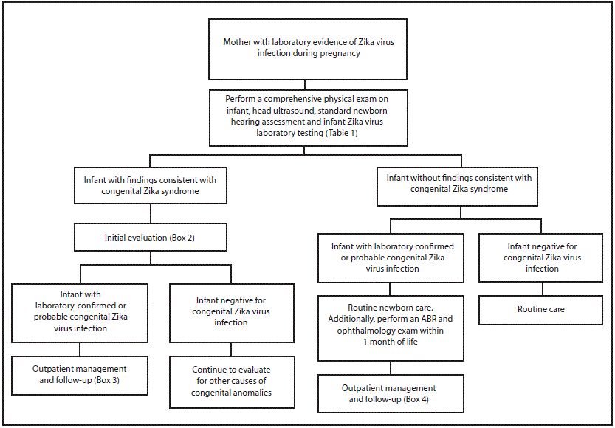
Russell K, Oliver SE, Lewis L, et al. Update: Interim Guidance for the Evaluation and Management of Infants with Possible Congenital Zika Virus Infection — United States, August 2016. MMWR Morb Mortal Wkly Rep 2016;65:870–878
Notes:
Mothers in the registry, infant is born: Must perform comprehensive physical exam, NB hearing screen and head ultrasound and Zika virus lab testing

Slide 14
Laboratory Testing:
Recent Zika virus infection detected by:
  Zika RNA nucleic acid test (NAT) on any infant/fetal specimen
  (rRT-PCR)
Recent Zika virus infection or recent flavivirus infection (serum or CSF):
  Zika virus IgM positive or equivocal AND Zika virus plaque reduction neutralization test (PRNT) titer ≥10
  OR
  Zika virus IgM negative AND dengue virus IgM positive or equivocal AND Zika virus PRNT titer ≥10

Slide 15
Russell K, Oliver SE, Lewis L, et al. Update: Interim Guidance for the Evaluation and Management of Infants with Possible Congenital Zika Virus Infection — United States, August 2016. MMWR Morb Mortal Wkly Rep 2016;65:870–878

Slide 16
Initial evaluation of an infant with findings consistent with Congenital Zika Syndrome
Consultation with:
  Neurologist for determination of appropriate neuroimaging and additional evaluation.
  Infectious disease specialist for diagnostic evaluation of other congenital infections (e.g., syphilis, toxoplasmosis, rubella, cytomegalovirus infection, lymphocytic choriomeningitis virus infection, and herpes simplex virus infection).
  Ophthalmologist for comprehensive eye exam and evaluation for possible cortical visual impairment prior to discharge from the hospital or within 1 month of birth.
  Endocrinologist for evaluation for hypothalamic or pituitary dysfunction.
  Clinical geneticist to evaluate for other causes of microcephaly or other anomalies if present.

Slide 17
Initial evaluation of an infant with findings consistent with Congenital Zika Syndrome
Consider Consultation with:
  Orthopedist, physiatrist, or physical therapist for the management of hypertonia, club foot or arthrogrypotic-like conditions
  Pulmonologist or otolaryngologist for concerns about aspiration
  Lactation specialist, nutritionist, gastroenterologist, or speech or occupational therapist for the management of feeding issues
Perform auditory brainstem response to assess hearing
Perform complete blood count and metabolic panel, including liver function tests
Provide family and supportive services

Slide 18
Initial evaluation of an infant with findings consistent with Congenital Zika Syndrome
The evaluation is for every baby born with abnormalities consistent with congenital Zika syndrome
For babies with abnormalities that test negative for the virus
  Investigate other causes for the abnormalities, such as other congenital infections or genetic causes
  All babies born with abnormal findings consistent with congenital Zika Syndrome should be followed by Zika-related Birth Defects Surveillance

Slide 19
Russell K, Oliver SE, Lewis L, et al. Update: Interim Guidance for the Evaluation and Management of Infants with Possible Congenital Zika Virus Infection — United States, August 2016. MMWR Morb Mortal Wkly Rep 2016;65:870–878

Slide 20
Russell K, Oliver SE, Lewis L, et al. Update: Interim Guidance for the Evaluation and Management of Infants with Possible Congenital Zika Virus Infection — United States, August 2016. MMWR Morb Mortal Wkly Rep 2016;65:870–878

Slide 21
Management of Infants with laboratory evidence of Zika Virus and an abnormal exam
Monthly visits with PCP for at least the first 6 months
Refer to Neurology, Ophthalmology, Endocrinology, Early Intervention
Consider referral to Developmental Pediatrician
Repeat comprehensive ophthalmologic exam at age 3 months
Repeat ABR testing at age 4–6 months
Repeat testing for hypothyroidism at age 2 weeks and 3 months
Provide family and supportive services

Slide 22
Russell K, Oliver SE, Lewis L, et al. Update: Interim Guidance for the Evaluation and Management of Infants with Possible Congenital Zika Virus Infection — United States, August 2016. MMWR Morb Mortal Wkly Rep 2016;65:870–878

Slide 23
Russell K, Oliver SE, Lewis L, et al. Update: Interim Guidance for the Evaluation and Management of Infants with Possible Congenital Zika Virus Infection — United States, August 2016. MMWR Morb Mortal Wkly Rep 2016;65:870–878

Slide 24
Management of Infants with laboratory evidence of Zika Virus and an Normal exam
PCP should:
Follow growth parameters, and perform developmental screening at each well child visit
Emphasize anticipatory guidance for families regarding developmental milestones, feeding and growth, sleep and irritability, and abnormal movements
Use a standardized, validated developmental screening tool at 9 months
Referral to ophthalmology within one month of birth. Perform vision screening and assess visual regard at every well child visit
Perform auditory brainstem response within one month of birth. Consider repeat auditory brainstem response at 4–6 months or perform behavioral diagnostic testing at 9 months of age
Provide family and supportive services

Slide 25
Management of Infants born to mothers enrolled in the USZPR in Kentucky?
Kentucky is uniquely able to provide medical care and wrap around services for infants born to mothers in the USZPR providing comprehensive services in a multidisciplinary clinic located in their local community through the CCSHCN
We follow both positive and negative infants through the first year of life
Report to the KBSR and CDC

Slide 26
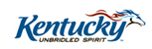
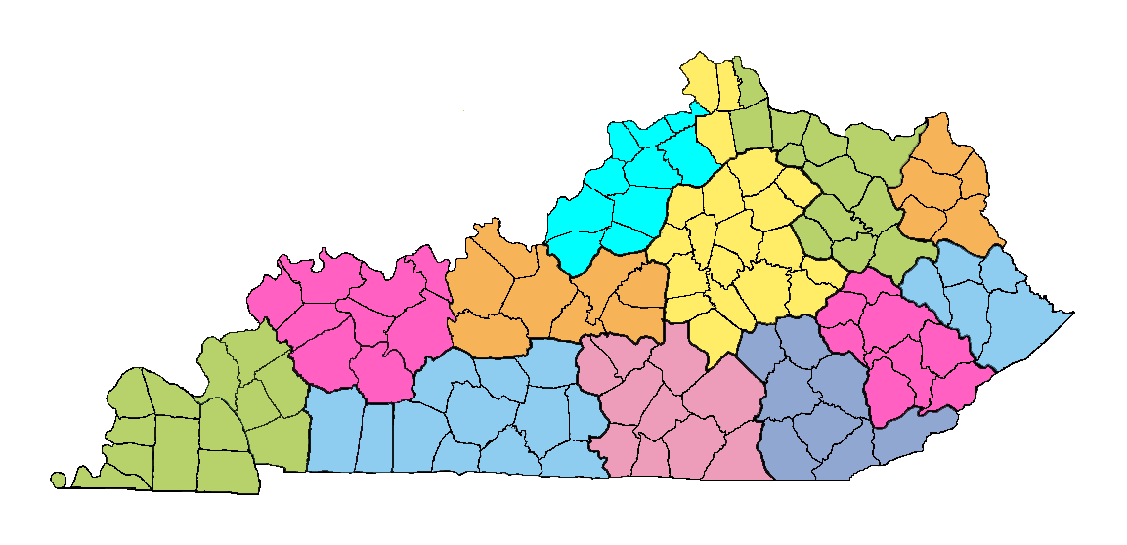
Commission Neurology Clinic Locations
Lexington
Lexington
Morehead
BOONE
Morehead
BOONE
KENTON
KENTON
CAMPBELL
CAMPBELL
Louisville
Louisville
GALLATIN
GALLATIN
PENDLE-
TON
PENDLE-
TON
BRACKEN
GRANT
BRACKEN
CARROLL
GRANT
CARROLL
TRIMBLE
TRIMBLE
MASON
MASON
ROB-
ERT-
SON
ROB-
ERT-
SON
GREENUP
LEWIS
GREENUP
OWEN
LEWIS
Elizabethtown
OWEN
Elizabethtown
HARRISON
HENRY
HARRISON
HENRY
BOYD
OLDHAM
BOYD
OLDHAM
FLEMING
FLEMING
CARTER
NICHOLAS
CARTER
SCOTT
NICHOLAS
Owensboro
SCOTT
Owensboro
FRANK-
LIN
FRANK-
LIN
BOURBON
SHELBY
BOURBON
SHELBY
ROWAN
BATH
ROWAN
JEFFERSON
BATH
JEFFERSON
ELLIOT
WOOD-
FORD
ELLIOT
WOOD-
FORD
LAWRENCE
FAYETTE
LAWRENCE
FAYETTE
MONTGOMERY
SPENCER
MONTGOMERY
SPENCER
ANDER-
SON
ANDER-
SON
CLARK
BULLITT
CLARK
BULLITT
MORGAN
MENIFEE
MORGAN
MEADE
MENIFEE
MEADE
JESSA-
MINE
JESSA-
MINE
JOHNSON
HANCOCK
JOHNSON
HANCOCK
MARTIN
POWELL
MARTIN
MERCER
POWELL
HENDERSON
MERCER
HENDERSON
NELSON
BRECKINRIDGE
NELSON
BRECKINRIDGE
WOLFE
MADISON
WOLFE
WASHINGTON
MADISON
WASHINGTON
MAGOFFIN
DAVIESS
MAGOFFIN
DAVIESS
ESTILL
HARDIN
ESTILL
Paducah
HARDIN
Paducah
UNION
UNION
GARRARD
GARRARD
FLOYD
BOYLE
FLOYD
BOYLE
LEE
LEE
PIKE
MARION
PIKE
WEBSTER
MARION
WEBSTER
McLEAN
McLEAN
BREATHITT
LARUE
BREATHITT
OHIO
LARUE
OHIO
LINCOLN
LINCOLN
JACKSON
GRAYSON
JACKSON
GRAYSON
OWSLEY
CRITTENDEN
OWSLEY
CRITTENDEN
KNOTT
CASEY
KNOTT
CASEY
ROCKCASTLE
TAYLOR
ROCKCASTLE
TAYLOR
PERRY
HOPKINS
PERRY
HOPKINS
HART
LIVINGSTON
HART
LIVINGSTON
GREEN
BUTLER
GREEN
BUTLER
EDMONSON
EDMONSON
CLAY
MUHLENBERG
CLAY
CALDWELL
MUHLENBERG
CALDWELL
LETCHER
PULASKI
LETCHER
PULASKI
Prestonsburg
LESLIE
Prestonsburg
LAUREL
LESLIE
BALLARD
LAUREL
BALLARD
McCRACKEN
McCRACKEN
ADAIR
LYON
ADAIR
LYON
WARREN
WARREN
RUSSELL
BARREN
RUSSELL
BARREN
METCALFE
MARSHALL
METCALFE
MARSHALL
KNOX
CARLISLE
KNOX
CARLISLE
CHRISTIAN
CHRISTIAN
LOGAN
LOGAN
HARLAN
WAYNE
HARLAN
TODD
WAYNE
TODD
CUMBER-
LAND
TRIGG
CUMBER-
LAND
TRIGG
WHITLEY
WHITLEY
BELL
SIMPSON
BELL
SIMPSON
ALLEN
ALLEN
Hazard
HICKMAN
Hazard
HICKMAN
McCREARY
GRAVES
McCREARY
GRAVES
CLINTON
MONROE
CLINTON
CALLOWAY
MONROE
FULTON
CALLOWAY
FULTON
Bowling Green
Bowling Green
Barbourville
Somerset
Barbourville
Somerset

Slide 27
Management of Infants born to mothers enrolled in the USZPR in Kentucky?
  Infant is referred to the KY Commission for Children with Special Health Care Needs Cerebral Palsy or Neurology clinic
    Seen at 2, 6 and 12 months by Child Neurologist
    Hearing testing performed by Audiologist at 2 and 4-6 months
    Ensure Early Intervention referral
    Care Coordinators ensure infants are seen by pediatric Ophthalmologist and other sub-specialists as needed (ID, Genetics, Endocrinology)
    Seen by Family to Family representative
    Foreign language interpreters including ASL

Slide 28
Kentucky EHDI program
  EHDI ensures all children in KY are screened at birth for hearing loss and followed-up if they do not pass the screen or if they pass with risk factors
  Kentucky prevalence of Childhood hearing loss is 1.6 per 1000 children screened, biggest risk factor is congenital infection
  Preliminary data from Brazil:
  Symptomatic infants with Congenital Zika Infection had 6% prevalence for sensorineural hearing loss
Leal MC, Muniz LF, Ferreira TS, et al. Hearing Loss in Infants with Microcephaly and Evidence of Congenital Zika Virus Infection — Brazil, November 2015–May 2016. MMWR Morb Mortal Wkly Rep 2016;65:917–919.

Slide 29
Early Hearing Detection & Intervention
  What do we know about other congenital infections and hearing?
  cCMV 0.5%-0.7% of live births in the US (20,000-31,500)
  Hearing loss due to cCMV is substantial
  20% of all hearing loss at birth and
  25% of all hearing loss at 4 years of age
  Most other causes of PCHL are genetic
.

Slide 30
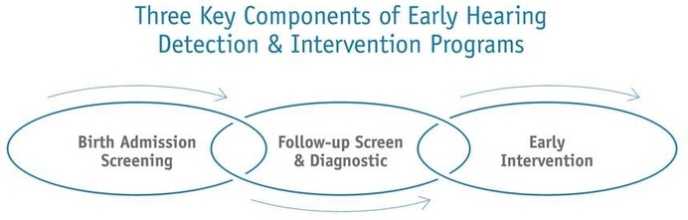
Early Hearing Detection & Intervention (EHDI) Program
National
Hearing Loss Surveillance
All infants will receive a hearing screening before 1 month of age
Infants not passing the screening will receive appropriate audiologic and medical evaluation before 3 months of age
All infants identified as deaf or hard of hearing will begin receiving early intervention services before 6 months of age
1-3-6
Goals
Notes:
The Joint Committee on Infant Hearing (JCIH) was established in 1969 and brought together representatives from audiology, otolaryngology, pediatrics, and nursing.
Originally it was formed by the American Speech Language Hearing Association (ASHA), the American Academy of Ophthalmology and Otolaryngology (AAOO) and the American Academy of Pediatrics (AAP).
The goal was to make recommendations concerning newborn hearing screening and early identification of children with, or at-risk for hearing changes.
The JCIH also outlined the following three major components of EHDI programs:
Birth admission screening
Follow-up screening and diagnostics
Early intervention
There have been multiple position statements released by the JCIH and the most recent in 2007 outlined the following items:
Goals of universal newborn screening
Diagnosis of all children with hearing changes by 3 months of age, and early intervention before 6 months of age
The 2007 JCIH position statement also outlines that the EHDI system be centered on the medical home and should provide the child and family access to high-quality intervention technology and interdisciplinary intervention programs.
Information systems should be designed to interface with electronic health records and should be used to measure outcomes and report the effectiveness of EHDI services at the community, state, and federal levels.

Slide 31


Kentucky EHDI Data
1-3-6 Goals
2014 Kentucky CDC EHDI Data
% Screened: 99.4% (n=53,822)
% screened excluding deaths and refusals 99.8%
% of those identified receiving Early Intervention: 66.7% (n=84)
% Screened before 1 month of age: 96.9% (US 96.1%)
% Diagnosed before 3 months of age: 74.1% (US 71.3%)
% Receiving Intervention before 6 months of age: 66.1% (67.9%)
% Loss to Follow-up or Documentation: 11.1% (US 34.4%)
Notes:
99.8% screened excluding deaths and refusals
Only 2/3 of the babies receiving EI get it before 6 months

Slide 32
Closing the Gap
USZPR is used to gather data on mothers and their infants diagnosed with the Zika virus
If a mother is not diagnosed prenatally her infant may not be included in the registry
ZRBD surveillance is intended to close the gap in reporting pregnancy outcomes related to Zika.

Slide 33
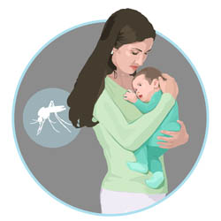
Zika-Related Birth Defects Surveillance

Slide 34
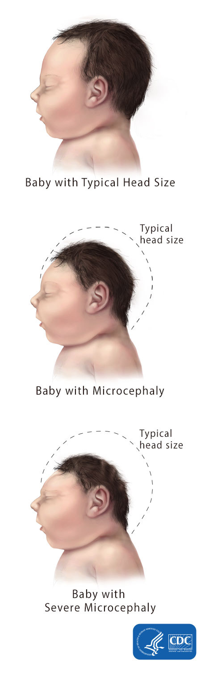
Zika-Related Birth Defects Surveillance (ZBDS)
CDC established Zika-related Birth Defects Surveillance to gain a better understanding of the effects of the Zika virus infection during pregnancy.
CDC supports 50 states and local areas to track and collect information about babies born with microcephaly and other birth defects that might be associated with Zika virus infection during pregnancy.

Slide 35
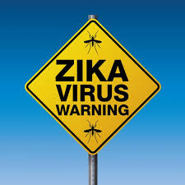
CDC has asked local jurisdictions to use a standard approach for gathering information on Zika
  Population-based birth defects surveillance – information is collected on ALL infants with birth defects that might be related to Zika (not just the infants that are positive for the virus) This helps to identify the full spectrum of outcomes associated with Zika
  Active case-finding – utilizing direct medical record review
  Consistent case definitions – ensure data is collected in a consistent systematic way to ensure data collected from different regions can be compared in a meaningful way

Slide 36

What are the inclusion criteria for ZBDS?
Birth Defects possibly related to Zika Virus:
  Brain abnormalities with and without microcephaly
  Neural tube defects and other early brain malformations
  Structural eye abnormalities
  Consequences of central nervous system (CNS) dysfunction
  Infants with these abnormalities are tracked in ZBDS regardless of congenital zika virus exposure

Slide 37
Brain abnormalities
Confirmed or possible congenital microcephaly
Intracranial calcifications
Cerebral atrophy
Abnormal cortical formation
Corpus callosum abnormalities
Cerebellar abnormalities
Porencephaly
Hydranencephaly
Ventriculomegaly / hydrocephaly (excluding “mild” ventriculomegaly without other brain abnormalities)
Fetal brain disruption sequence
Other major brain abnormalities, including intraventricular hemorrhage in utero (excluding post-natal IVH)

Slide 38

What is the “case definition” of microcephaly?
Live Births: measured head circumference (HC) adjusted for gestational age and sex <3rd percentile at birth, or if not measured at birth, measure as soon as possible after birth
Pregnancy Loss: prenatal HC* more than 3 SD below the mean based on ultrasound or postnatal HC <3rd percentile
Birth measurements based on “Intergrowth-21st” standards
Charts available at: intergrowth21.tghn.org/articles/new-intergrowth-21st-international-postnatal-growth-standards-charts-available/
Notes:
Villar J, Giuliani F, Bhutta ZA, et al. Postnatal growth standards for preterm infants: the preterm postnatal follow-up study of the INTERGROWTH-21st Project. Lancet Glob Health 2015;3:e681-691. Charts available at:https://intergrowth21.tghn.org/articles/new-intergrowth-21st-international-postnatal-growth-standards-charts-available/

Slide 39
Measuring Head Circumference (WHO*)
Use a measuring tape that cannot be stretched
  Securely wrap the tape around the widest possible circumference of the head
  At the most prominent part of the back of the head
Take the measurement three times and select the largest measurement to the nearest 0.1 cm
* World Health Organization

Slide 40
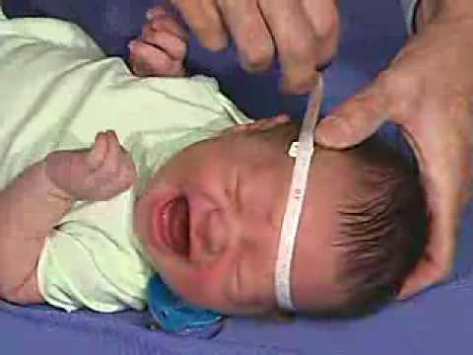
When to measure Head Circumference
Although HC measurements may be influenced by molding and other factors related to delivery, most commonly-used HC reference charts by age and sex are based on measurements taken before 24 hours of life.
If measurement within the first 24 hours of life is not done, the HC should be measured as soon as possible after birth.

Slide 41
Measuring Head Circumference

Slide 42
Congenital Microcephaly
  Congenital microcephaly is present prenatally or at the time of birth/delivery
    Abnormal development of the brain (often genetic)
    Arrest or destruction of normally-forming brain (e.g., infection, vascular disruption)
  Acquired microcephaly develops after birth due to a delivery complication or postnatal insult, trauma or infection
    HC is normal at birth
    As the baby grows in length, the head becomes comparatively smaller
AP Photo/Felipe Dana

Slide 43

Brain Abnormalities That Can Occur with Congenital Microcephaly
Intracranial calcifications
Hydrocephalus ex-vacuo
  Damaged brain matter shrinks and is surrounded by fluid
Hydranencephaly
  Damaged brain matter replaced by pockets of Fluid
Pachygyria, lissencephaly
  Abnormal ridges and folds (gyri) in the brain

Slide 44
Brain abnormalities
Confirmed or possible congenital microcephaly (see next slide)
Intracranial calcifications
Cerebral atrophy
Abnormal cortical formation
Corpus callosum abnormalities
Cerebellar abnormalities
Porencephaly
Hydranencephaly
Ventriculomegaly / hydrocephaly (excluding “mild” ventriculomegaly without other brain abnormalities)
Fetal brain disruption sequence
Other major brain abnormalities, including intraventricular hemorrhage in utero (excluding post-natal IVH)

Slide 45
Fetal Brain Disruption Sequence
First described in 1984 but noted in earlier literature
Brain destruction resulting in collapse of the fetal skull, microcephaly, scalp rugae and neurologic impairment
Photos and x-ray from 1990 series*; phenotype appears to be present in affected babies in Brazil
*Moore, et al. J Pediatr 1990;116:383-386.

Slide 46
Neural tube defects and other early brain malformations
Anencephaly / Acrania
Encephalocele
Spina bifida
Holoprosencephaly / Arhinencephaly
Structural eye abnormalities
Microphthalmia / Anophthalmia
Coloboma
Cataract
Intraocular calcifications
Chorioretinal anomalies involving the macula; excluding retinopathy of prematurity
Optic nerve atrophy, pallor, and other optic nerve abnormalities
Consequence of CNS dysfunction
Congenital contractures (e.g., arthrogryposis, club foot, congenital hip dysplasia) with associated brain abnormalities
Congenital deafness documented by postnatal testing

Slide 47
Neural tube defects and other early brain malformations
Anencephaly / Acrania
Encephalocele
Spina bifida
Holoprosencephaly / Arhinencephaly

Slide 48
Other Birth Defects with Abnormal Head Size
Anencephaly
  Failure of the neural tube to close resulting in
  failure of the brain and skull to form
Spina bifida
Failure of neural tube closure resulting in
an opening in the spine
    Can occur anywhere along the spine

Slide 49
Other Birth Defects with Abnormal Head Size
Encephalocele
  A sac-like protrusion of the brain and
  membranes that cover it through an opening in the skull
  Can have other brain and face defects
Holoprosencephaly/Arrhinencephaly
  Failure of the brain to fully divide into
  two hemispheres or other parts
Hydrocephalus
    Accumulation of fluid in the brain
    Enlarged ventricles and skull

Slide 50
Structural eye abnormalities
Microphthalmia / Anophthalmia
Coloboma
Cataract
Intraocular calcifications
Chorioretinal anomalies involving the macula; excluding retinopathy of prematurity
Optic nerve atrophy, pallor, and other optic nerve abnormalities
Consequence of CNS dysfunction
Congenital contractures (e.g., arthrogryposis, club foot, congenital hip dysplasia) with associated brain abnormalities
Congenital deafness documented by postnatal testing

Slide 51
Structural eye abnormalities
Microphthalmia / Anophthalmia
Coloboma
Cataract
Intraocular calcifications
Chorioretinal anomalies involving the macula; excluding retinopathy of prematurity
Optic nerve atrophy, pallor, and other optic nerve abnormalities
Consequence of CNS dysfunction
Congenital contractures (e.g., arthrogryposis, club foot, congenital hip dysplasia) with associated brain abnormalities
Congenital deafness documented by postnatal testing

Slide 52
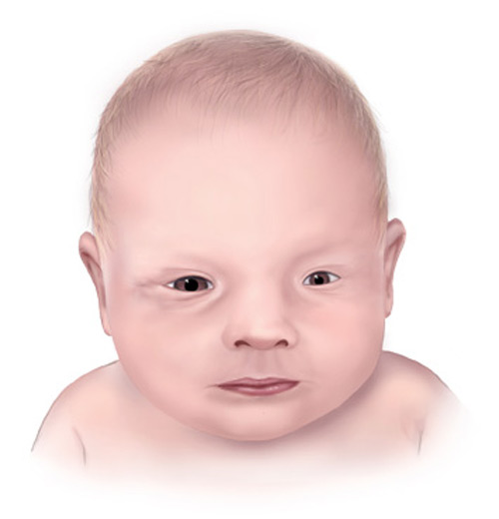
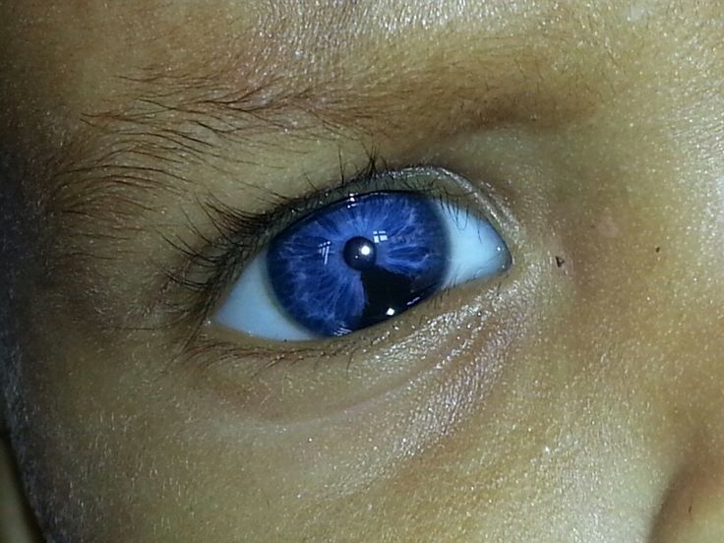
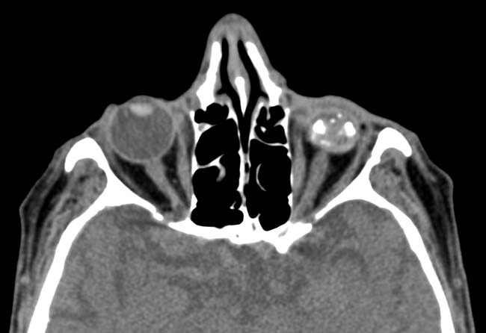
Eye Abnormalities:

Slide 53
Structural eye abnormalities
Microphthalmia / Anophthalmia
Coloboma
Cataract
Intraocular calcifications
Chorioretinal anomalies involving the macula; excluding retinopathy of prematurity
Optic nerve atrophy, pallor, and other optic nerve abnormalities
Consequence of CNS dysfunction
Congenital contractures (e.g., arthrogryposis, club foot, congenital hip dysplasia) with associated brain abnormalities
Congenital deafness documented by postnatal testing

Slide 54
Structural eye abnormalities
Microphthalmia / Anophthalmia
Coloboma
Cataract
Intraocular calcifications
Chorioretinal anomalies involving the macula; excluding retinopathy of prematurity
Optic nerve atrophy, pallor, and other optic nerve abnormalities
Consequence of CNS dysfunction
Congenital contractures (e.g., arthrogryposis, club foot, congenital hip dysplasia) with associated brain abnormalities
Congenital deafness documented by postnatal testing

Slide 55
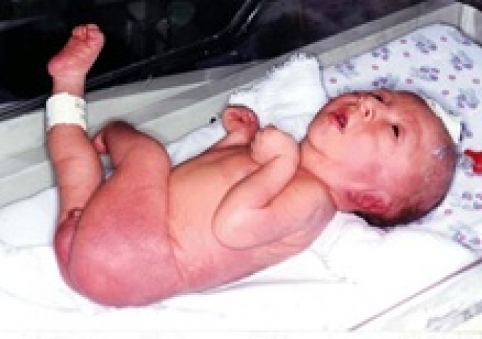
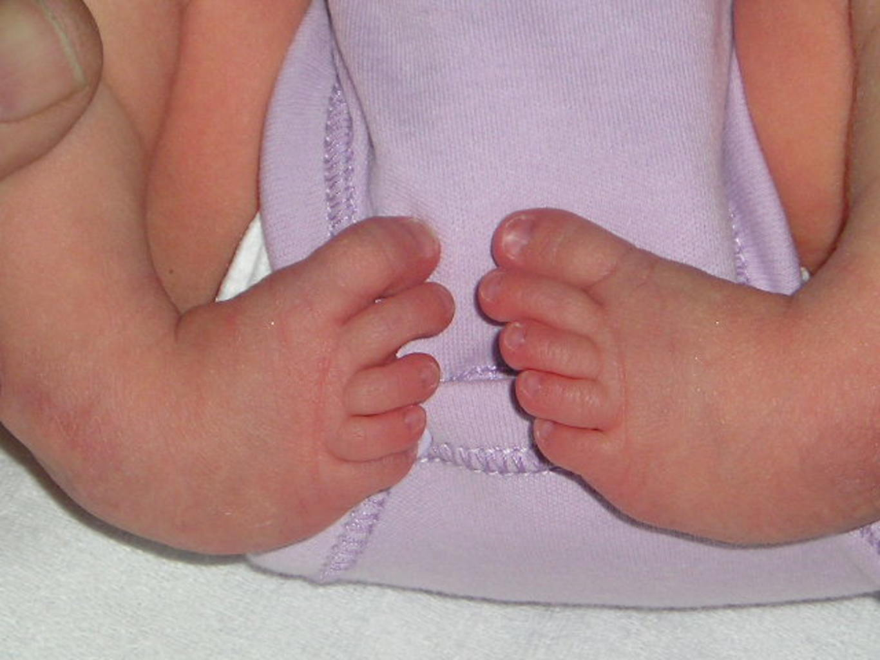
Consequence of CNS dysfunction
Club Feet
Arthrogryposis
Notes:
Consequences of CNS dysfunction
Sensory neural hearing loss

Slide 56
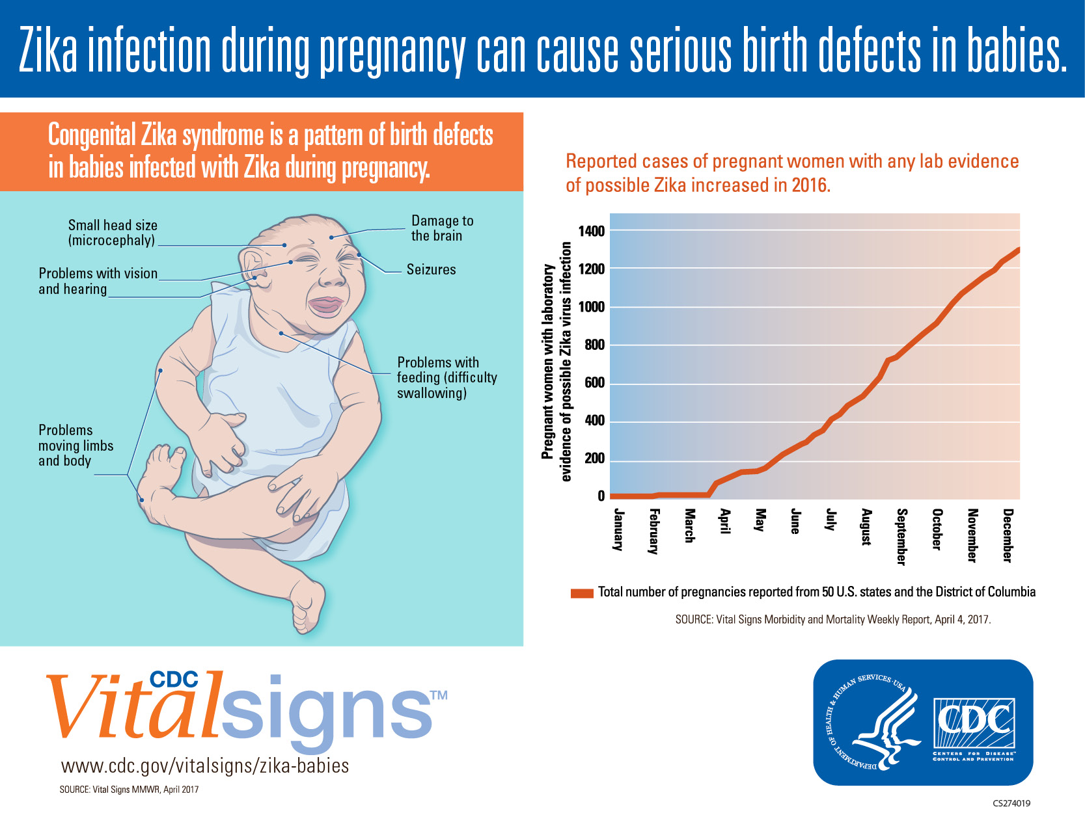
Vital Signs Morbidity and Mortality Weekly Report April 4, 2017

Slide 57

What information is included in ZBDS?
Zika-related birth defects surveillance utilizes two primary collection tools to obtain information about maternal risk factors present and babies born with abnormalities potentially related to Zika virus infection during pregnancy:
  Maternal Health History
    Demographics, Maternal Zika Virus History, Exposure History, Maternal Health History, Pregnancy Information, Prenatal Imaging and Diagnostics
  Neonatal Assessment
    Demographics, Physical Examination, Imaging and Diagnostics, Postnatal Infection and Cytogenetic Testing Results

Slide 58

How will ZBDS data be used?
  Understand disease patterns and risk factors
    Help identify the types of birth defects that are more common in infants who were exposed to Zika virus and the subpopulations that are most affected by Zika-related outcomes.
  Understand effects on populations and communities
    Help identify who in a population is affected by birth defects that are potentially associated with Zika virus infection and can serve as a foundation to link with other data to better understand the effect of Zika virus on communities.

Slide 59
How will ZBDS data be used?
  Inform prevention activities
    Help improve prevention of Zika virus infection during pregnancy and help researchers study the full range of other potential health problems.
  Connect families to health and social services
    Birth defects surveillance systems provide one way to identify and refer infants born with birth defects, including those that may be caused by Zika virus infection, for services they need as early as possible.

Slide 60

USZPR
Compared to
ZBDS

Slide 61
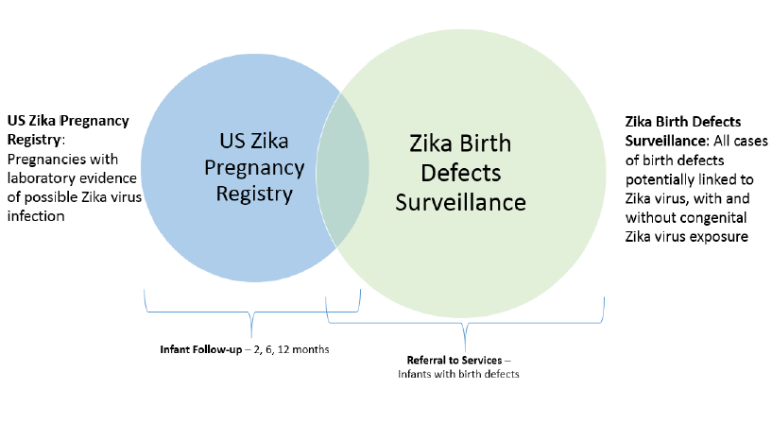
Notes:
The overlap between the USZPR and ZBDS are those infants born to mother’s with Zika virus infection that also have Zika-related congenital anomalies.
Note: The Maternal Health History Form and Neonate Assessment Form are completed for both. However, the Infant Follow-up Form is only completed for those infants in the USZPR.
Infants included in the USZPR who appear normal at birth but is found to have an anomaly at a later follow-up visit would be retrospectively included in the ZBDS.

Slide 62
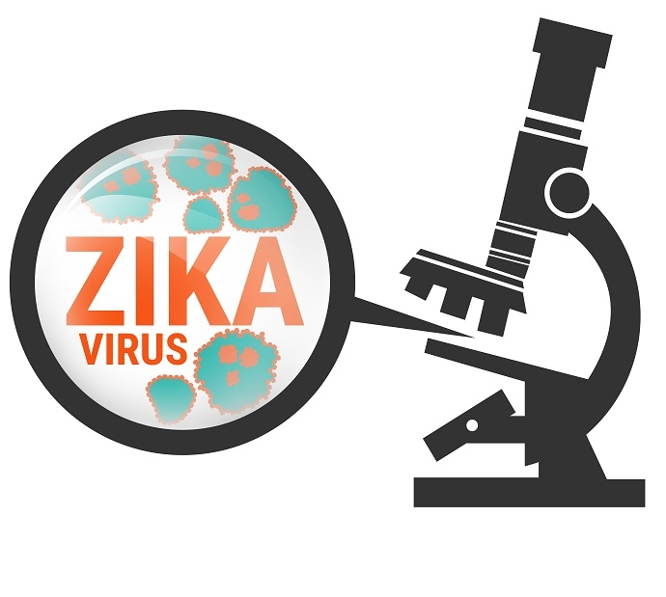
Zika Virus Surveillance in the US and Kentucky

Slide 63
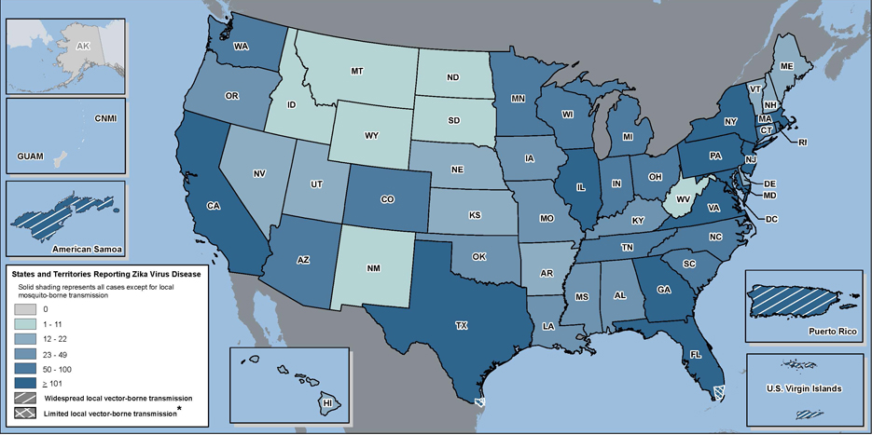
Zika Virus Disease in the U.S.
Laboratory-confirmed Zika virus disease cases reported to ArboNET by state or territory (as of May 3, 2017)
Source: CDC. Updated 5/3/17
Notes:
CDC manages the collection of data through ArboNET in collaboration with state and territorial health departments. ArboNET is a national arboviral surveillance system that collects information on laboratory-confirmed Zika virus disease cases reported from US states and territories.

Slide 64
Zika Virus Disease Cases by Mode of Transmission
United States, January 1, 2015 – May 3, 2017
Other Transmission routes include: sexual (46), congenital infection (28), Laboratory (1), person-to-person, unknown (1)

Slide 65
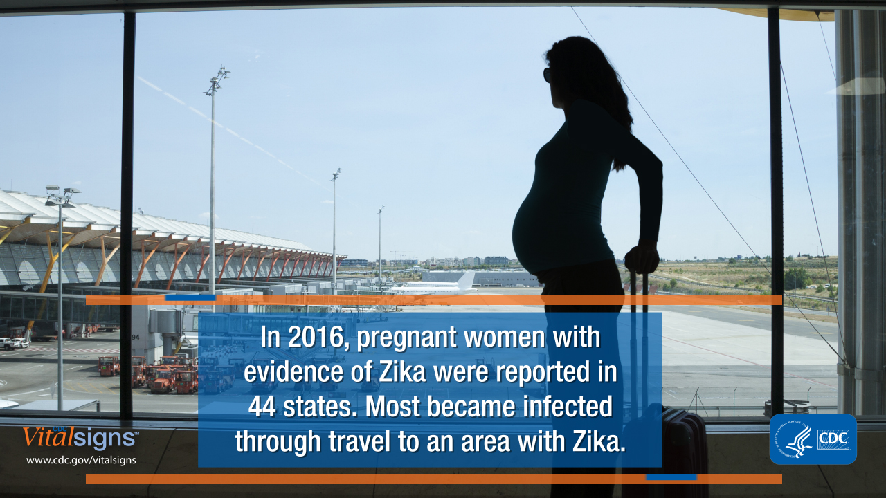

Slide 66

Pregnancy Outcomes in the United States
Pregnancy Outcomes in the US (Updated 4/25/17)
  1,793 pregnant women with laboratory evidence of possible Zika virus infection in the 50 US States and District of Columbia.
  1,409 completed pregnancies
    58 liveborn infants with birth defects
    8 pregnancy losses with birth defects
CDC.gov/zika
Notes:
Data accessed on 3/30/17, updated on 4/25/17 for pregnancy counts
Based on risk models from the current outbreak in Brazil, the estimated risk of microcephaly was 1-13% when the Zika infection occurred in the first trimester of pregnancy.
A report from the US Zika Pregnancy Registry found that about 6% of women with laboratory evidence of possible recent Zika virus infection had birth defects potentially related to Zika virus.
• The proportion of pregnancies with birth defects was similar (around 6%) among pregnant women who experienced symptoms and pregnant women who were asymptomatic.
• This emphasizes the importance of screening pregnant women for Zika risk and testing them when indicated, because asymptomatic women are just as likely to have babies with birth defects.

Slide 67

USZPR data
In 2016 the USZPR reported 972 completed pregnancies
  5% with possible Zika virus had birth defects
  10% with laboratory confirmed Zika had birth defects
  15% with laboratory confirmed Zika in the first trimester had birth defects
  These data are for symptomatic and asymptomatic mothers
Reynolds MR, Jones AM, Petersen EE, et al. Vital Signs: Update on Zika Virus–Associated Birth Defects and Evaluation of All U.S. Infants with Congenital Zika Virus Exposure — U.S. Zika Pregnancy Registry, 2016. MMWR Morb Mortal Wkly Rep 2017;66:366-373.

Slide 68
ZRBD data
Baseline prevalence of birth defects associated with zika infection
  CDC case definition was retrospectively applied to the population-based birth defects data collected in 3 areas of the country in 2013-2014
  Massachusetts, North Carolina, and Atlanta, Georgia
    All Zika-related Birth defects 2.86/1000
    Brain abnormality/microcephaly 1.5/1000
    Cragan JD, Mai CT, Petersen EE, et al. Baseline Prevalence of Birth Defects Associated with Congenital Zika Virus Infection — Massachusetts, North Carolina, and Atlanta, Georgia, 2013–2014. MMWR Morb Mortal Wkly Rep 2017;66:219–222.

Slide 69
Zika-related Birth Defects
January through September 2016
USZPR reported 26 infants/fetuses born to 442 mothers with the same baseline birth defects born to mothers with laboratory evidence of Zika Virus Infection
These data suggest a 20 fold increase in all Zika-related birth defects
30 fold increase in brain abnormalities and microcephaly
Cragan JD, Mai CT, Petersen EE, et al. Baseline Prevalence of Birth Defects Associated with Congenital Zika Virus Infection — Massachusetts, North Carolina, and Atlanta, Georgia, 2013–2014. MMWR Morb Mortal Wkly Rep 2017;66:219–222.

Slide 70
Vital Signs Morbidity and Mortality Weekly Report April 4, 2017

Slide 71
Zika Virus Infection in Kentucky
Cases with evidence of Zika in Kentucky (Updated 5/03/2017)
  34 cases with laboratory-confirmed Zika virus infection
    Adult cases have had travel exposure and/or sexual exposure to a traveler.
    No known local transmission.
  Most commonly reported symptoms in Kentucky:
    97% Rash
    74% Fever
    71% Arthralgia
    54% Conjunctivitis

Slide 72
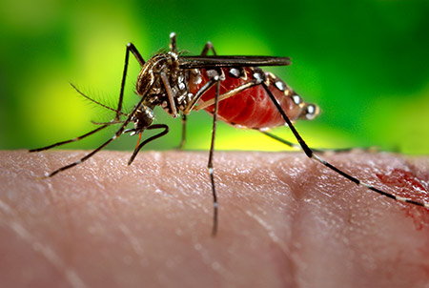
Following this talk ….
You should be familiar with the US Zika Pregnancy Registry (USZPR) and Zika-Related Birth Defects Surveillance (ZBDS)
You should be able to recognize some of the Zika-related birth defects
Have an understand of the similarities and differences between the USZPR and ZBDS
Have an understanding of why it is important to collect surveillance data on Zika virus and its effects
Be familiar with recent Zika prevalence data in the US and Kentucky

Slide 73
Questions?
Judy Theriot, MD, CPE
Medial Director
Commission for Children with Special Health Care Needs
Judy.Theriot@ky.gov

