Slide 1
Mosquito 101
Dr. Grayson Brown
Public Health Entomology Laboratory
Department of Entomology
University of Kentucky
Lexington KY

Slide 2
Mosquitoes in the N. American Suburban Landscape
About 150 spp. of mosquitoes in N. America in 8 genera. Of these:
< 10 are serious disease transmission threats
About 10 more are less serious threats
Another 20 or so are seasonal nuisance pests
Most problems are confined to a few species in only 2 genera: Aedes and Culex.
These two genera differ in very important ways.

Slide 3
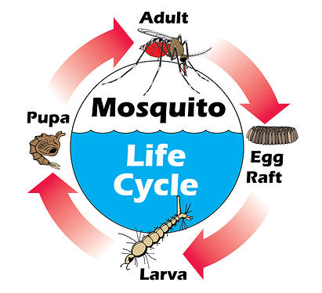
Mosquito Life Cycle
Larvae are wigglers
Pupae are tumblers (quite active)
Both breath air
Eggs are laid on the surface of water in rafts (Culex) or singly (Anopheles) or near water (Aedes)

Slide 4
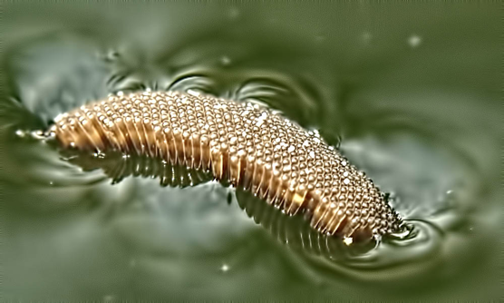
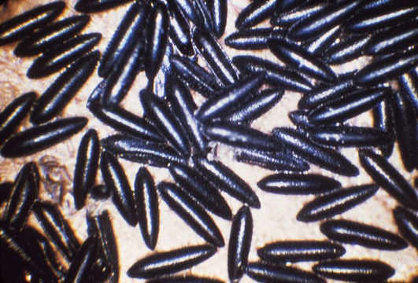
Eggs
Culex egg raft
Anopheles (note floats)
Aedes eggs are laid near water

Slide 5
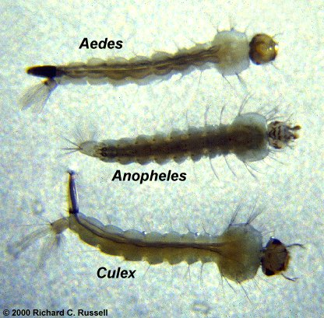
Mosquito Diet
Most Larvae feed on algae & bacteria but a few are predaceous and feed on other mosquito larvae
Only females are blood sucking
Males and females feed on nectar and other plant juices

Slide 6
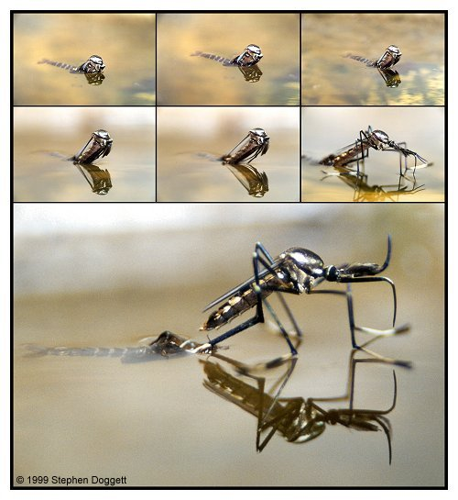
Mosquito Lifestyle
Most mosquitoes do not travel far from the water from which they emerged
Adults are active at night or twilight
Many spend the day in hollow trees, culverts, and dense shaded areas

Slide 7
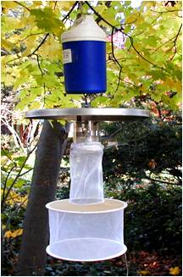
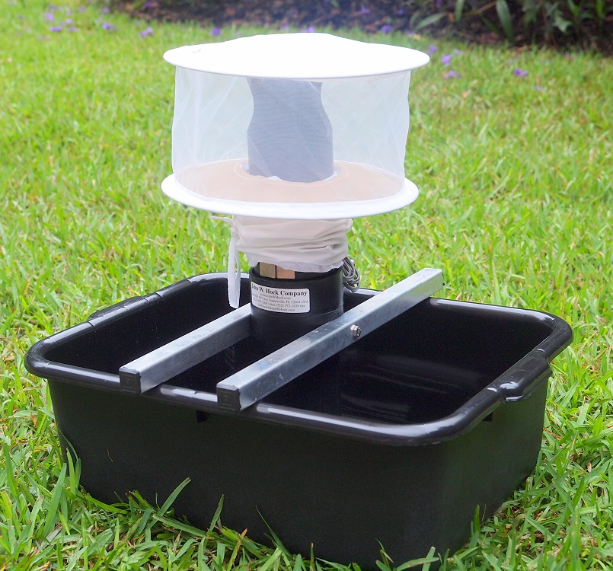
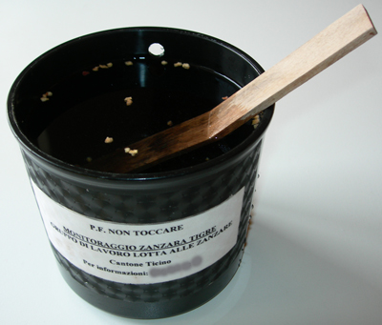
Mosquito Population Estimation
CDC Light Trap
Gravid Trap
Ovitrap
Catches mosquitoes looking to take a blood meal. Measures biting pressure
Catches mosquitoes that have HAD a blood meal and are looking for a place to lay eggs. Measures virus prevalence.
Collect eggs. Measures egg hatch rate, used for measuring resistance.

Slide 8
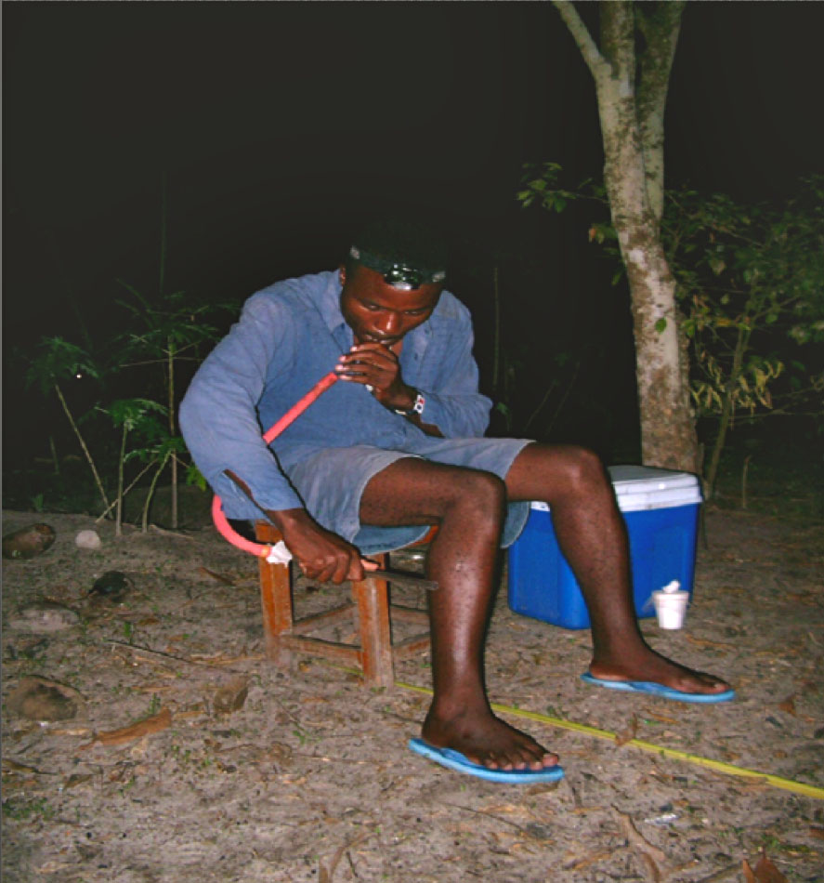
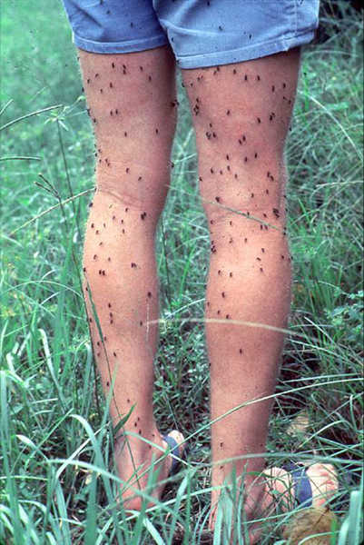
Biting Rate Estimation
Human Landing Rate is the best kind of measurement
All other methods are surrogates for this.
Generally requires a volunteer to sit/stand still for a period of time and count the number of mosquitoes that land on them.
Banned by most agencies, universities, and corporate concerns.

Slide 9
Two Generic Biologies
Aedes/Ochlerotatus | Culex
Dengue, EEE, LaCrosse, Chikungunya, Zika | West Nile, SLE, other encephalitis
Attacks mammals | Attacks birds, few human bites
Daytime – early evening | Late night – early morning
Prefers cleaner water | Prefers stagnant water
Few gens/year, OW as eggs | Many gens/year, OW as adult
Daytime resting sites < 10 ft (bushes) | Daytime resting sites > 10 ft (trees)
We have several species within both groups that are especially important

Slide 10
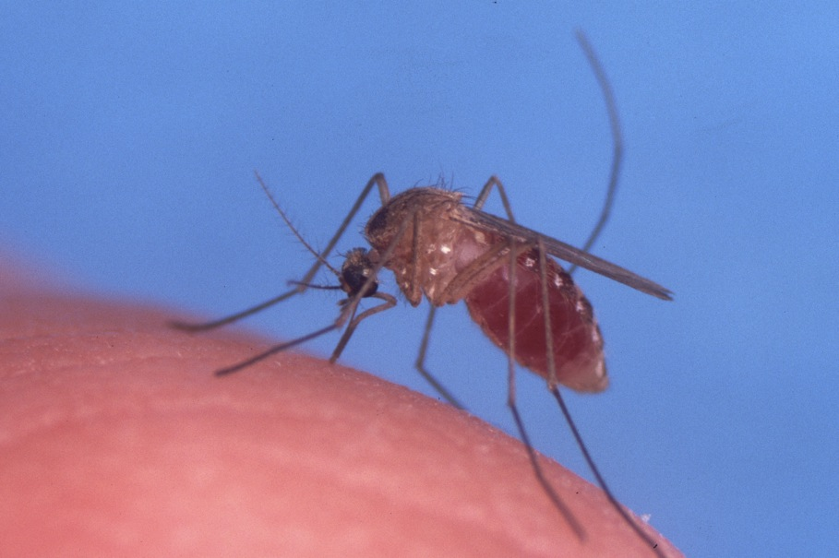
Culex pipiens/restuans
Northern house mosquito
Most likely to transmitt WNV
Feeds at night on birds, humans

Slide 11
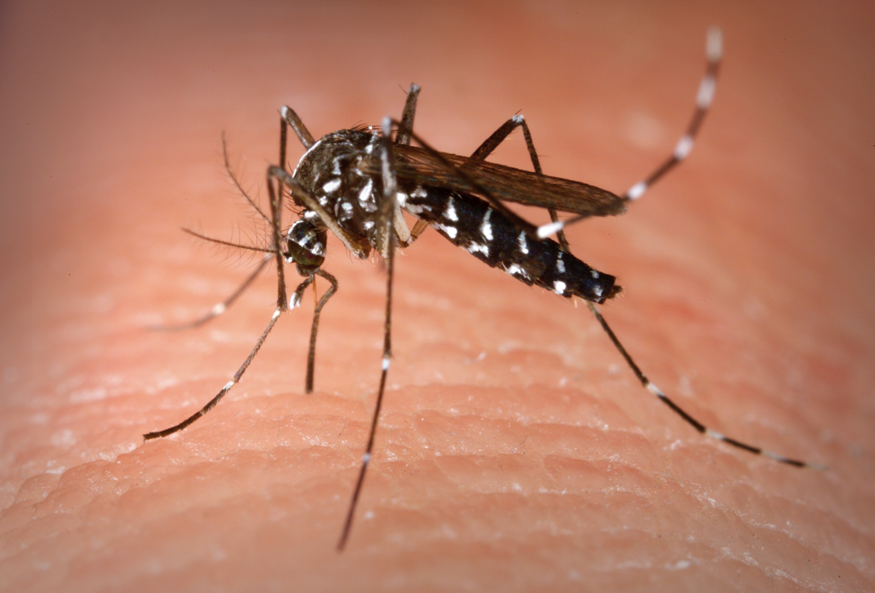
Aedes albopictus
Asian tiger mosquito
Nuisance biter, potential dengue/chikungunya vector
Feeds evenings, mornings on humans

Slide 12
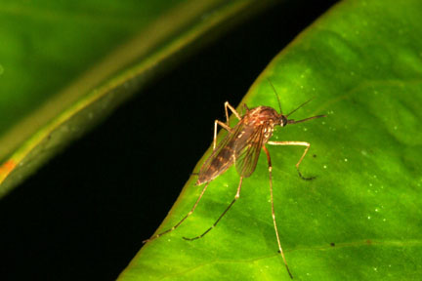
Aedes vexans
Inland floodwater mosquito
Nuisance biter, transmits dog heartworm, WEE/EEE
Feeds at dusk

Slide 13
Control Options
Larvicides
Nonresidual Adulticides
Residual Adulticides
Other
Biological Controls
Genetic Techniques

Slide 14
Larvicides
Smothering agents
Oils (Cocoabear)
Monomolecular films (Aquatain) -- surfactants
IGR
Methoprene (Altosid) – increasingly rotated for resistance management
Pyriproxyfen (Archer)
Nerve toxins
Spinosad (Natular)
Temephos (Abate)
Bacterials
BTI
B. sphaericus (VectoLex)

Slide 15
Larvicide Formulations
Natular™ 2EC
Natular™ XRT
Natular™ T30
Natular™ DT (International)
Natular™ G
Natular™ XRG

Slide 16
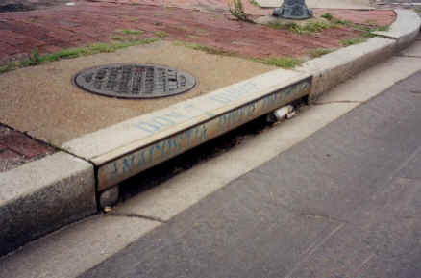
Natular™ XRT Briquets Habitat: Catch Basins Location: Minnesota
Notes:
THIS IS XRT DATA!!!
As was the case with the T30 tablet, MN uses successful development of larvae to the pupal stage (with cumulative pupal numbers) to get a picture of the XRT tablet’s efficacy over the season.
Metropolitan MCD treated their basins prior to on-set of their larval populations – essentially a pre-treatment.
That’s why you don’t see the black diamonds – the untreated basins – pupal populations rise until nearly a month after treated basins received an XRT tablet. Once pupal populations are found, they continue to rise for the duration of the season (and likewise adults emerge from the basins).
However, look at the white squares representing XRT treated catch basins – flat lined! The population was successfully controlled for the entire season!

Slide 17
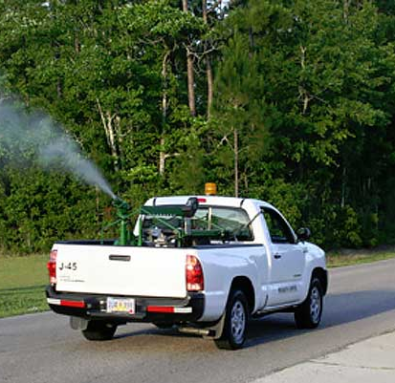
Nonresidual Adulticides
Nerve toxins, sumethrin (Anvil), Naled, malathion
Applied with ground equipment or aircraft
Applied at ULV rates: 1 – 2 oz/Acre of product.
Ideal is to use adulticides as a way to
regain lost control
prepare population for a more sustainable control method
Wide area applications
3-step process
Pre-treatment sample the night before
Droplet capture/measurement the night of treatment
Post-treatment sample the night after

Slide 18
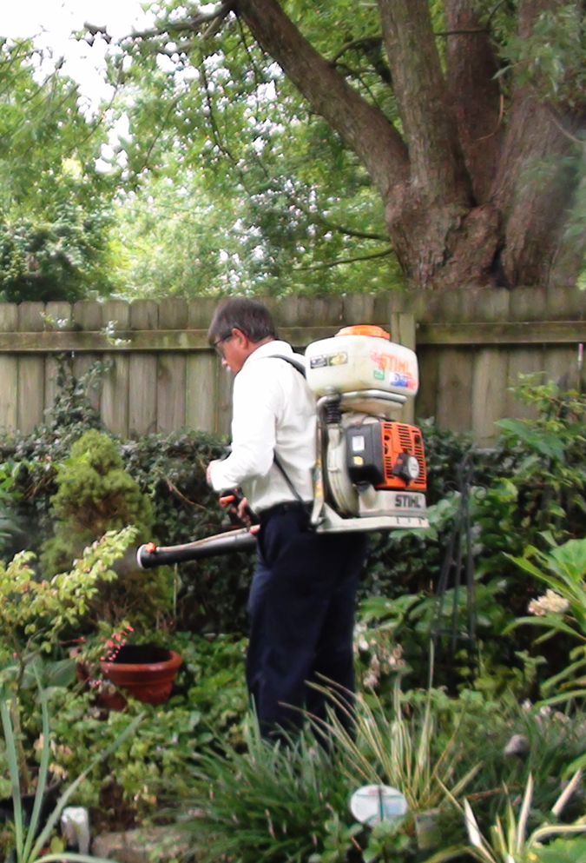
Residual Insecticides
Products are bifenthrin, lambda cyhalothrin, deltamethrin
Target the adult resting sites
Main advantages
Extremely effective against Aedes spp.
Can be targeted to small areas
Effect lasts weeks – months
Well suited for spot treatments
Basis for the backyard mosquito control services

Slide 19
Municipal Control Vs. Backyard Control
The two are compatible and complementary
 | Municipal ULV | Backyard Perimeter
AI | Sumithrin, dibrom, malathion | Lambda cyhalothrin, bifenthrin, deltamethrin
Application Time | Late PM/Early AM | Daytime
Residual activity | Hours | Weeks/months
Spatial Scale | Area Code | Single Backyard
Most effective against | Culex spp, some Anopheles | Aedes, Ochlerotatus
Diseases Controlled | West Nile, other encephalitis | Zika, Dengue, Chikungunya

Slide 20
How does this method help in a public health context?

Slide 21
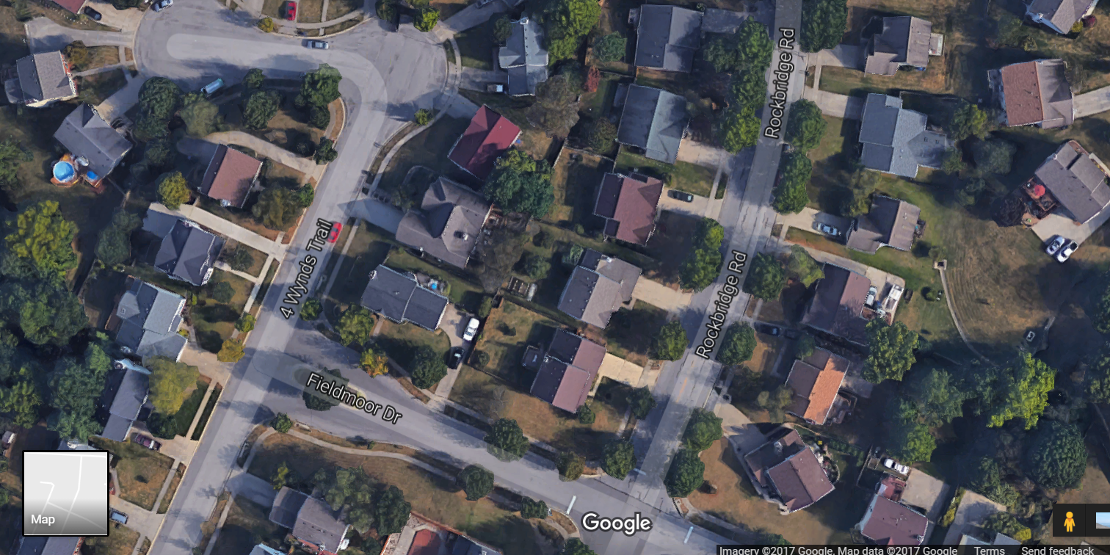
Consider a home with a viremic patient

Slide 22
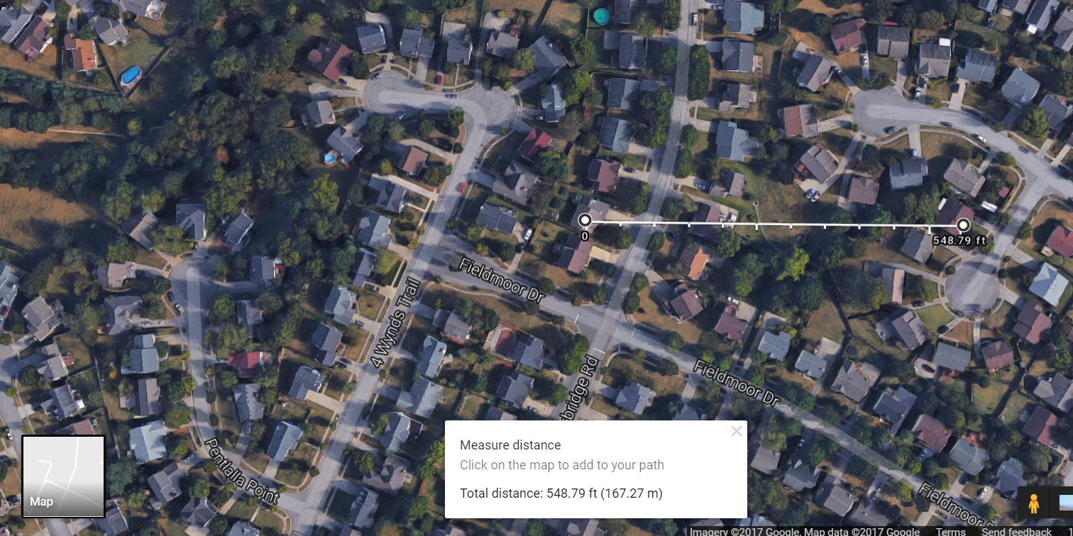
How far away from that home do we need to treat?

Slide 23
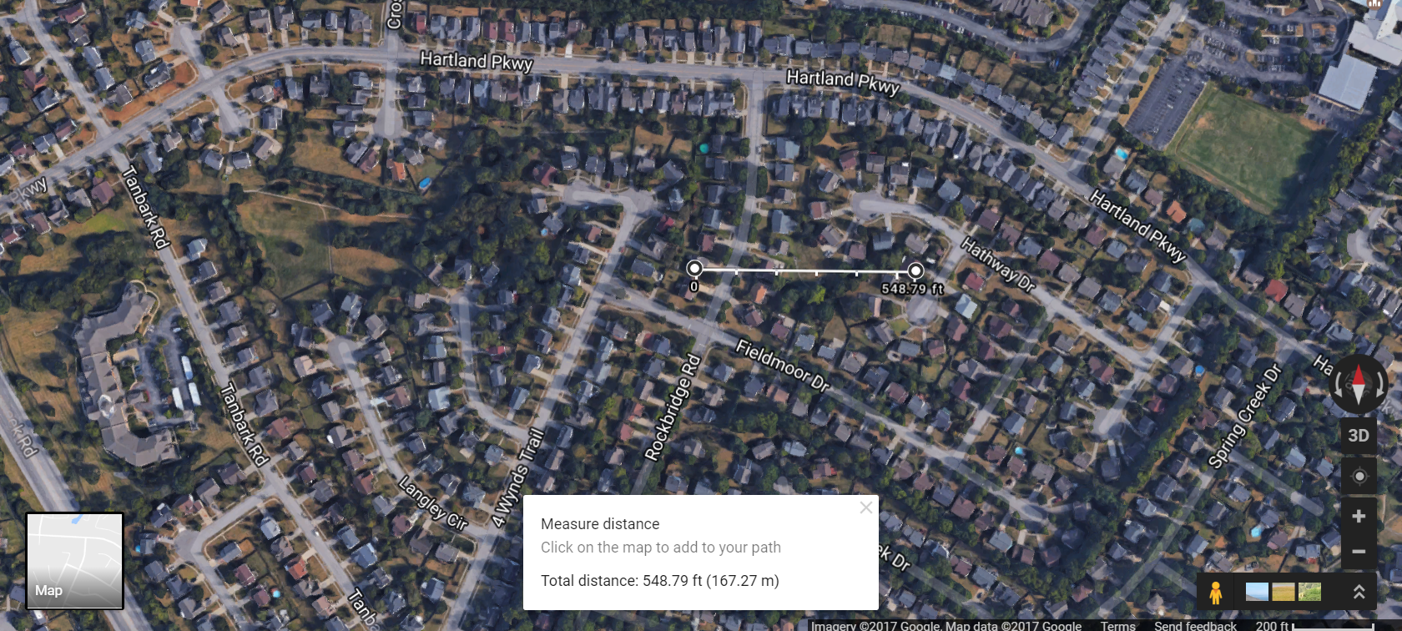

Slide 24
Mosquito Density
Viremic Home

Slide 25
Consider a home with a viremic patient

Slide 26
Technique and properties are important
Bad Things:
Properties with little to no perimeter vegetation
Properties whose predominate vegetation is grass and flower/vegetable/herb gardens
Treating grass/flowers/vegetables
Treating in a haphazard pattern
Failing to use proper PPE

Slide 27
Bad Property, Bad Technique

Slide 28
Good Property, Good Technique

Slide 29
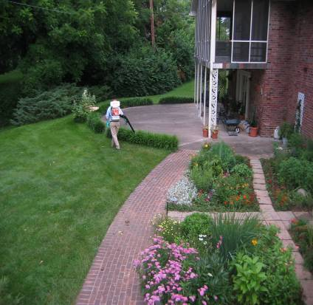
Dense non-flowering ground vegetation

Slide 30
Dense Canopies

Slide 31
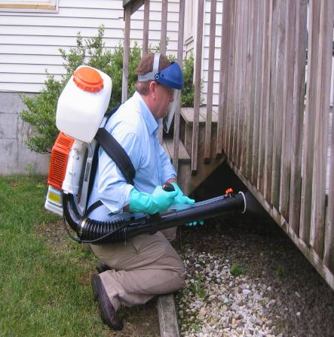
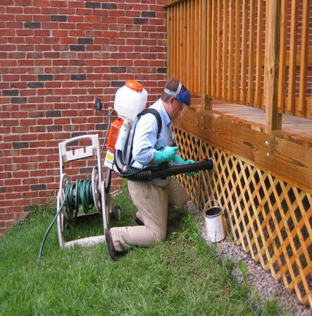
Underneath decks, crawlspaces or other raised structures

Slide 32
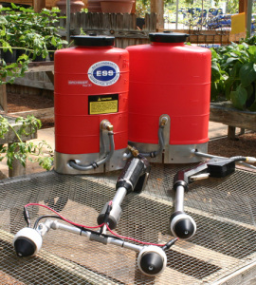
Other Application Equipment
Electrostatic Sprayers – imparts a positive electric charge to droplets
Advantages
Better coverage
Less drift
Possibly less product
Disadvantages
More expensive
Needs a hose (air and/or product)
Less field experience

Slide 33
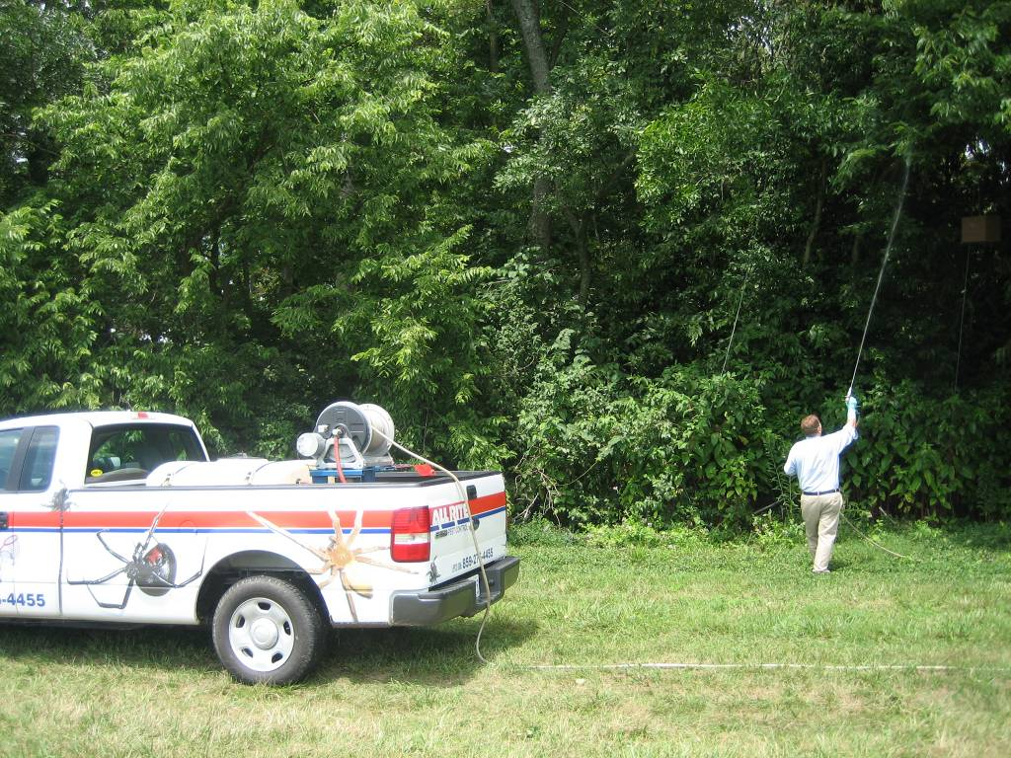
Low Pressure Sprayers
Advantages
Less cost
More familiar
Disadvantages
Long hose
Poorer coverage

Slide 35
What results should you expect?

Slide 36
Excellent control of Aedes
96% Aedes species
Avg. 60% reduction over 6 weeks
Avg. 75% reduction after 1 week
Before Treatment
After Treatment
96% Aedes

Slide 37
Greatly reduced mosquito bites
98% Aedes species
73% reduction over 6 weeks
85% reduction after 1 week
98% Aedes

Slide 38
Mosquito bites on humans (2015 data)
Notes:
The results of our Human Landing Rate counts showed a striking effect of nuisance mosquito control, through week 9. These counts were performed between 4:30 and 6:30 PM, when the majority of homeowners indicated they were likely to be outdoors. Counts were taken every minute for 5 minutes. Both treatments showed a significant effect 9 weeks post-treatment and the most commonly observed mosquito was Aedes albopictus.

Slide 39
Barrier treatments are only one part of a mosquito isolation effort

Slide 40
Residents
They have responsibility too
Source Reduction
Avoiding pruning/removal of treated foliage
Ideally removing harborage sites prior to treatment
Gutter repair
Expectations
Suppression is not elimination
May reduce some disease risk but not all

Slide 41
Questions?

Slide 42
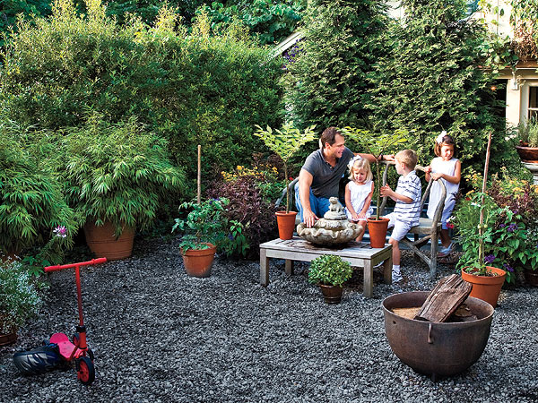
How do they move toward people?
Direction of air movement
CO2 Plume

Slide 43
How do they move toward people?
Direction of air movement
CO2 Plume

Slide 44
This is the basis for how perimeter applications for mosquito control work.
Resting Sites
Transit points
In our previous example …

Slide 45
How do they move toward people?
Resting Site
Transit Points

Slide 46
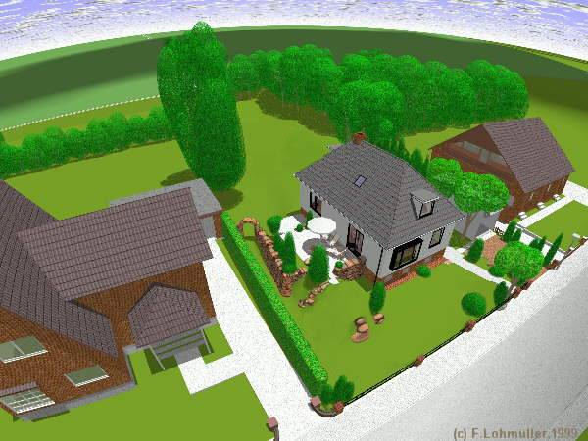
Objective is to treat mosquito adults’ daytime resting sites/transit points and work FROM the house

Slide 47
Start with vegetation near home

Slide 48
Then vegetation in the yard

Slide 49
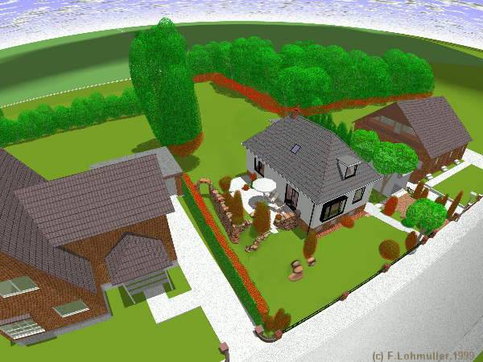
Finally treat the perimeter

Slide 50
Objective is to flush the mosquitoes from the yard

