Slide 1
Hot Topics in Flaviviruses
Dora V. Savani-Blackham M.D.

Slide 2
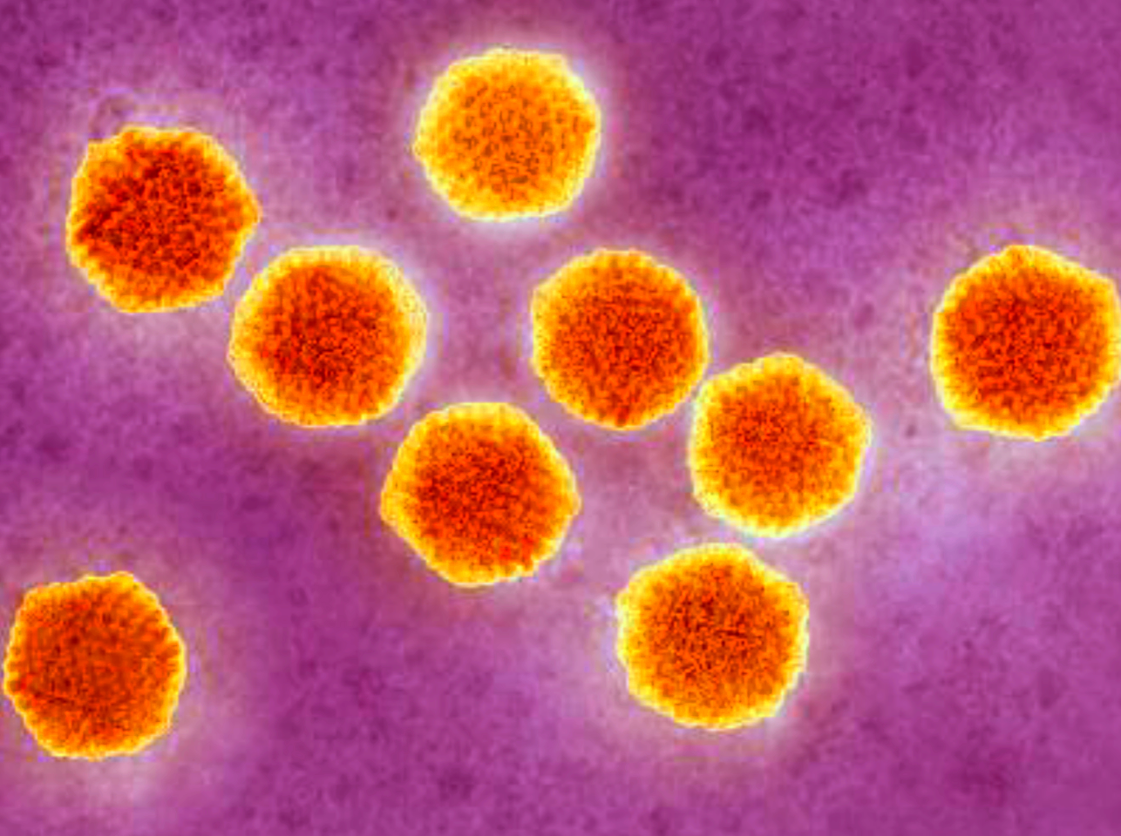
Zika Virus
1

Slide 3
ZIKA VIRUS INFECTION
An arthropod-borne FLAVIVIRUS transmitted by mosquitoes
Related to other FLAVIRUSES: Dengue, Yellow Fever, Chikungunya, West Nile, and Japanese Encephalitis virus
Newly emerging in the Western hemisphere with on-going outbreak in the Americas, Caribbean, and the Pacific

Slide 4
ZIKA VIRUS COMPLICATIONS
Congenital microcephaly (29%)
Fetal losses
Widespread brain calcifications
Ventricular enlargement
Optic nerve abnormality
Macular atrophy
Hydranencephaly
Guillain-Barre syndrome:
2.4 cases per 10,000 Zika virus infections

Slide 5
ZIKA VIRUS
ZIKA virus RNA has been detected in blood, urine, semen, saliva, CSF, amniotic fluid, and breast milk
ZIKA RNA can be detected in the blood from 3-7 days post infection by rt-PCR
Pregnant women may have longer viremia and viral RNA has been detected up to 10 weeks after symptom onset
French Polynesia outbreak: 3% of donated blood tested Positive for ZIKA RNA by rt-PCR

Slide 6
ZIKA VIRUS
ZIKA virus is detected in the urine of an infected person for at least two (2) weeks after onset of symptoms
ZIKA virus has been detected in semen 62 days after onset of febrile illness, when it was no longer detected in the blood
Semen viral load may be high; in one report the VL>2 weeks post symptoms was roughly 100,000x that of blood or urine

Slide 7
ZIKA VIRUS
First isolated in a rhesus monkey in 1947 at the Zika Forest in Uganda
Humans cases were described in 1952 in Uganda and Tanzania
Spread across Equatorial Africa and Southeast Asia
First recognized outbreak occurred in Micronesia in 2007 (70% population infected: 5,000 cases from total population of 6,500)
Large outbreak French Polynesia in 2013 ( 2/3 of population affected with ~32,000 infections)
First case in the WH in February 2014 on Chile’s Easter Island
Brazil in May 2015
December 2015 was detected in Puerto Rico

Slide 8
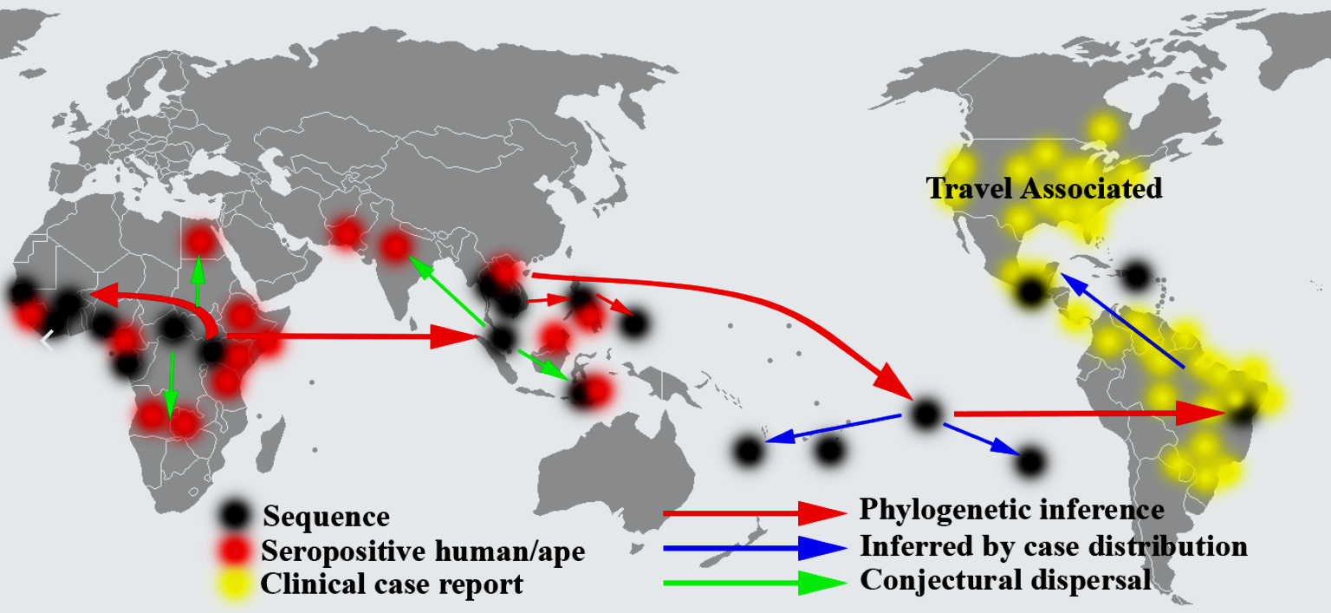
ZIKA VIRUS THROUGH the YEARS
2

Slide 9
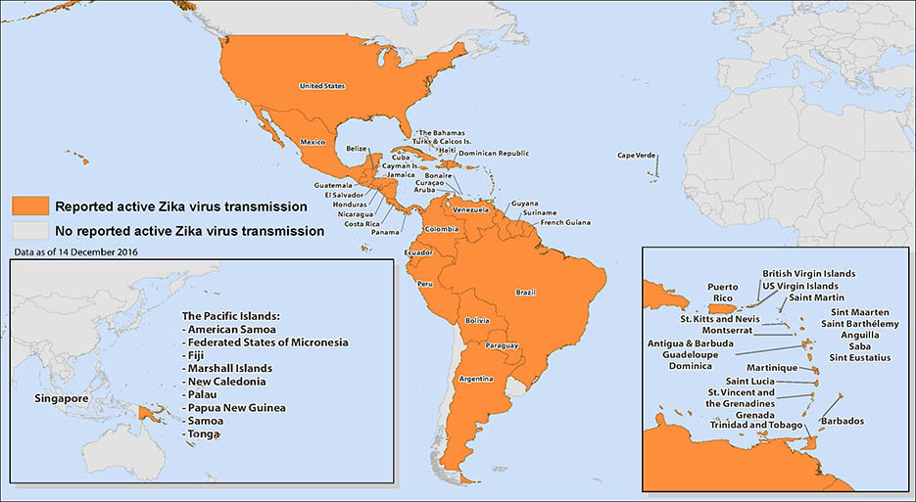
3

Slide 10
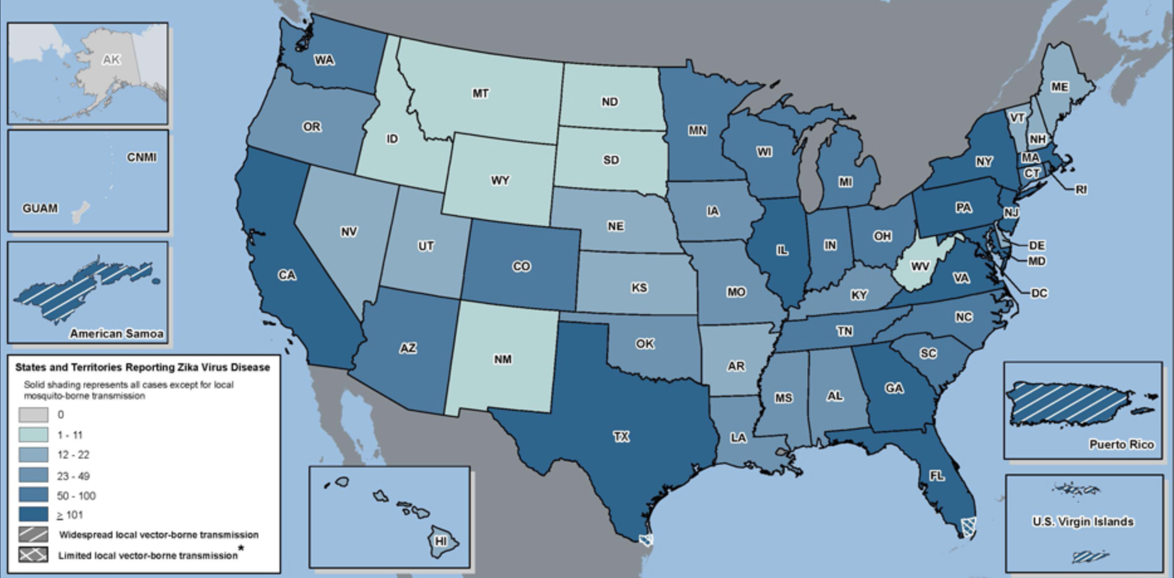
ZIKA VIRUS in the USA

Slide 11
Aedes aegypti
7
6

Slide 12
Aedes albopictus
5
4

Slide 13
ZIKA VIRUS in the USA
Total of 5,274 cases to date
4,973 travelers returning from affected areas
224 cases local mosquito-borne transmission in Florida (218) and Texas (6)
77 cases acquired through other routes including sexual transmission (46), congenital infection (29), laboratory transmission (1), and person-person through unknown route (1)
US Territories: 36,574 cases, of which 35,422 from Puerto Rico alone

Slide 14
ZIKA VIRUS in the USA
Kentucky: 34 cases and 0 case of asymptomatic viremic blood donors
Ohio: 85 cases and 0 case of asymptomatic viremic blood donors
Indiana: 51 cases and 0 case of asymptomatic blood donors
California: 447 cases and 5 cases of asymptomatic viremic blood donors
Florida: 1,134 cases and 26 cases of asymptomatic viremic blood donors
Texas: 326 cases and 5 cases of asymptomatic viremic blood donors

Slide 15
Cases in U.S. Pregnant Women
1,793 pregnant females infected with Zika in the continental USA
1,409 completed pregnancy with or without birth defects
58 liveborn infants with birth defects
8 pregnancy losses with birth defects
US Territories: 3,700 pregnant females infected with Zika
CDC: “American mothers infected with the Zika virus last year were 20 times as likely to give birth to babies with birth defects as mothers who gave birth two years before the epidemic”

Slide 16
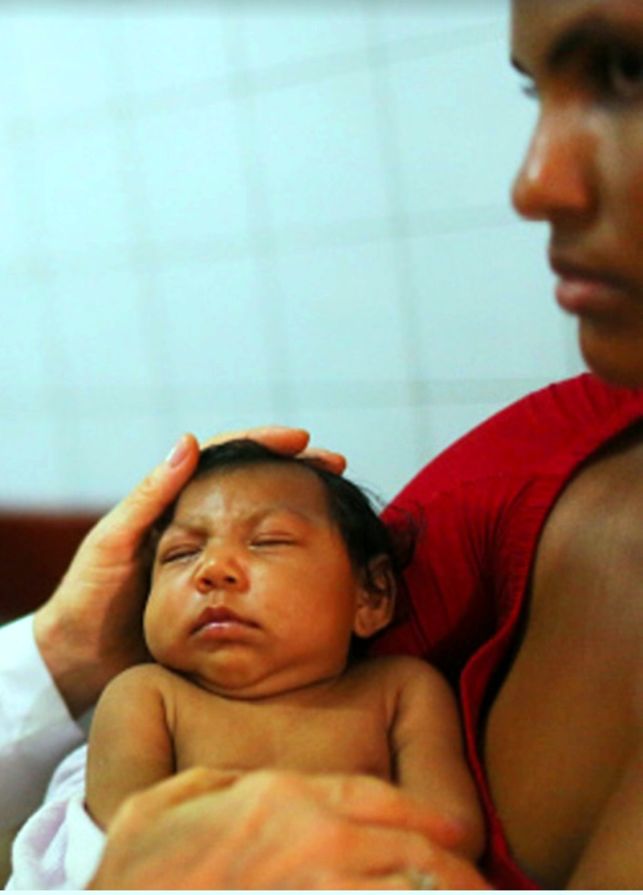
MICROCEPHALY in BRAZIL
9
8

Slide 17
MICROCEPHALY and ZIKA VIRUS
Not recognized at the time of the outbreak in the Yap Islands of Micronesia in 2007
Similarly, no fetal abnormalities initially detected in the French Polynesia outbreak in 2013-2014
Subsequent retrospective studies identified 19 cases of fetal abnormalities and a baseline microcephaly prevalence of 2 cases per 10,000 neonates (0.02%)
Risk of microcephaly associated ZIKA was of 95 cases per 10,000 women infected in the first trimester
Risk during that outbreak was estimated at 1%

Slide 18
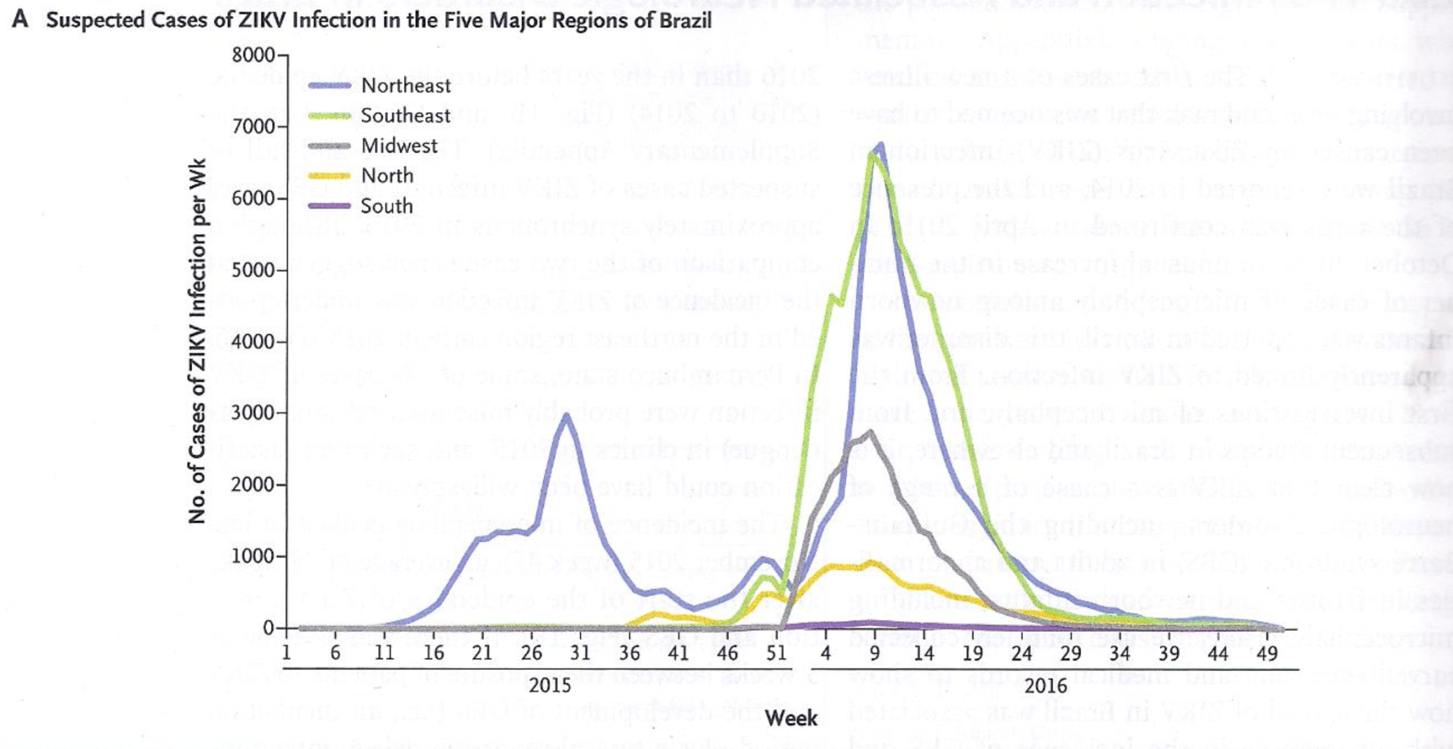
Zika Virus Infection and Associated Neurologic Disorders in Brazil

Slide 19
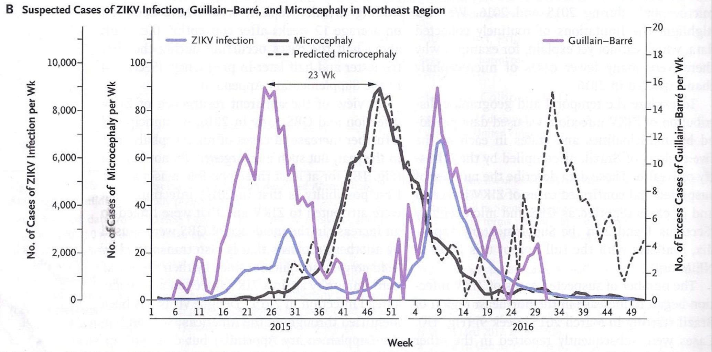
Zika Virus Infection and Associated Neurologic Disorders in Brazil

Slide 20
Children Aged <18 Years with ZVD Acquired Postnatally – U.S. [01/2015-07/2016]

Slide 21
Children Aged <18 Years with ZVD Acquired Postnatally – U.S. [01/2015-07/2016]

Slide 22
Zika in Transplants Patients (Am Journal Transplant-March/2017)
187 solid organ transplants performed in a center in Brazil between Jan 2015-April 2016
40 patients (29 Kidney, 11 liver) suspected of having Arbovirus disease
4 transplants recipients with confirmed ZVD by rt-PCR: 2 Liver and 2 Kidney
Symptoms: fever, myalgia, headaches, cough, anemia, thrombocytopenia, all with allograft dysfunction and 3 with bacterial superinfection
No Fatalities and no neurological sequelae

Slide 23
Transient Hearing Loss in Adults Associated with ZVD(CID March 2017:64)
Describes 3 patients with ZVD (1 confirmed and 2 probable) with acute hearing loss, tinnitus and dizziness
Supported by time-based audiometric studies
Hearing loss was transient and 2 recovered completely
Transient otologic symptoms persists for up to 28 days causing moderate to severe hearing disability and interfering with speech comprehension

Slide 24
Can Previous Dengue Virus Infection Exacerbate Subsequent Zika Infection
Priyamvada L., et al. (Proc Natl Acad Sci USA 2016: 113:7852-7) showed that serum from Dengue infected individuals, and monoclonal antibody derived from plasmablasts from these individuals enhanced in vitro infection by Zika virus of cells displaying Fc gamma receptor
Dejnirattisai, W., et al. (Nat Immunol 2016:1102-8) similarly demonstrated serological cross-reactivity of Dengue-immune plasma, as well as its ability to drive antibody-dependent enhancement of Zika infection in vitro

Slide 25
Dengue-virus-Specific antibodies enhance Brazilian Zika Infection (JID 3/2017:215)

Slide 26
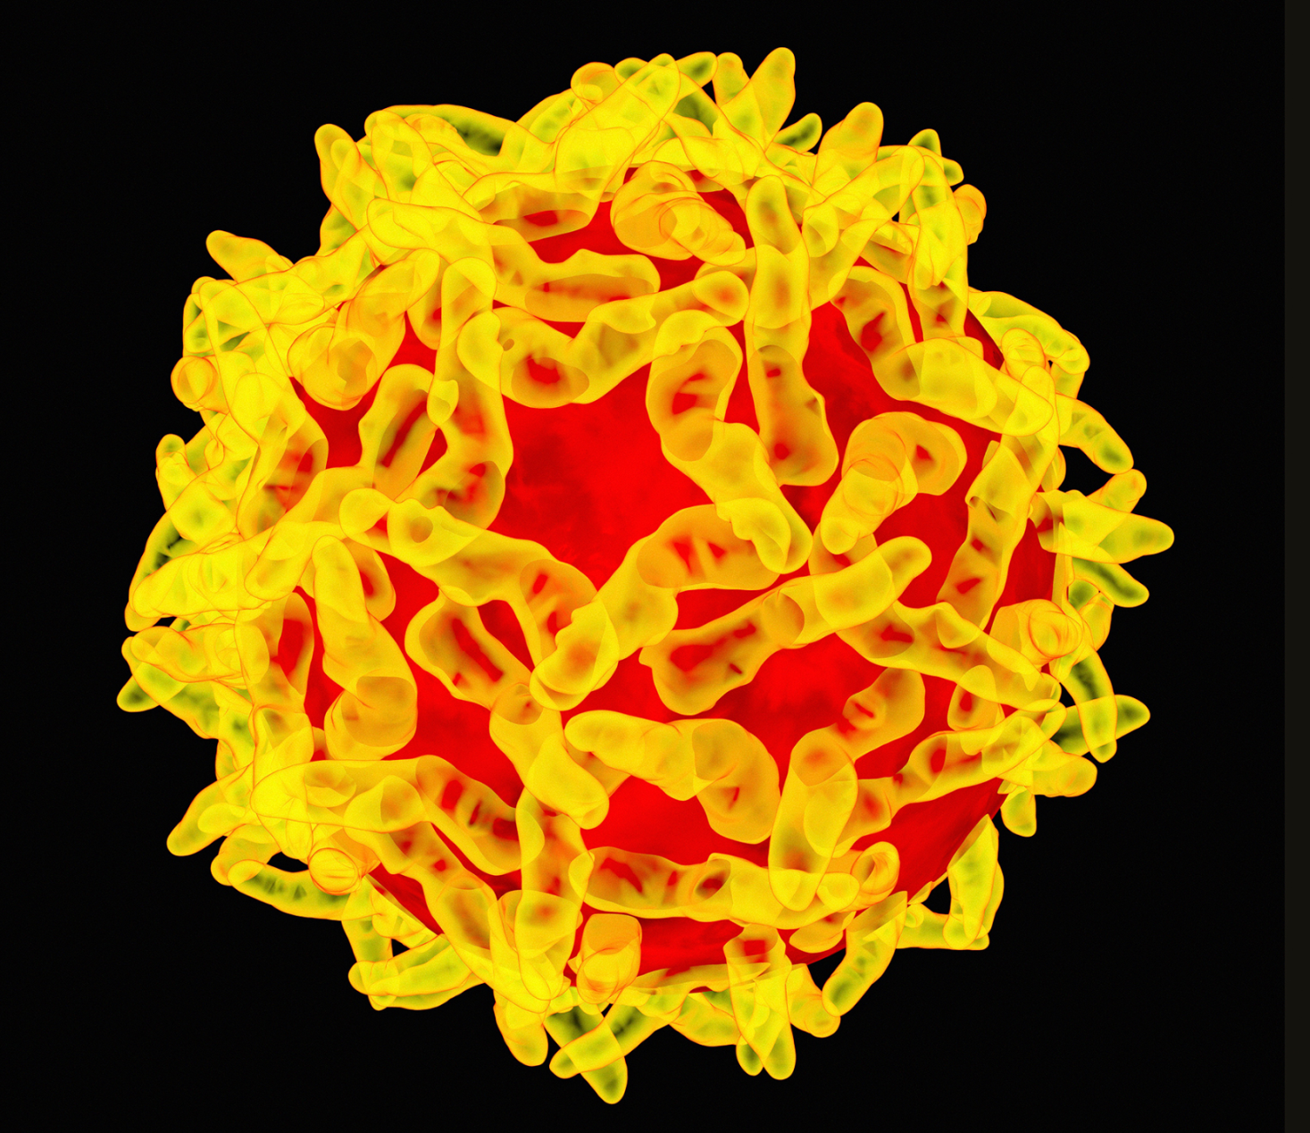
Yellow Fever

Slide 27
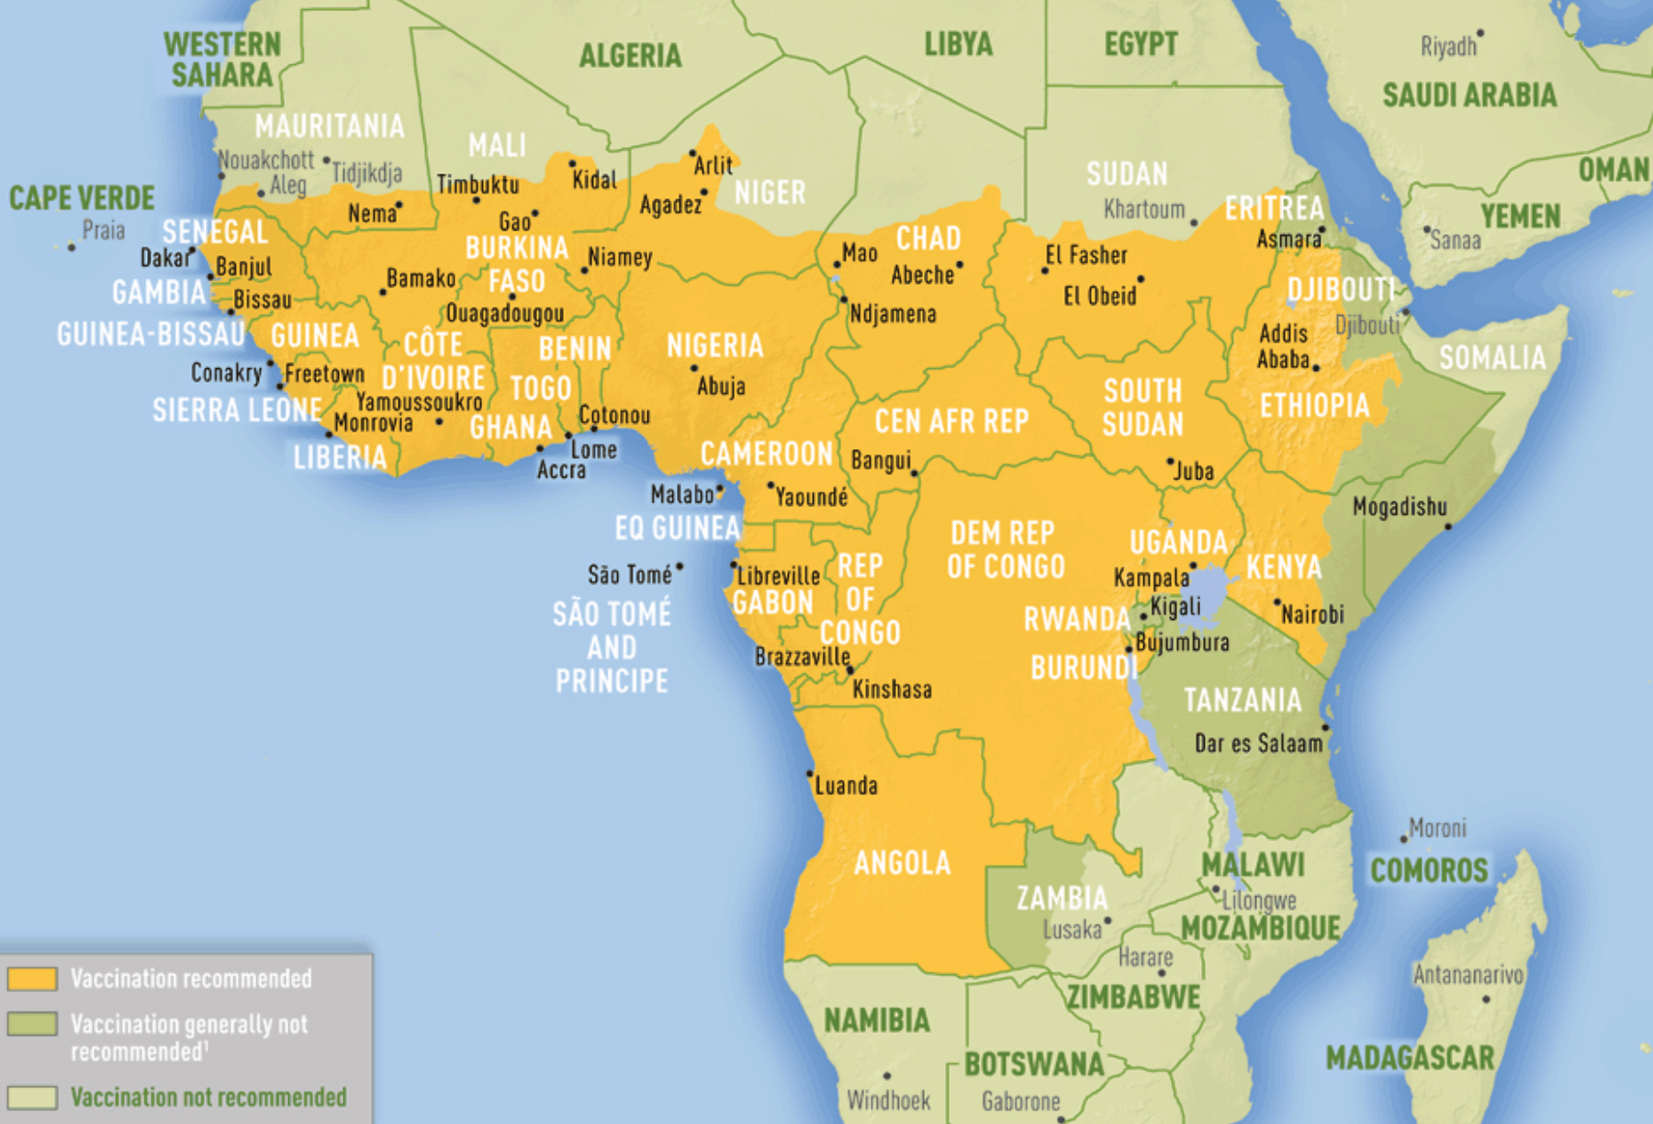
Yellow Fever – Once Again on the Radar

Slide 28
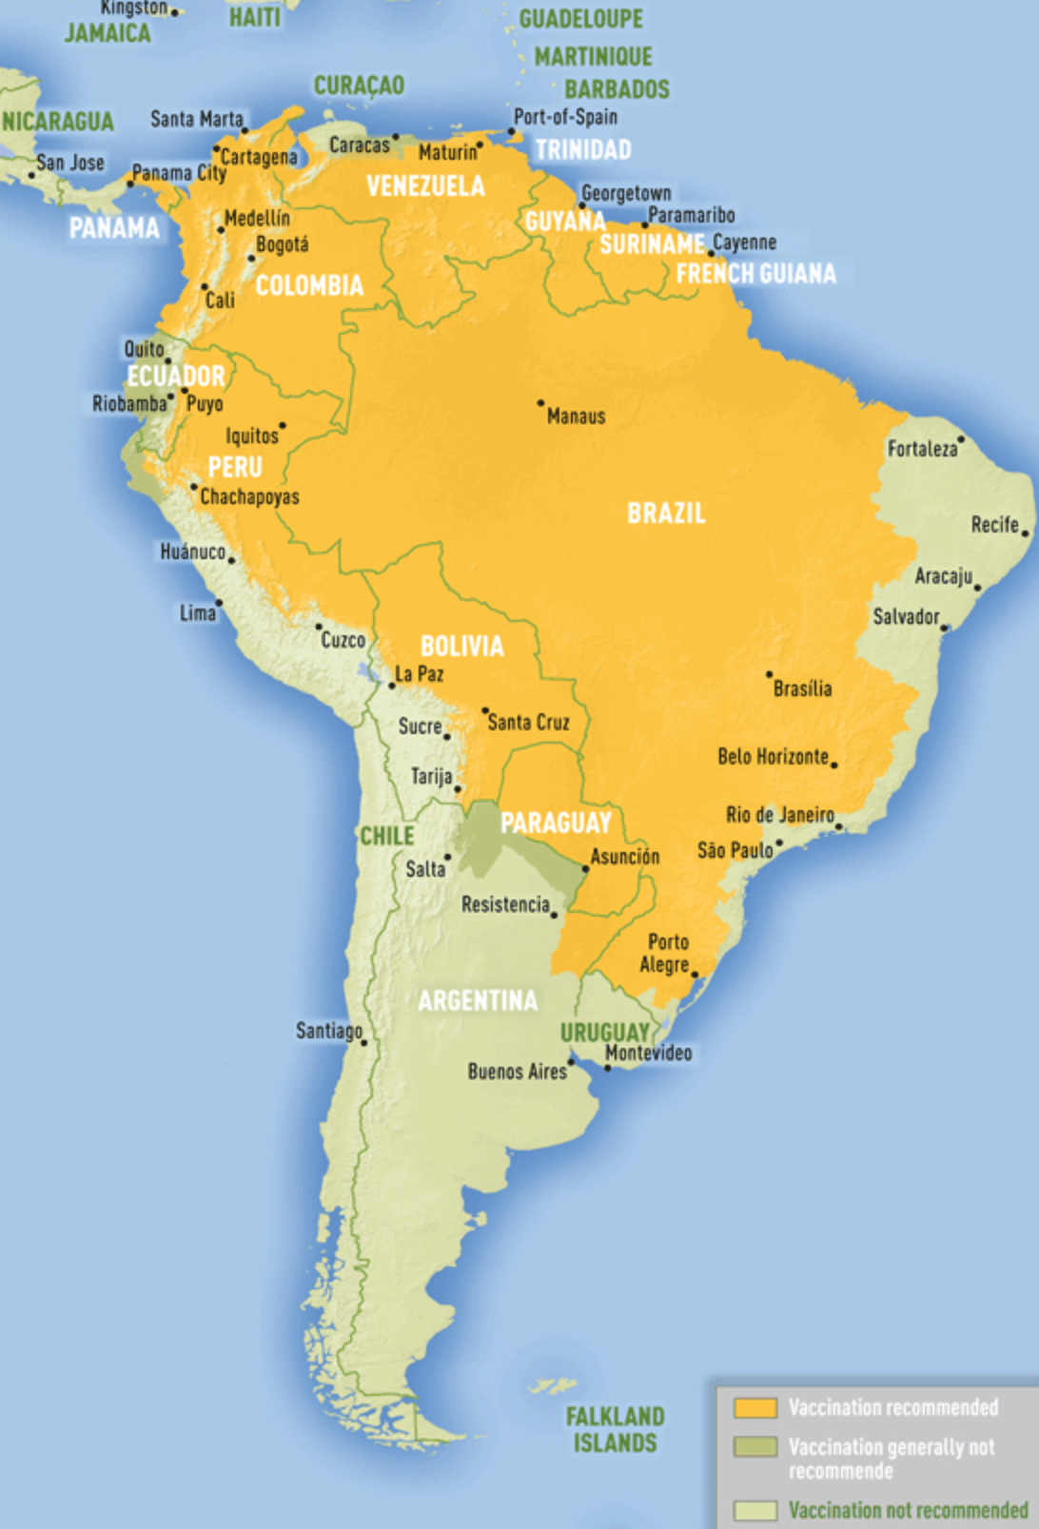
Yellow Fever – Once Again on the Radar

Slide 29
Yellow Fever – Since December 2016 Through April 27, 2017
1542 cases of Yellow Fever reported
715 confirmed
825 under investigation
240 deaths (confirmed)
39 deaths (under investigation)
Case fatality rate (CFR): 34% among confirmed cases
6 states: ES, MG, Pará, RJ, SP, Tocantins
To date Aedes aegypti has not been reported to have roll in transmission (“urban yellow fever”)
Haemagogus species sylvatic transmission “jungle yellow fever”

Slide 30
Yellow Fever Outbreak Southeast Brazil

Slide 31
REFERENCES
Tang H, Hammack C et al. ZIKA virus infects Human Neural Progenitors and Attenuates Their Growth. Cell Stem Cell 2016
Garcez PP, Loiola EC,Madeiro da Costa R, et al. Zika virus impairs growth in human neurospheres and brain organoids. Science 2016.
Milakar J, Korva M, Tul M et al. Zika virus associated with Microcephaly. NEJM 2016; 374:951.
WHO. Consensus on casual link between Zika and neurological disorders. http://www.euro.who.
Driggers RW, Ho CY, et al. Zika virus Infection with prolonged Maternal Viremia and fetal Brain abnormalities. NEJM 2016.

Slide 32
REFERENCES
Carteaux G, Marquat M, Bedet A,et al. ZIKA Virus associated with meningoencephalitis. NEJM 2016; 374:1595
CDC and Prevention. New CDC laboratory Test for Zika Authorized for Emergency Use by FDA. http://www.cdc.gov
UN Dept of Economic and Social Affairs. http://www.esa.un.org
Brazil Turism. http://www.dadosefatos.turismo.gov.br
WHO. Zika virus and the Olympic and Paralypmic Games Rio 2016. http://www.who.int

Slide 33
13

