Slide 1
Growing Threat of Vector-Borne Diseases
Dr. Grayson C. Brown
Public Health Entomology Laboratory
Department of Entomology
University of Kentucky

Slide 2
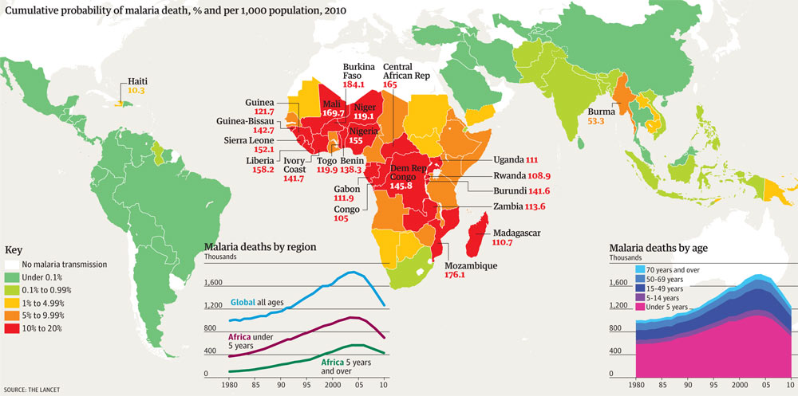
Shouldn’t vector-borne disease be in decline by now?
For some things, like malaria, it is.

Slide 3
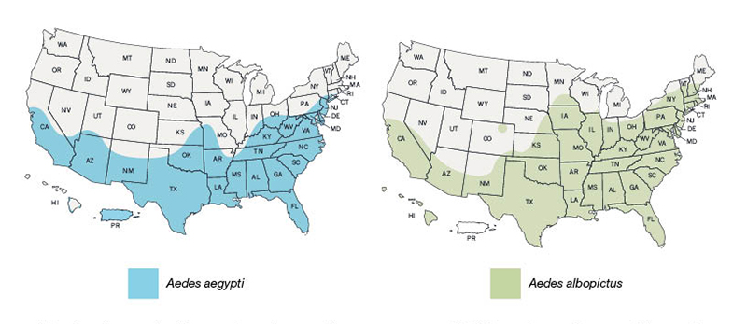
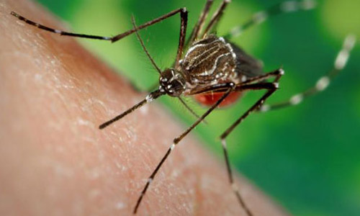
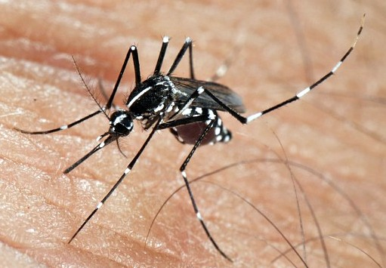
Two important container breeders
85% of mosquito bites in suburban KY
yellow fever mosquito
Asian tiger mosquito

Slide 4
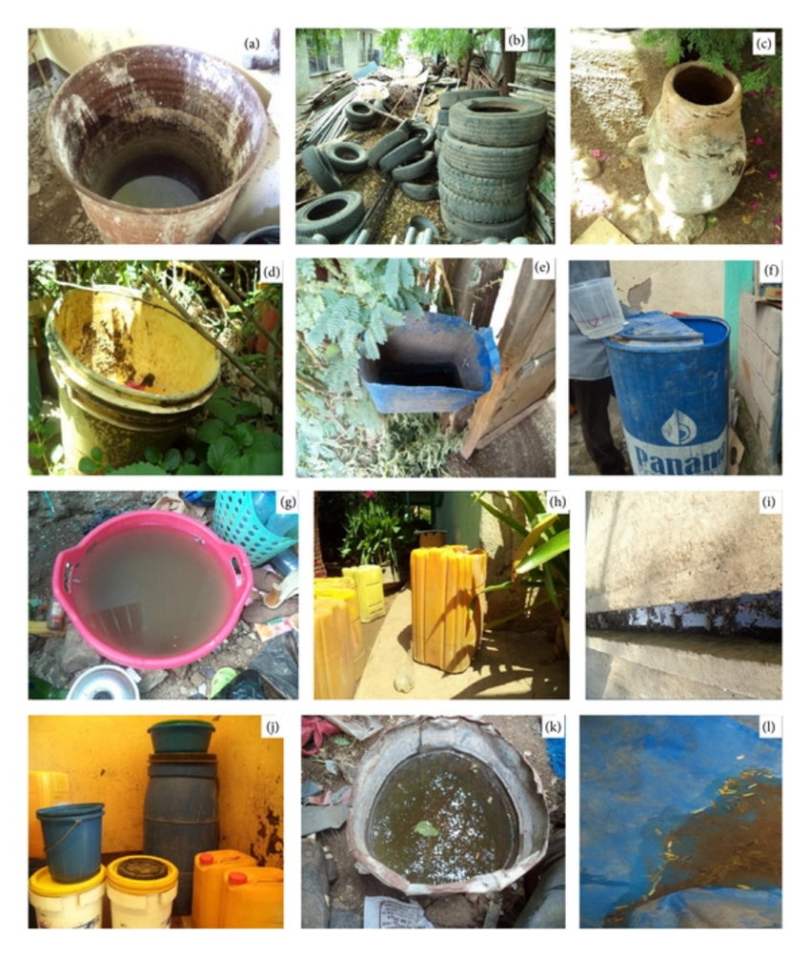
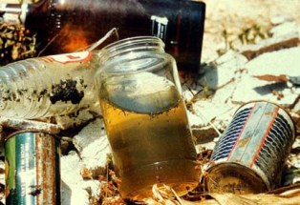
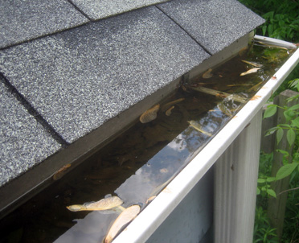
Mostly breed in human-created containers
Found where people are

Slide 5
Recent mosquito-borne disease threats
West Nile Virus: 1999 – 2006
Dengue: 2005 – 2011
Chikungunya: 2011 – 2015
Zika: 2016 – Present
Yellow Fever is currently epidemic in Brazil
Mayaro now circulating in the Caribbean & S. America
Oropouche virus – numerous recent outbereaks in S. America affecting about 500,000 people. Bunyavirus with WNV-like symptoms,
President Obama proposes to cut CDC Division of Vector Borne Infectious Disease

Slide 6
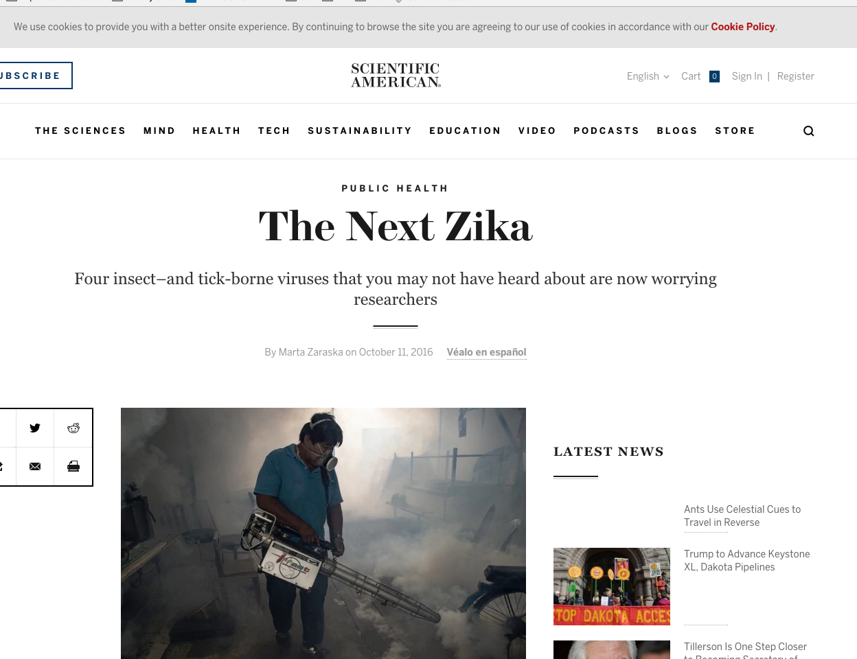
Mayaro is gaining traction

Slide 7
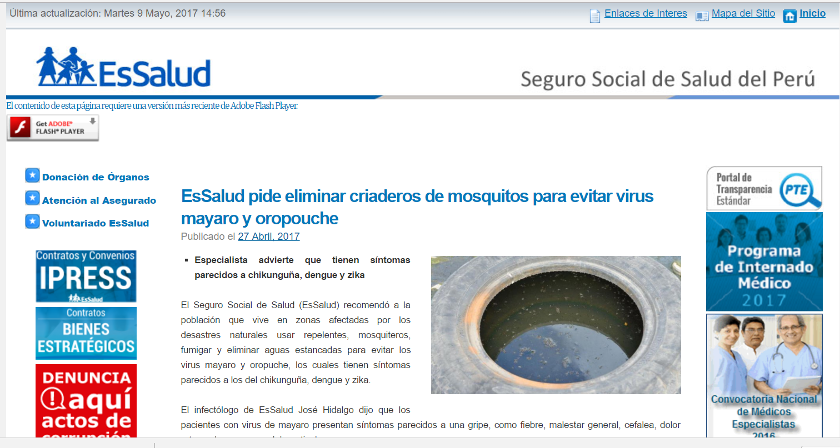
Both Mayaro and Oropouche are national Priorities in Peru

Slide 8
28 Epidemics in the S. Pacific in 2012 - 2014
Source: Roth A, Mercier A, Lepers C, Hoy D, Duituturaga S, Benyon E, Guillaumot L, Souares Y. Concurrent outbreaks of dengue, chikungunya and Zika virus infections – an unprecedented epidemic wave of mosquito-borne viruses in the Pacific 2012–2014. Euro Surveill. 2014;19(41):pii=20929.

Slide 9
Outbreaks are becoming more intense
World-Wide Dengue Cases
Sustaining the drive to overcome the global impact of neglected tropical diseases. Second WHO report on neglected tropical diseases. Geneva: World Health Organization; 2015. WHO/HTM/NTD/2015.

Slide 10
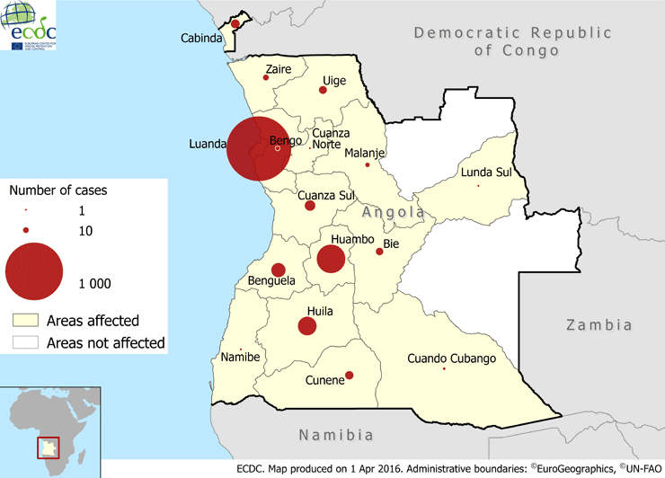
Old Enemies are Returning
The return of yellow fever

Slide 11
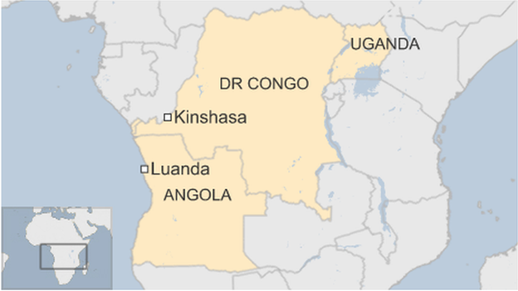
By the end of 2016

Slide 12
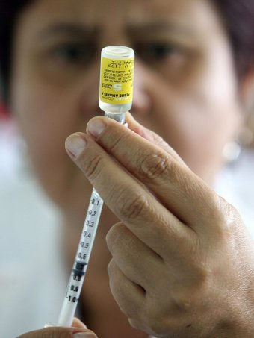
But we have a vaccine, right?
Yep, just not enough
Only 4 vaccine factories in the world, and 2 of those are out.
Current production is 1/3 normal demand
Senofi-Pasteur is no longer accepting orders
Current dosing in Kinshasa and Rio de Janeiro is 1/5 dose and there’s not enough for that
What happens when YF hits Nairobi? How about Mumbai?

Slide 13
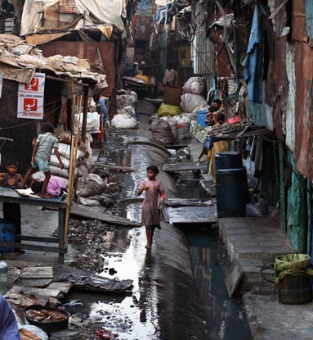
Speaking of Mumbai
Largest city in India at 18.5 million
Giant, mosquito infested slums
82 weekly nonstop flights from Nairobi, 8 hrs
1,500 cases/week of Dengue last October, another 2,000 cases/week of Chikungunya
Estimated YF vaccination rate ~5%. Rate needed to stop a YF epidemic: 80%
PS: 2,000 cases /week in New Deli, 3,500+/week in Bangalore

Slide 14
But we don’t need to worry about yellow fever, right?

Slide 15
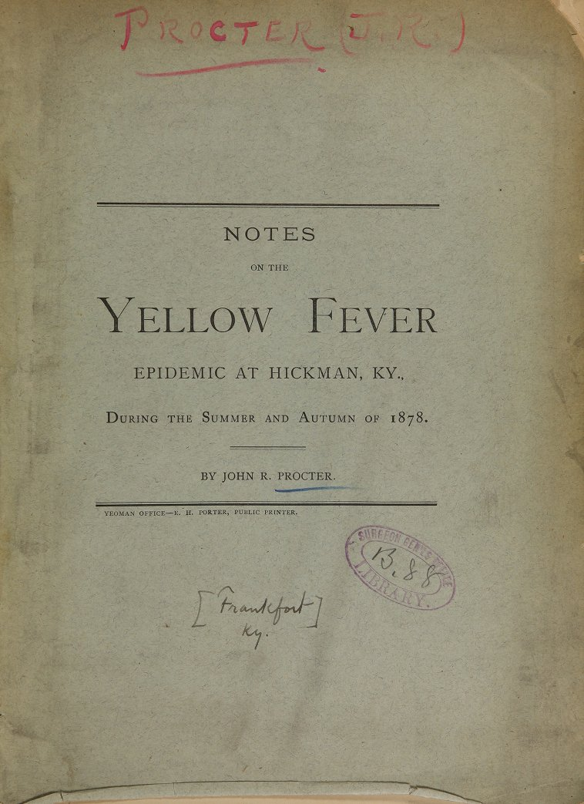
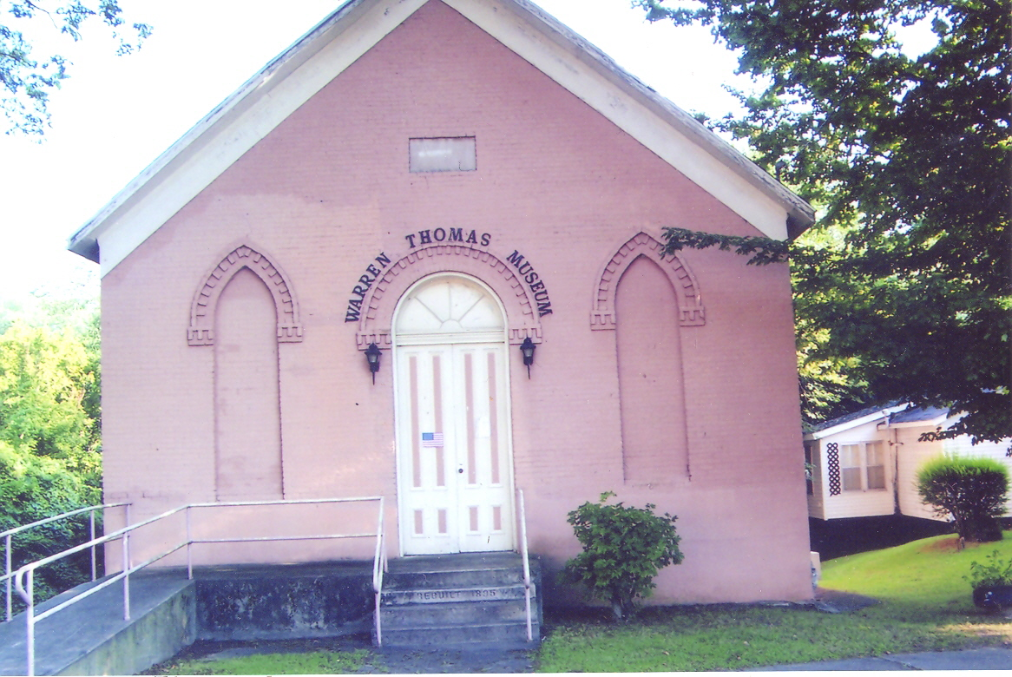
It Has been here before

Slide 16
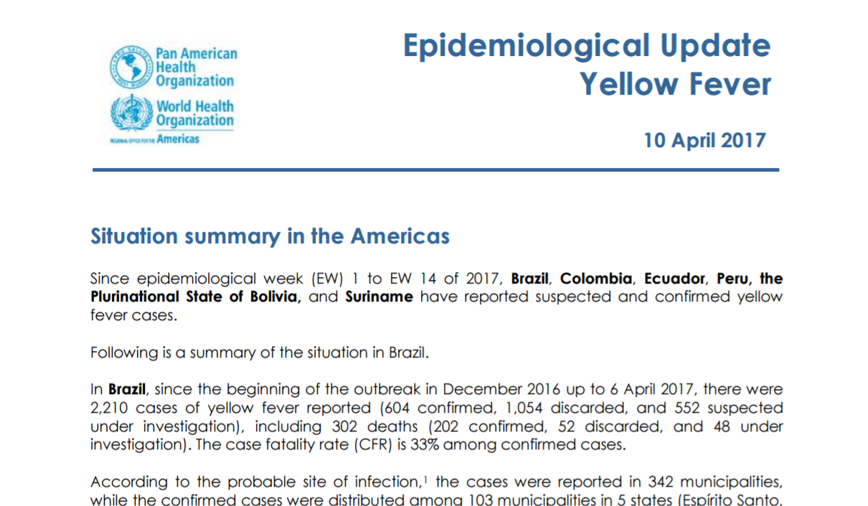
Yellow Fever in Brazil
Over 3500 cases in this year
Case Fatality Rate 33%
By mid-April, cases in Belo Horizonte, Rio de Janiero, Sao Paulo

Slide 17
It has spread rapidly to the major cities

Slide 18
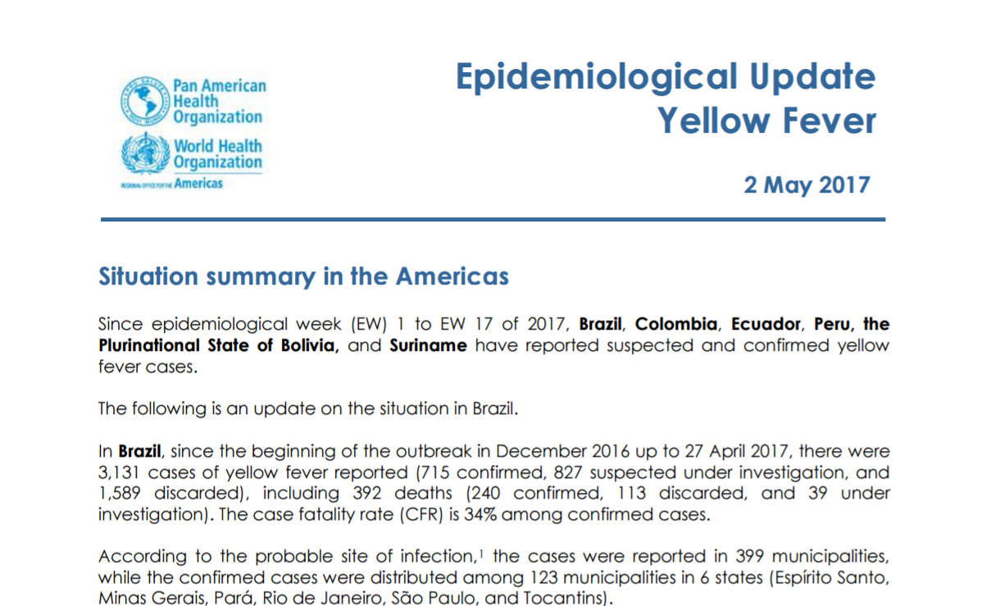
More recent reports are ominous
“To date, Aedes aegypti has not been reported to have a role in transmission.”
“Confirmed epizootics in large cities … represent a high risk for a change in the transmission cycle.”

Slide 19
What’s going on here?
Mutations of the pathogens
Factors specific to Aedes aegypti
Adaptation of zoonotic pathogens to human hosts
Human travel patterns
Urbanization & decline in standard of living
Note: Climate change role, if any, is minor

Slide 20
What’s going on here?
Mutations of the pathogens
Factors specific to Aedes aegypti
Adaptation of zoonotic pathogens to human hosts
Human travel patterns
Urbanization & decline in standard of living
Note: Climate change role, if any, is minor

Slide 21
Mutations
Most mosquito-vectored viruses have a zoonotic origin and have mutated from the original mosquito-animal host system
All of the viruses discussed so far are RNA viruses
RNA viruses typically have very high mutation rates
  Zika mutation rate is about 25 substitutions/year out of a genome of about 10,000 base pairs or 2.5 × 10^{-3 *}
  Mammals have about 10⁻⁶ to 10⁻⁸/BP/gen
*Source: LOGAN IS. ZIKA-How fast does this virus mutate? Zoological Research. 2016;37(2):110-115. doi:10.13918/j.issn.2095-8137.2016.2.110.

Slide 22
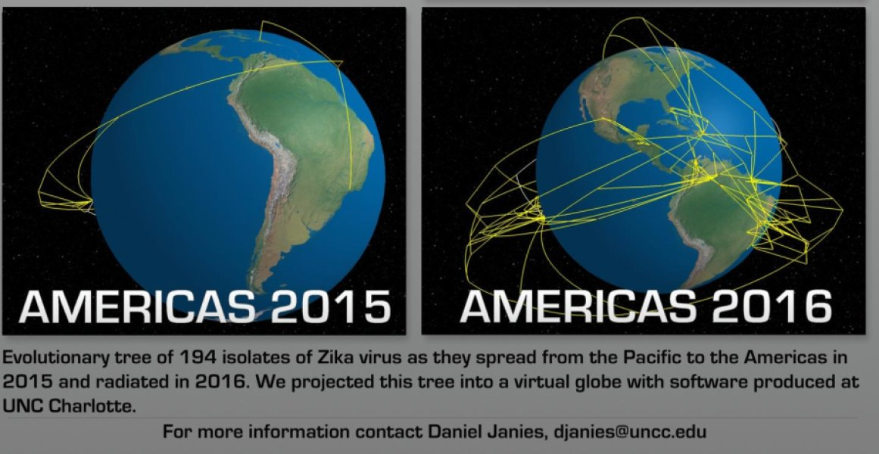
Zika’s mutations have been well documented

Slide 23
The best studied case of mutation is with chikungunya
The E1-A226V
Substitutes Valine for Alanine at position 226 of the genome that codes for the E1 coat glycoprotein

Slide 24
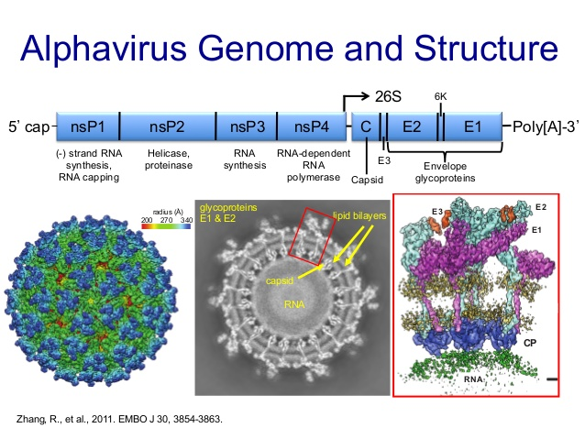

Slide 25
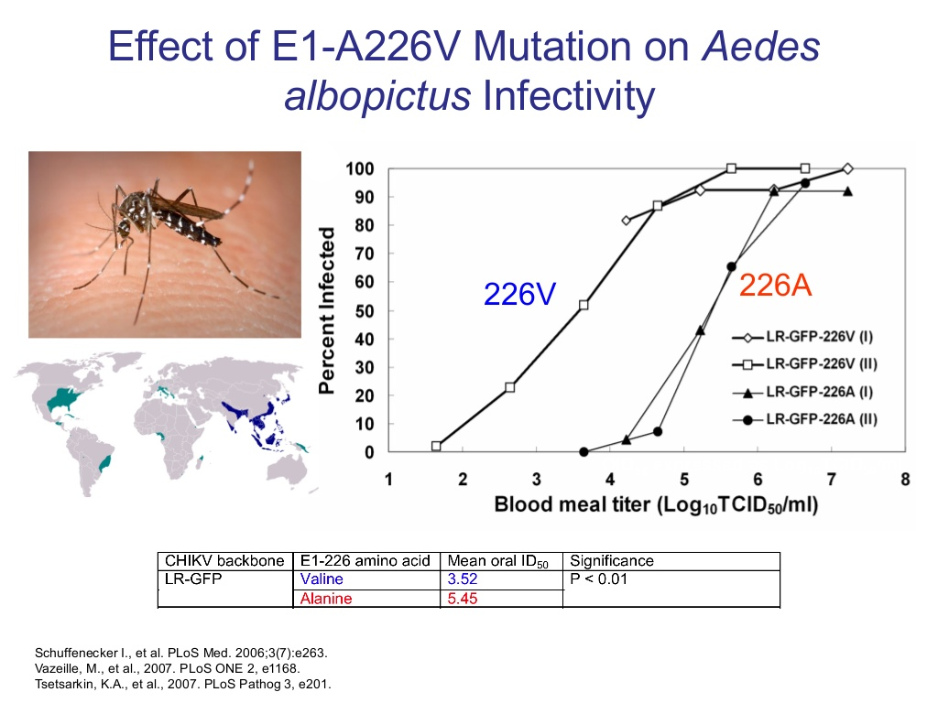

Slide 26
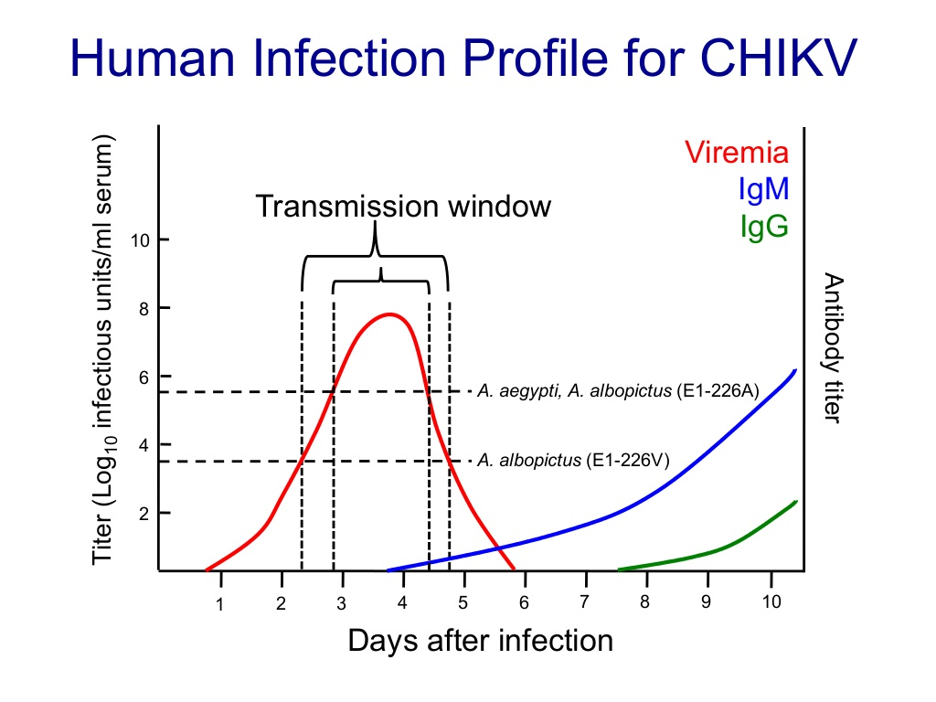

Slide 27
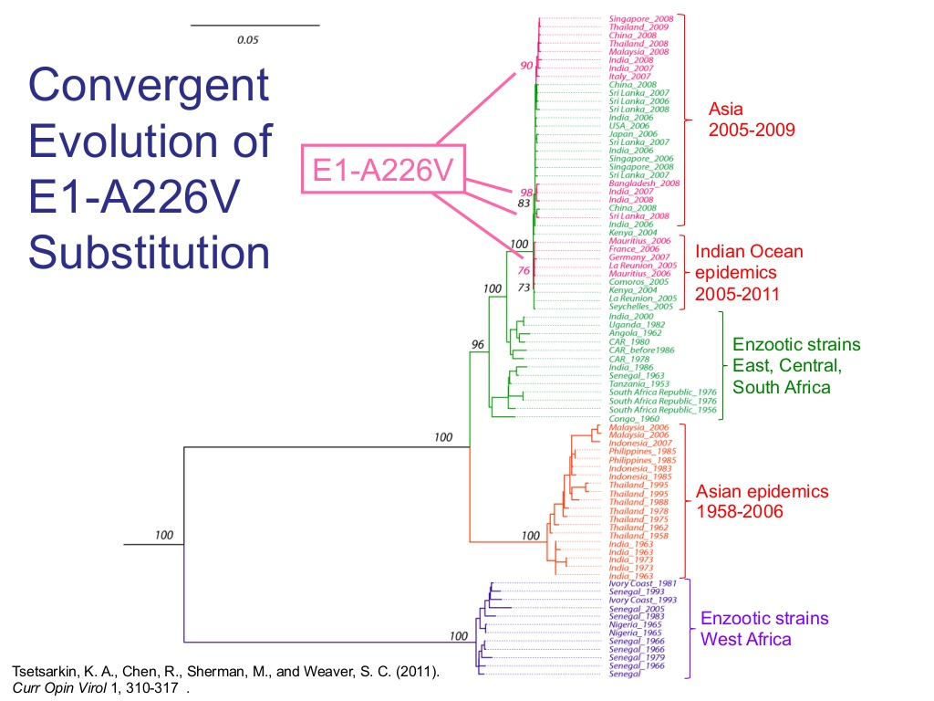

Slide 28
In addition to the viruses mutating, we’re also:
Moving infected people around faster and over longer distances
Packing people closer together thereby facillitating transmission
Increasing the number and density of slums which, in turn, increases breeding sites and likelihood of transmission in various ways.

Slide 29
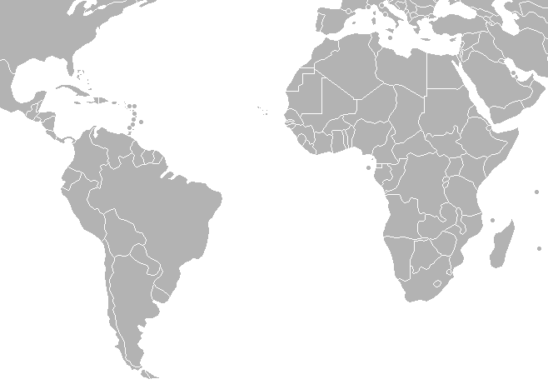
Passenger traffic up 20 fold
1970 – 172K
2011 – 2.58M
Ae. aegypti (African biotype) common to both regions

Slide 30
Part of a larger trend
Annual airline passenger traffic for selected parts of the world. 1970 vs. 2015.
Origin | 1970 | 2015 | Increase
World | 310,441,392 | 3,440,862,893 | 11.08 X
Sub-Saharan Africa | 4,585,300 | 45,059,116 | 9.83 X
Latin America | 17,717,500 | 260,171,866 | 14.68 X
Low Income | 2,298,100 | 14,943,744 | 6.50 X
Least Developed (UN) | 2,730,800 | 26,184,681 | 9.59 X
North America | 173,629,292 | 878,458,302 | 5.06 X
International Civil Aviation Organization, Civil Aviation Statistics of the World, http://data.worldbank.org/indicator/IS.AIR.PSGR

Slide 31
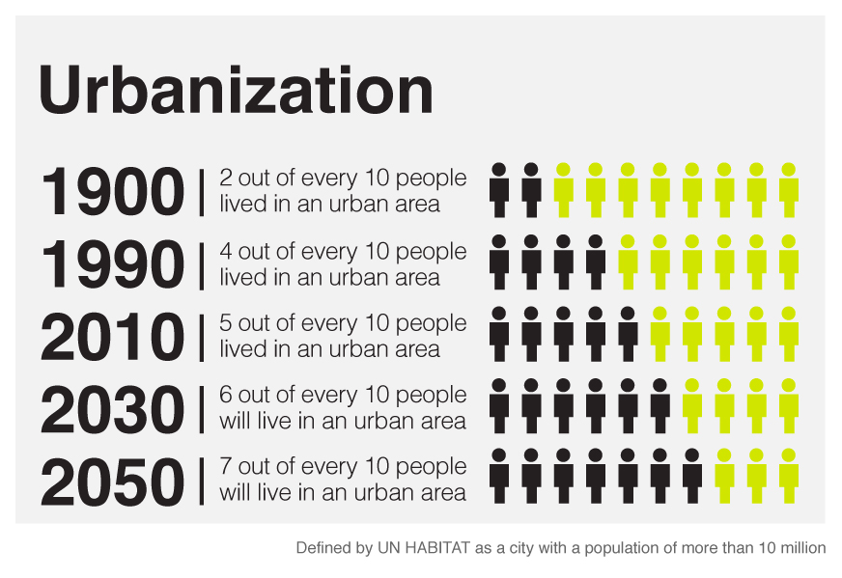
Packing People Closer Together
Creates perfect conditions for container breeding mosquitoes

Slide 32
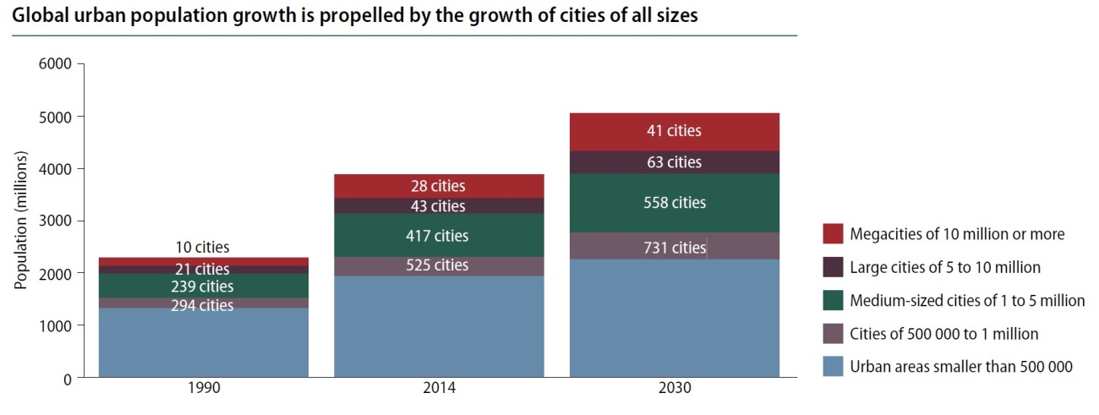
Between now and 2030, a 50% increase in the number of cities >5 million

Slide 33
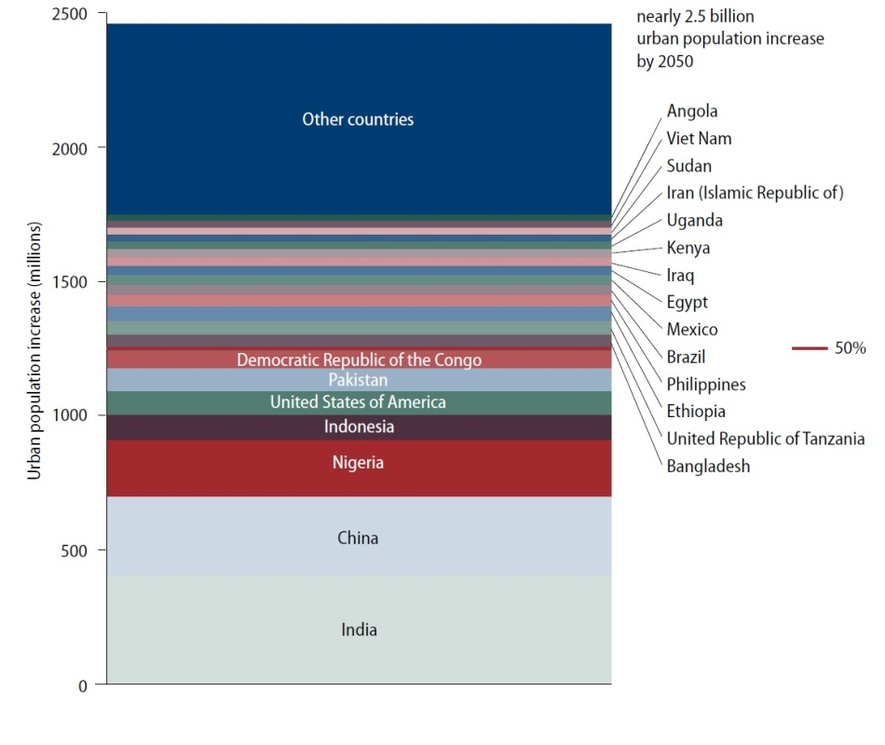
Urban population will grow >2.5B by 2050

Slide 34
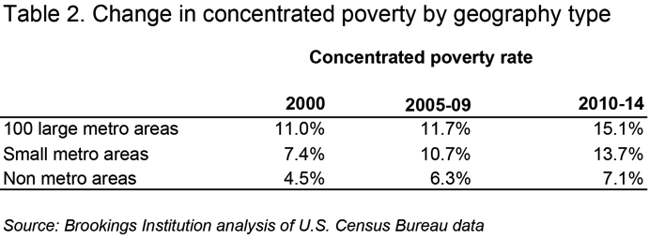
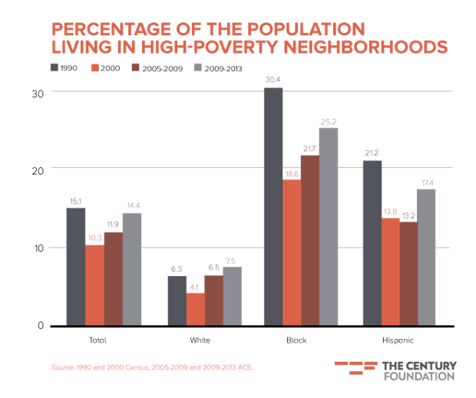
Rising concentrated poverty
Many studies show more mosquitoes in poor neighborhoods
More disordered, more trash, older drainage systems, more maintenance issues
People less likely to take measures against mosquitoes (repellents, less air conditioning, etc.)
People more likely to be outside
Better overall conditions for disease to spread

Slide 35
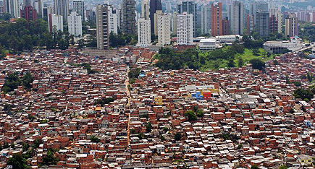
This creates an immense problem

Slide 36
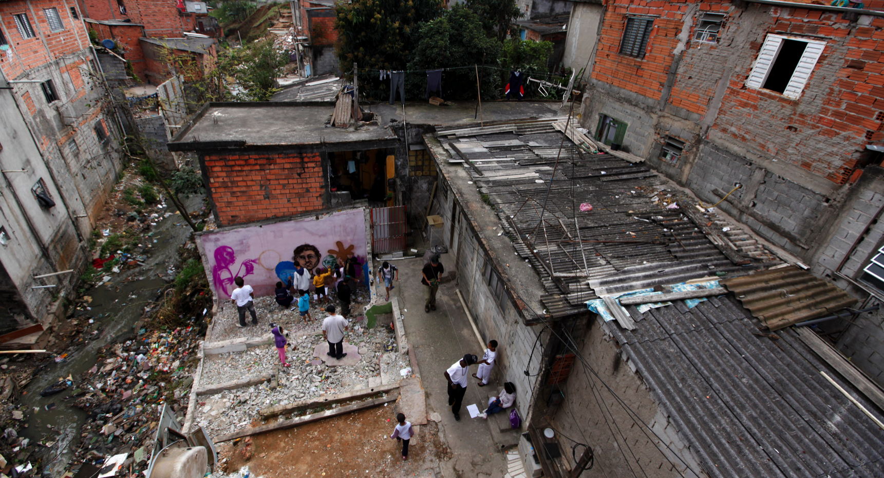
Up Close

Slide 37
So what do we do?
Get better at mosquito control
Accept mosquito control as necessary
Get better at community participatory programs
Start a long-term social education program
Commit to a comprehensive, sustainable, and permanent area-wide program of mosquito management

Slide 38
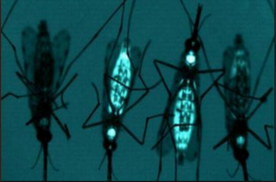
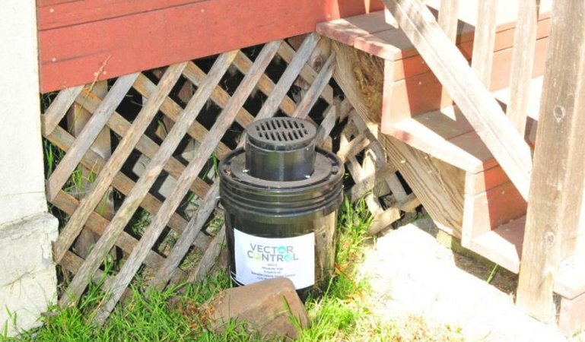
Better Mosquito Control
New insecticides coming on line
Better resistance management
Genetically modified mosquitoes
Sterile male mosquitoes
Wolbachia mosquitoes
Autocidal traps
Train for emergency response

Slide 39
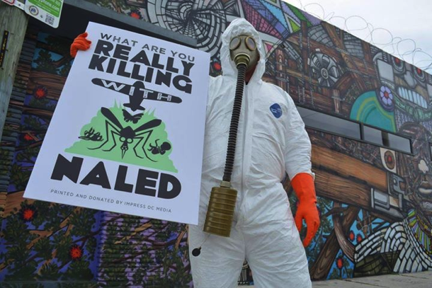
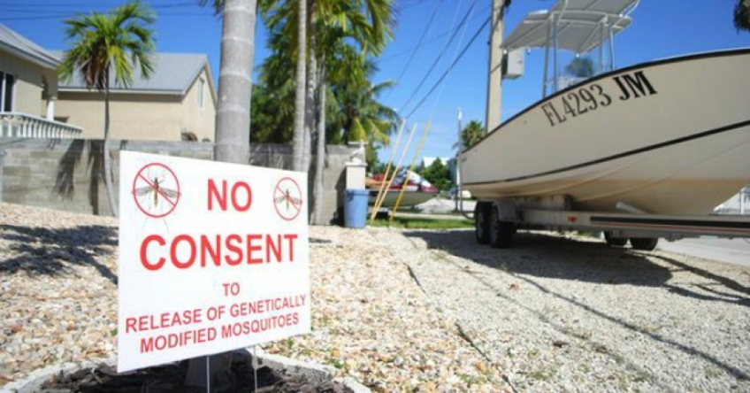
Accept the necessity
If we don’t control mosquitoes …
The suffering will be enormous.
Environmental costs will be higher
Economic costs will be higher
The burden will fall on those least capable of bearing it.

Slide 40
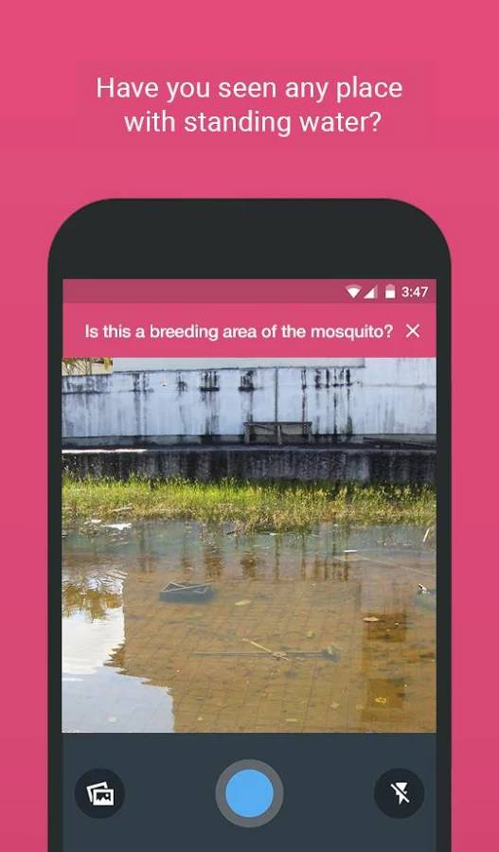

Community Participation
Individual home-based efforts
School programs
Neighborhood organizations
Phone Apps.
Sem Dengue
Developed in Niteroi, Brazil

Slide 41
Long-Term Effort
Think of Aedes-vectored diseases as social disease
Result of individual and community lifestyle decisions
Need to begin thinking of them as undesirable social outcomes
We need to work collaboratively – health care professionals, entomologists, public health professionals, and ordinary citizens.

Slide 42
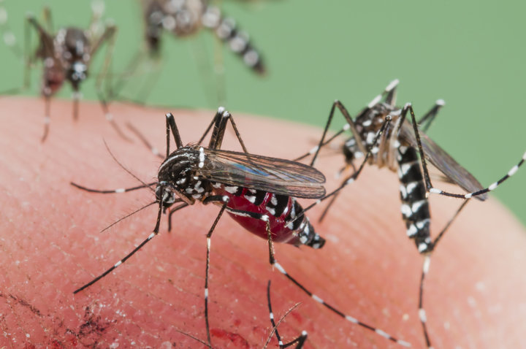
Single Biggest Urgency
Must educate the community and governments at all levels on the need for a permanent and sustainable wide area mosquito management program.

Slide 43
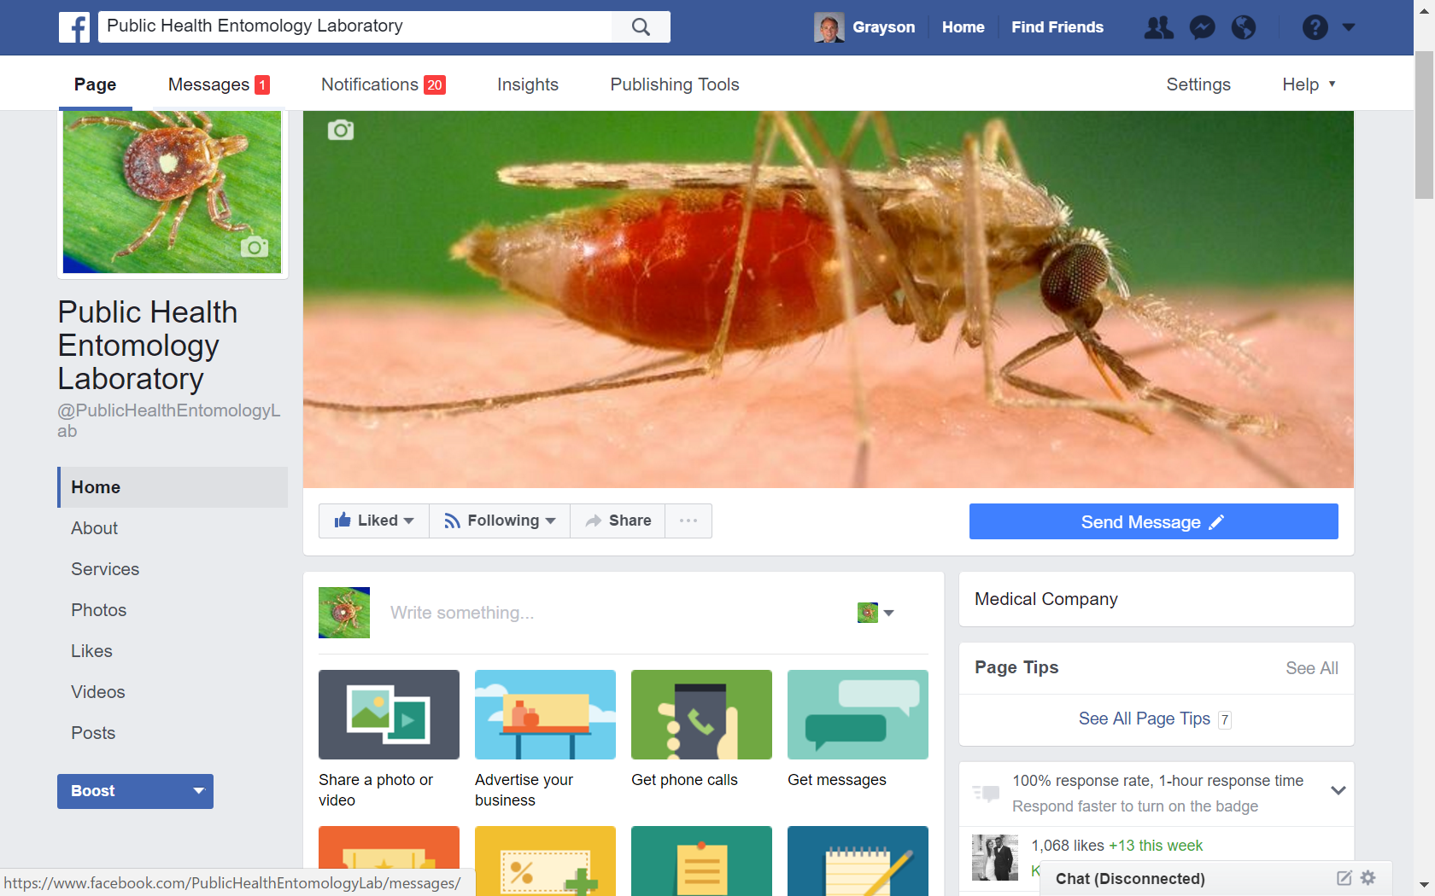
Visit us on facebook
https://www.facebook.com/PublicHealthEntomologyLab/

