Slide 1
Kentucky Functional and Access Needs Collaborative 2016 Update
Betty Shiels, PhD-C, MSSW, LCSW
KY Emergency Preparedness for Aging Program
Kent School of Social Work
University of Louisville
November 1, 2016

Slide 2
KY Vulnerable Populations
Under Age 18 | 1,018,238 | 23.3%
Age 65 and Older | 614,653 | 14%
Estimated Deaf/Hard of Hearing | 194,067 | 4.4%
Blind & Vision Impaired | 129,008 | 3%
Non-English Speaking | 97,882 | 2.2%
Spanish Speaking | 99,979 | 2.3%
Oxygen Dependent | 92,200 | 2.1%
Dialysis Dependent | 4,856 | .1%
Insulin Dependent | 109,240 | 2.5%
Wheelchair/Cane/Ambulatory Difficulty | 402,662 | 9.2%
Foster Care | 7,145 | .2%
Home Health Care | 40,292 | .9%
Long Term Care Facility | 28,911 | .7%
Hospice Care | 2,996 | .07%
Incarcerated | 38,856 | .9%
Mental Health | 156,969 | 3.6%
Substance Abuse | 15,776 | .4%
Development & Intellectual Disabilities | 9,058 | .2%
Lacking Transportation | 341,430 | 7.8%
Living In Poverty | 809,762 | 18.5%
Homeless | 5,217 | .12%

Slide 3
KY Disability Rates for Persons over 65

Slide 4
KY FNSS Collaborative 2016 Goals
Complete resource booklet for independent shelter operators,
Disseminate the medical needs shelter plan and conduct associated training for public health nurses;
Conduct training/awareness about the shelter booklet, FAST and medical needs shelter plan template with LHD directors and coalitions.
Develop an emergency preparedness manual for elders and disabled living in HUD-funded properties

Slide 5
Activities
Provided FNSS Training to KY Crisis and Response Board Annual Conference
Disseminated FNSS at-risk population to all health care coalitions
Presented webinar to Dept. for Homeland Security Geriatric/Elder Disaster Resilience Group—Alzheimer’s Disease & Emergency Planning Challenges, and filmed a YouTube video of Alzheimer’s webinar for posting to KY Emergency Preparedness for Aging & LTC Program website at DHS request
Established a workgroup for Elders Living in HUD-funded properties Emergency Preparedness Manual
Presented the purpose and goals of the FNSS Collaborative to the KY BHDID leadership
Currently responding to training requests from BHDID

Slide 6
New Partners
KY Dept. for Behavioral Health and Developmental/Intellectual Disabilities
Project CARAT
KY Governor’s Council on Alzheimer’s Disease and Related Disorders
Leading Age KY
Christian Care Communities

Slide 7
Expansion of HUD Housing Model
HUD-funded housing for older persons can include:
low and moderate income tenants,
frail to very-frail tenants, and
tenants with limited transportation options.
Functional challenges can include mobility difficulty, toileting and dressing limitations, medication management issues and even speech and hearing limitations.
And yet, HUD emergency preparedness requirements are building-based, not tenant-based, leaving it to the communities and family/friends to assist the tenant in emergency preparations.

Slide 8
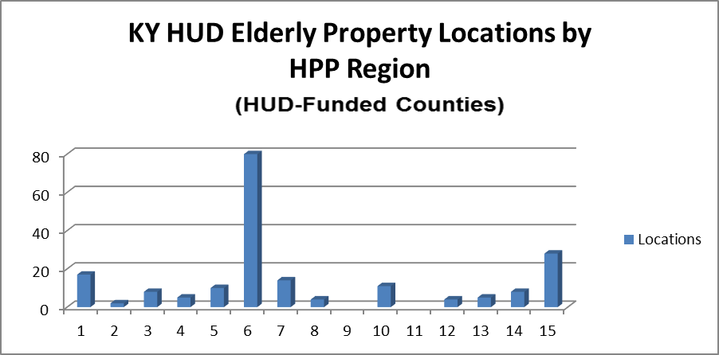

Slide 9
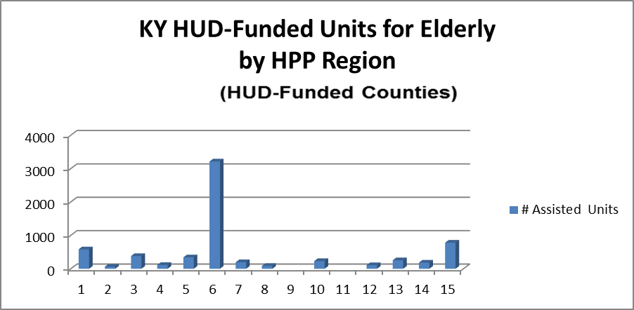

Slide 10
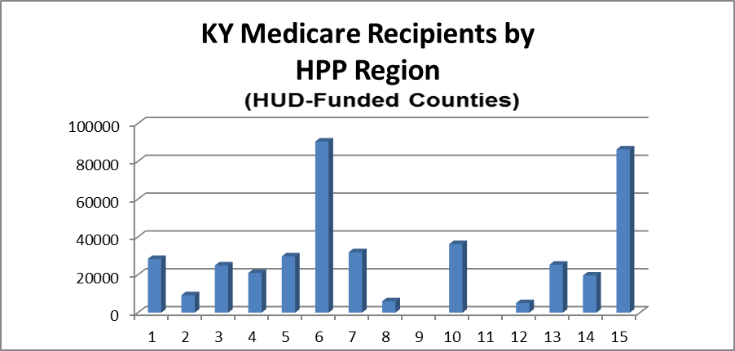

Slide 11
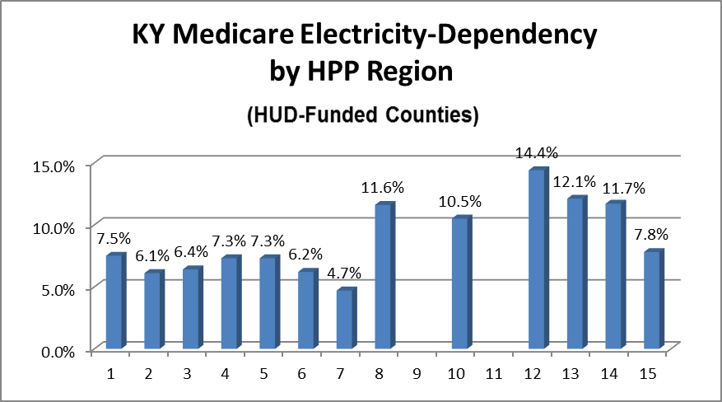

Slide 12
Ongoing
Utilize new relationships to gain improved and more current data on vulnerable populations
Share that data with regional coalitions
Support regional coalition FNSS planning and outreach
Expand representation on FNSS Collaborative

Slide 13
Additional Information
Betty Shiels, PhD-C, MSSW, LCSW
Director, KY Emergency Preparedness for Aging and Long Term Care Program
University Of Louisville
Kent School of Social Work
(502) 852-8003
Betty.shiels@Louisville.edu
Funding through KCHFS/KDPH 2016-2017 grant #PON2-728-1600005053-1 University of Louisville Vulnerable Populations Grant

