Slide 1
Office FreakOut Compilation - YouTube

Slide 2
ACTIVE AGGRESSOR
IDENTIFY, ALERT AND SURVIVE

Slide 3
Overview
An active shooter is an individual or multiple individuals actively engaged in killing or attempting to kill people in a confined and populated area, typically through the use of firearms.
Though typically associated with schools, the threat of an active shooter exists anywhere people gather. College campuses, movie theaters, churches, office buildings, and restaurants have all been targeted by active shooters.
Although many perpetrators have a history of negative, sometimes violent, behavior there is still no single, accurate one-size-fits-all profile of an active shooter.

Slide 4
ACTIVE SHOOTER: IDENTIFY, ALERT AND SURVIVE
WORKPLACE VIOLENCE STATS PAGE
From 2006 to 2010, an average of 551 workers per year were killed as a result of work-related homicides
About 4 out of 5 homicide victims were male
Robbers and other assailants accounted for 72 percent of homicides to men, for example, and only 37 percent of homicides to women
Relatives and other personal acquaintances accounted for only 3% of assailants of homicides for men, but 39% for women.
Shootings accounted for 80% of all the workplace homicides in 2010.
Co-workers and former co-workers were the assailants in 12% of all shootings.
Robbers were the assailants in another 40%.
Nearly half of these shootings (48%) occurred in public buildings.

Slide 5
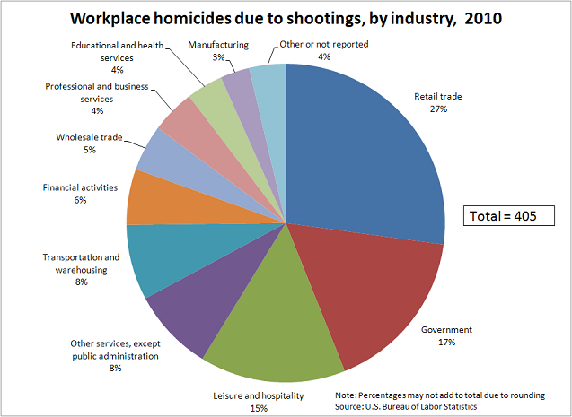
ACTIVE SHOOTER: IDENTIFY, ALERT AND SURVIVE

Slide 6
ACTIVE SHOOTER: IDENTIFY, ALERT AND SURVIVE
AWARENESS OF THE ACTIONS OF CO-WORKERS
NOTICEABLY ANGRY, IRRITABLE, THREATENING
ESCALATION FROM VERBAL TO PHYSICAL
KNOWLEDGE OF PRIOR VIOLENCE ISSUES
ANY EPO’S, DVO’S OR IPO’S
ARE THESE REPORTED TO SUPERVISORS

Slide 7
ACTIVE SHOOTER: IDENTIFY, ALERT AND SURVIVE
ONCE A THREAT MOVES FROM A WORKPLACE VIOLENCE ISSUE INTO AN ACTIVE SHOOTER SITUATION:
THE DIFFERENCE BETWEEN AN ACTIVE SHOOTER AND JUST WORKPLACE VIOLENCE
MOORE, OKLAHOMA BEHEADING:
https://www.youtube.com/watch?v=UP44wbChuPM

Slide 8
ACTIVE SHOOTER: IDENTIFY, ALERT AND SURVIVE
WHAT DOES AN ACTIVE SHOOTER LOOK LIKE?
THERE IS NO PROFILE ON WHAT AN ACTIVE SHOOTER LOOKS LIKE. BUT THERE ARE HOWEVER BEHAVIORAL INDICATORS.

Slide 9
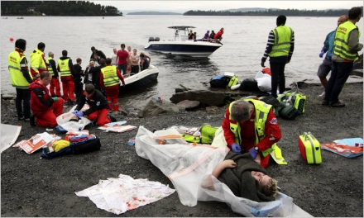
At Least 80 Dead in Norway Shooting
Emergency workers tended to a woman who had been rescued from Utoya, the island where a gunman opened fire on a camp. Credit Svein Gustav Wilhelmsen/Agence France-Presse — Getty Images

Slide 10
ACTIVE SHOOTER: IDENTIFY, ALERT AND SURVIVE
WHAT SYSTEMS ARE IN PLACE TO ALERT IN THE CASE OF AN ACTIVE SHOOTER:
Number the support pillars on each floor to assist law enforcement in identifying locations.
Identification of Emergency Resources:
Panic switches.
Knowledge of nearest exit and other routes of exit.
People with personal defense items: pepper spray, CCDW? Who are these people.
Policies and law on CCDW.

Slide 11
ACTIVE SHOOTER: IDENTIFY, ALERT AND SURVIVE
IST- INDIVIDUAL SECURITY TEAMS
Every person should have a role in the IST
i.e., if someone is limited in physical abilities they can be the person charged with making the appropriate calls to proper authorities.
Someone must be in charge of sounding the alarm, preferably the first person of contact.
The clock starts for law enforcement response when the first survivor notifies the authorities.

Slide 12
ACTIVE SHOOTER: IDENTIFY, ALERT AND SURVIVE
Run, Hide or Fight
Run: knowing where exits are, if normal exit is blocked where can you go?
Noise discipline
Shelter in place: what provisions are currently in place for taking shelter?
Reinforced desks, doors with locks, get something between yourself and shooter
Cover vs Concealment
Cover is? Concealment is?
Fight.

Slide 13
Evacuation
Be aware of your environment and any possible dangers.
Take note of the 2 nearest exits in the facility you visit.
Have an escape plan in mind.
Follow Law Enforcement instructions and keep your hands visible
Do not attempt to move wounded people

Slide 14
Hiding Out
Your hiding place shouldn’t trap or restrict your movement. Example: Closet
Barricade entrance if possible.
Remain in hiding until law enforcement gives you the all clear.

Slide 15
Taking Action Against the Shooter
Engaging the attacker is a last resort.
Improvise weapons and target vulnerable areas: Head, Groin, Etc.
Incapacitation of the target is top priority.
Do not hesitate, commit to your actions.

Slide 16
ACTIVE SHOOTER: IDENTIFY, ALERT AND SURVIVE
Proper interaction with Law Enforcement:
Keep hands where they can be seen at all times
Do not touch, hug or make quick movements towards law enforcement
Not there at this time for first aid
Only communicate vital information to law enforcement

Slide 17
ACTIVE SHOOTER: IDENTIFY, ALERT AND SURVIVE
Accountability
Knowing who has exited the building, roll call or roster?
Alerting other floors to the situation.
What are your plans leaving this meeting?

Slide 18
ACTIVE SHOOTER: IDENTIFY, ALERT AND SURVIVE
Questions?
Contact info: Sheriff Pat Melton
502-875-8740
Pat.melton@franklincountyky.com
Deputy Montey Chappell

