Slide 1
Vulnerable Populations and Climate-Related Health Impacts
Colleen Kaelin, MSPH RS
KOIN Meeting
November 1, 2016
Notes:
I’m going to describe how climate change impacts human health, what we mean when we talk about vulnerable populations, and the steps we can take to can prepare and protect the most vulnerable people in our communities.

Slide 2
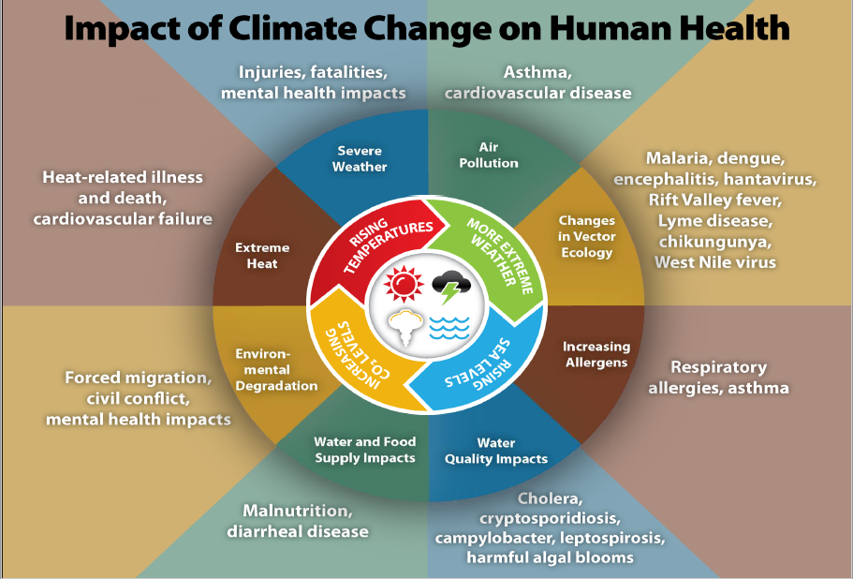
CDC Building Resilience Against Climate Impacts
Notes:
So, exactly how does climate affect the health of the population? As you can see, the climate drivers in the center of the wheel will ultimately impact every aspect of physical, social and mental health. Direct impacts, such as deaths and injuries from heat waves and floods, are the most obvious, but there are more subtle health effects such as higher rates of asthma and waterborne illnesses. Even wars and refugee populations will be traced more and more to our changing climate.

Slide 3
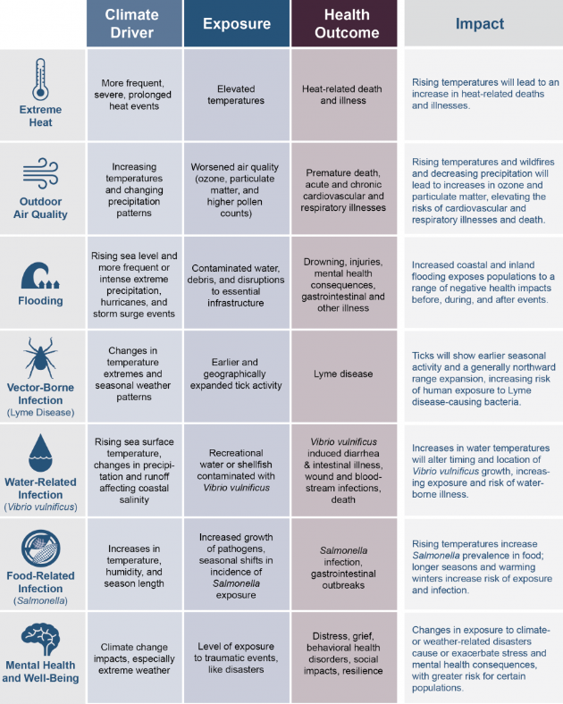
U.S. Global Change Research Program
Notes:
This graphic was developed by the U.S. Global Change Research Program and says pretty much the same thing as the previous graphic, but in a table format.

Slide 4
What is a Vulnerable Population?
Socially Vulnerable
Young and Old
Minority\Limited English
Rural\Roadless\Geographically Isolated
Economically Vulnerable (poor, uneducated)
Medically Vulnerable
Underserved Areas and Populations
Chronic Disease (Diabetes, Respiratory, Cardiac)
Oxygen and/or Dialysis Dependent
Notes:
As you can see, vulnerability can be defined by poverty, by personal factors like age and education, or by access to medical treatment, transportation and communication.
The definition of vulnerability often depends on the type of risk or hazard you are trying to prepare for.
Many different groups can be at increased risk from the same hazard. For example, the elderly and outdoor workers are both especially vulnerable to health impacts from heat waves

Slide 5
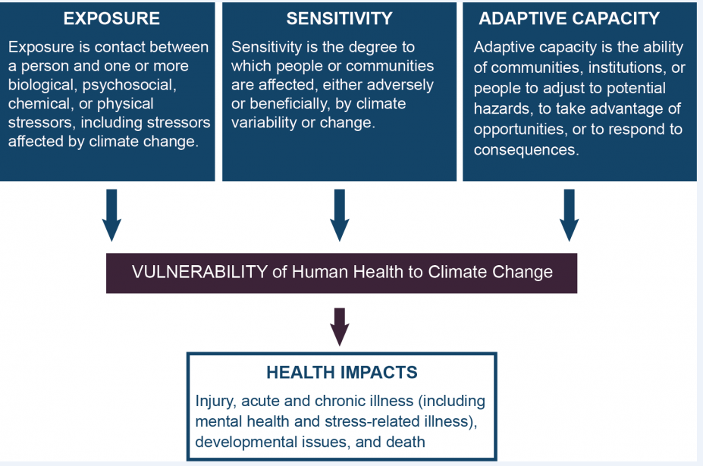
Determinants of Vulnerability-USGCRP
Notes:
So, what makes some groups more likely to be hurt by climate extremes than others? Some people are more likely to be exposed to a particular hazard because of the area where they live or work. Or they be more sensitive to climate-related health impacts because of conditions such as asthma, diabetes, or heart disease. Other people are less able to adapt and prepare for climate hazards because of their age, being disabled, not speaking English well, or because they live in a isolated or medically underserved area. The U.S. Global Change Research Program report can be accessed at health2016.globalchange.gov

Slide 6
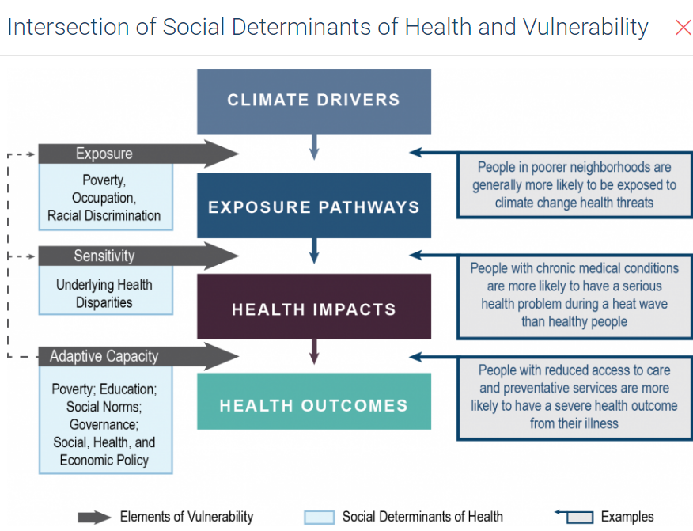
Notes:
This graphic describes how vulnerabilities interact with climate-related exposures to result in various health impacts and outcomes. Adaptive capability can influence the exposures, sensitivity and resilience of individuals and populations, which in turn can influence access to medical care and preventative services.

Slide 7
What are the highest priority hazards in Kentucky?
According to the Kentucky Emergency Management Plan
Flood
Severe Storm
Health Emergency
Natural Hazard
Man-made Hazard
Earthquake
Cyber-terrorism
Notes:
As you can see, the top three hazards in our state are Flooding, Storms like the Ice Storm of 2009, and health emergencies such as severe influenza outbreaks. From 2000 to 2012, there were 25 Major Disaster Declarations and one Presidential Emergency Declaration (2009 Ice Storm) in Kentucky. All were related to climate.

Slide 8
Does Kentucky Have a Plan to Adapt?
Notes:
This map from the US Center for Climate and Energy Solutions shows that most states do not have a plan to adapt to climate change. In our region, only Louisville and Cincinnati have plans on record. Louisville’s Climate plan includes reports on Land Use, Local Impacts, Transportation and Urban Forestry, but no section specifically related to health. Bowling Green, Frankfort, Lexington, Louisville, Owensboro, Prospect and Villa Hills have all signed the U.S. Conference of Mayors Climate Protection Agreement

Slide 9
How are Local Health Departments Involved?
Local public health departments take the lead in activities that are directly impacted by the changing climate, such as hazard mitigation planning and response. They also actively participate in collecting data and conducting surveillance on community health concerns that are directly or indirectly effected by the climate change…. (Frumkin et. al)
Notes:
All actions to document, prepare for, and prevent climate-related health impacts must be led by local government agencies, especially health departments.
LHD actions can be direct and short-term, such as opening cooling centers during heat waves, or long term, such as distributing information to vulnerable populations about their particular risks.
As climate impacts become more severe and require more frequent public health intervention, our resources will become strained

Slide 10
Guidance Document https://c.ymcdn.com/sites/cste.site-ym.com/resource/resmgr/EnvironmentalHealth/ClimateChangeIndicatorsRepor.pdf
Notes:
So, to help local jurisdictions collect the data they will need for their area, the Council of State and Territorial Epidemiologists developed this guide. The ultimate purpose of collecting and sharing this data is so that local governments will use their resources where they will do the most good for the greatest number of people at the highest risk for the worst health related effects of climate.

Slide 11
Tier I- Identify Hazards and Develop Indicators
Identify the highest priority climate related hazards in your region
Compile relevant indicators, using the Tracking Network and Council of State and Territorial Epidemiologist’s State Environmental Health Indicators (http://www.cste.org/default.asp?page=EHIndicatorsClimate)
Identify data sources
Create and disseminate baseline set of local indicators
Integrate climate change indicators into the overall local health surveillance program
Notes:
Step one is to identify which hazards are the most likely and the most damaging for your specific area.
The highest level hazards can vary greatly even within local jurisdictions.
Data resources include the Environmental Public Health Tracking Network. The national website is available, with data on air and water quality and related health indicators at the state and county level. The EnviroHealthLink website will be launched in the very near future.

Slide 12
Tier 2- Assess Vulnerability
Define Exposure based on the climate-related hazards developed for each jurisdiction
Research historical trends in morbidity and mortality related to climate and extreme weather
Identify the particularly vulnerable sub-populations
Combine socioeconomic, demographic, environmental, and health data to create a vulnerability index
http://www.sciencedirect.com/science/journal/01436228
http://www.ncbi.nlm.nih.gov/pmc/articles/PMC2801183/
Notes:
Once you’ve identified the highest priority hazards, the next step is to determine where are the people who are most in need of resources and assistance in your area
Mapping tools such as ArcGIS and GEMSS are crucial to visualize vulnerability
I’ll talk about the Social Vulnerability Index in a moment
Tying deaths and injuries directly to an extreme weather event can be difficult, but recently developed Electronic Death Records will make it easier

Slide 13
Tier 3-Predict Future Impacts
Identify Climate Projects at the geographic scale of your jurisdiction
Compare projected changes with the spatial distribution of vulnerable populations
Estimate future climate-related mortality and morbidity for the hazards selected in Tier 1
Compare projected changes with historical trends in morbidity, mortality and cost
Notes:
Modeling future climate and health impacts is the most difficult part of this program, but it may be the most important to convince key decision makers and the general public to prepare ahead of potentially catastrophic events.

Slide 14
Yes we can apply this in Kentucky!
Notes:
The Environmental Public Health Tracking program offered small grants to ten local and regional health departments to apply the tools offered by the tracking network in their communities. Green River District Health Department added measures on Extreme Heat, Drought and Flooding to their Community Health Assessment. The project leaders also submitted an article summarizing the project and the available data on environmental exposures, health outcomes, and population vulnerability for their jurisdiction.

Slide 15
Tools
*Social Vulnerability Index
http://svi.cdc.gov/
http://svi.cdc.gov/map.aspx
*Environmental Public Health Tracking Network
http://ephtracking.cdc.gov/showHome.action
*Health Resources and Services Administration Data Warehouse
http://datawarehouse.hrsa.gov/Tools/MapTool.aspx
Notes:
Now, we’ll explore some online tools you can use to access data on climate, health and social vulnerability.
The Social Vulnerability Index is composed of 4 main areas: Socioeconomic, Household Composition and Disability, Minority Status and Language, and Housing and Transportation.
You can explore the mapping tool by state, county or zip code.
The Tracking network has data on community development, future temperature projections, air quality, population and a new module on flood vulnerability
These are only a few of the available resources you can use to help determine the actions you should take to protect the most vulnerable members of your community from extreme weather and climate events.

Slide 16
Questions?

